Slide 1
Analyzing Spatial distribution of the accident locations - A Case Study of Mirpur Corridor, Dhaka, Bangladesh
Panini Amin Chowdhury, Corresponding Author
Graduate Student
Department of Geography & Planning,
The University of Toledo
Bhuiyan M. Alam
Associate Professor
Department of Geography & Planning,
The University of Toledo,
Bayes Ahmed
Post-Doctoral Associate
Institute for Risk and Disaster Reduction,
University College London (UCL)

Slide 2
Background of the Study
Road-traffic accidents are the leading injury related cause of death among people aged 10–24. (WHO,2008)
More than 1.2 million people are killed each year in automobile crashes in addition to 50 million injuries. (WHO,2008)
Bangladesh has one of the world’s highest fatality rates from road crashes—more than 100 deaths per 10,000 motor vehicles (UNESC, 2007).
Road crashes cost roughly 2% to 3% of the country's GDP every year (Ahshan,2012), equal to the total foreign aid received by Bangladesh in a given fiscal year (Al Mahmood,2007).
61% of urban road accident deaths are of pedestrians.

Slide 3
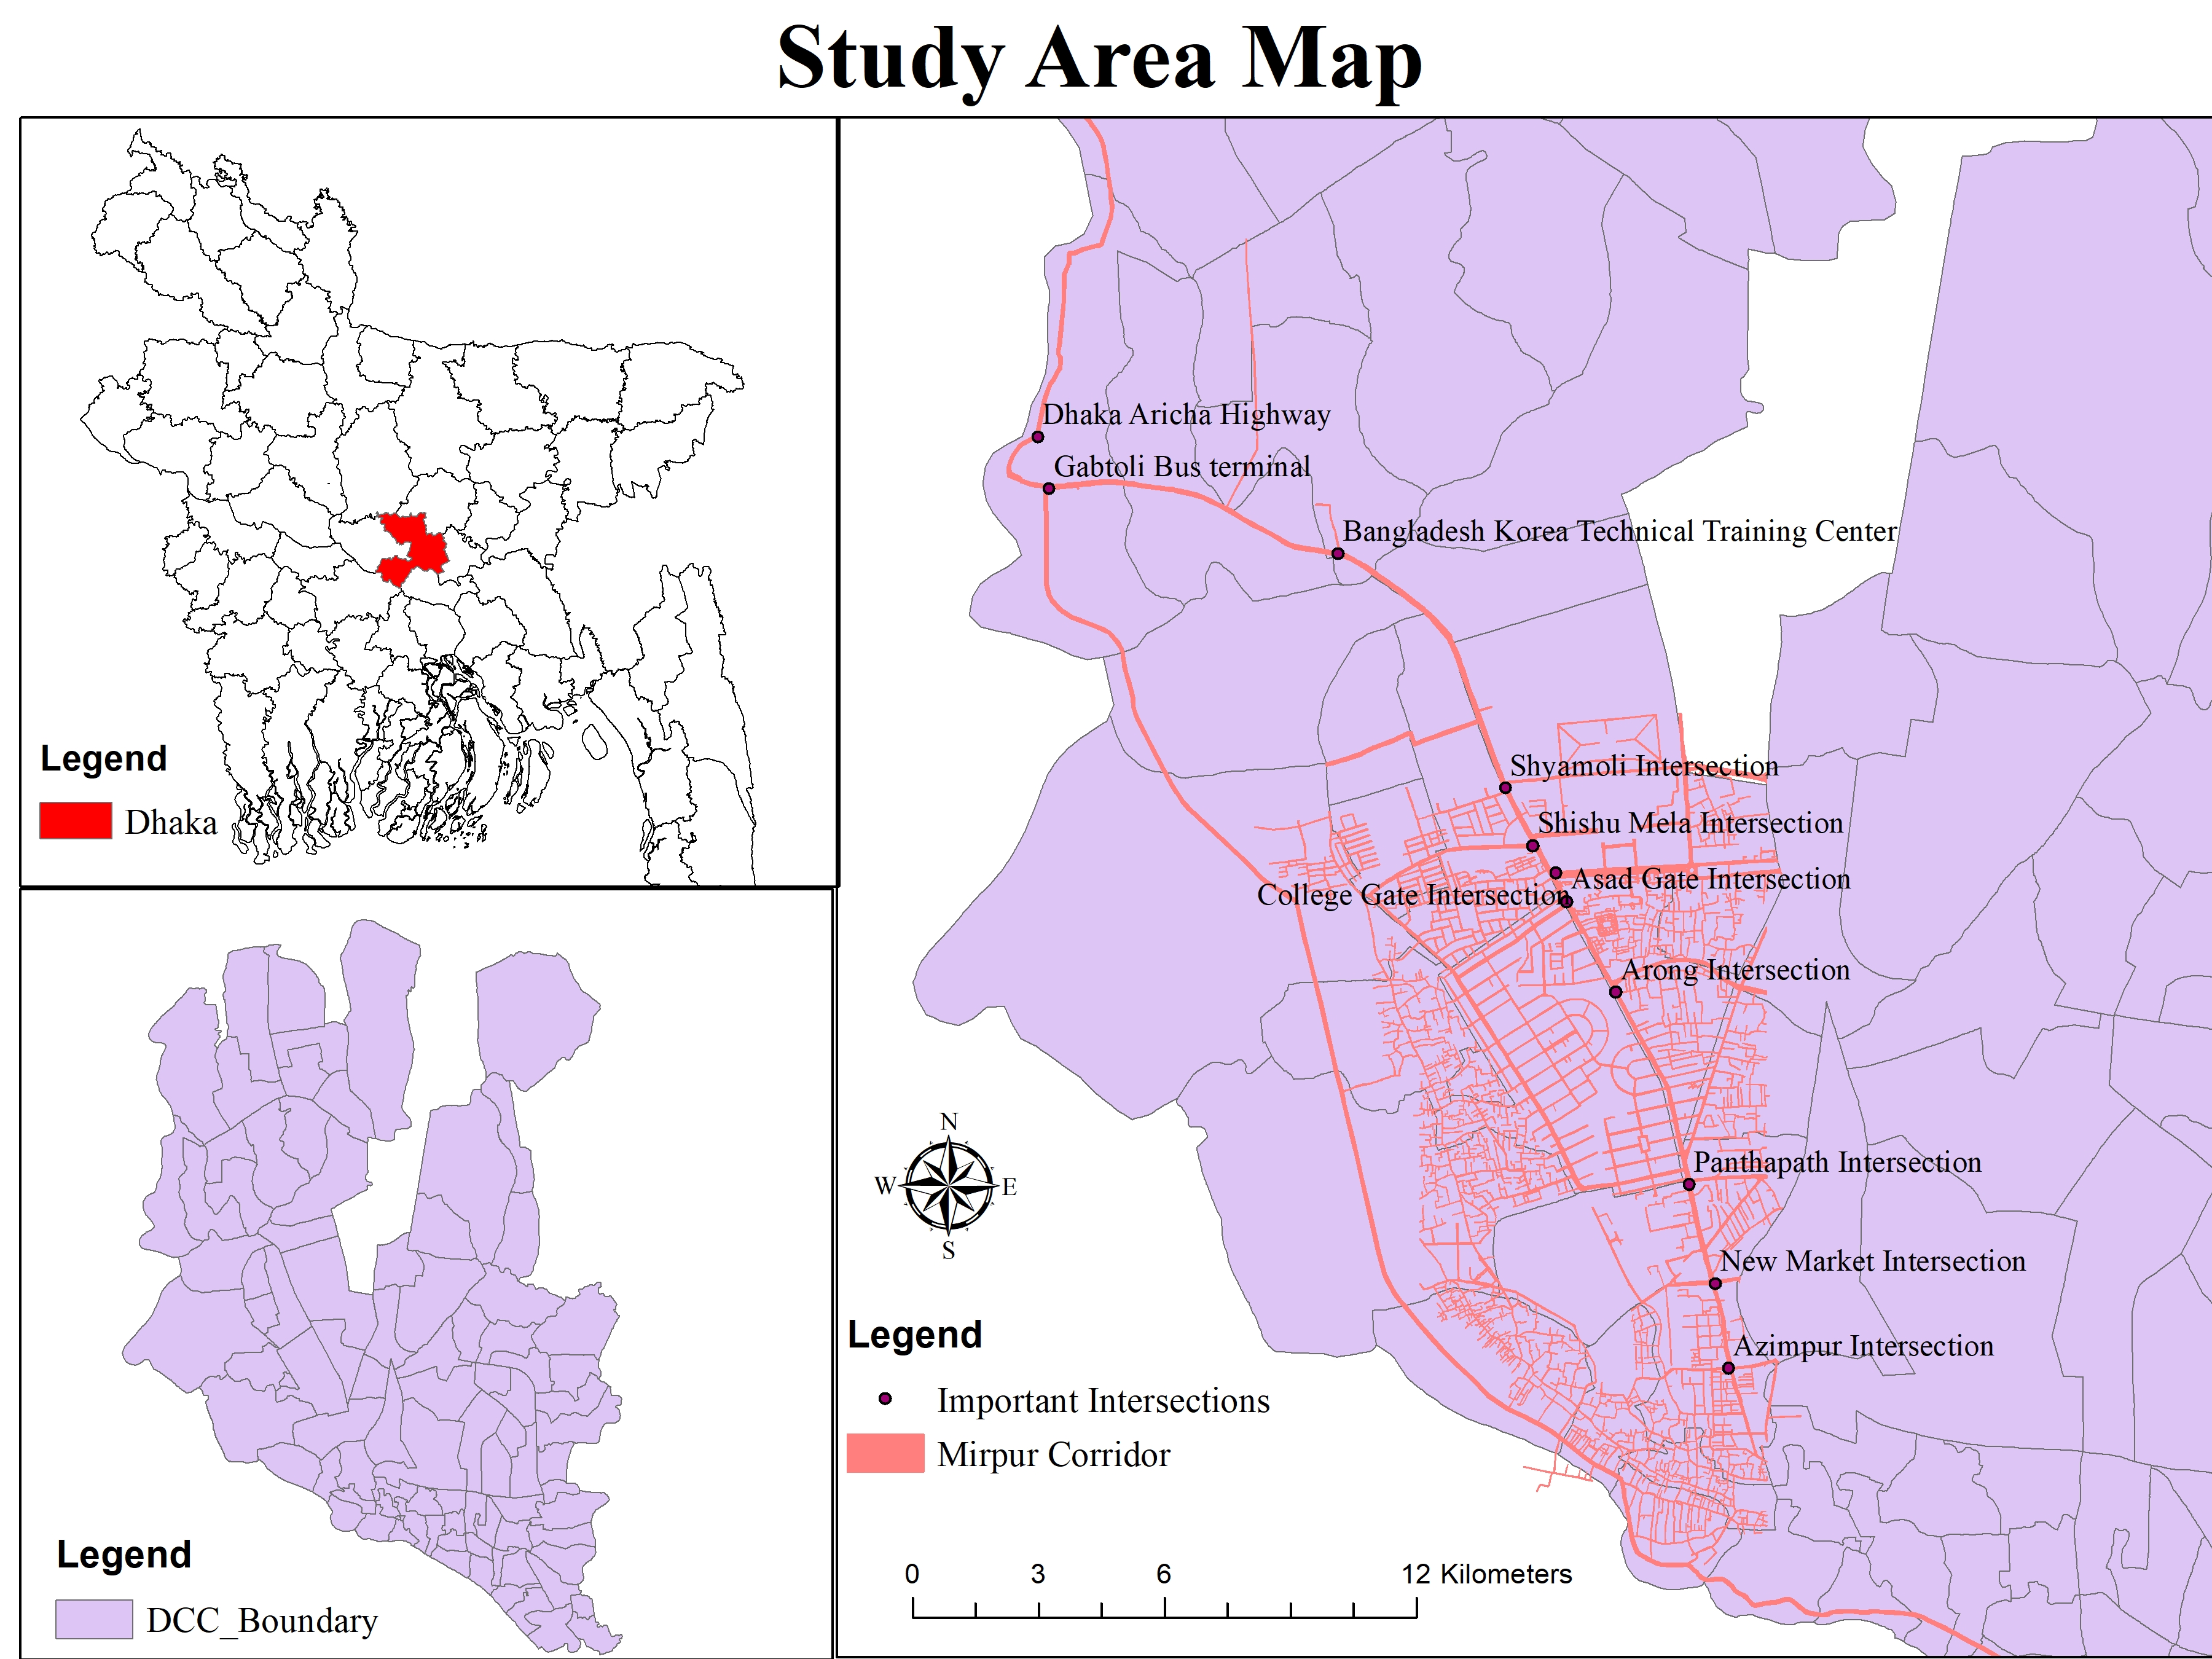
Study Area
Dhaka is the Capital of Bangladesh.
Population is over 14.6 million.
Population Density .15 million per square mile.
Mirpur Corridor
Azimpur to Gabtoli.(10 Kilometers= 6.2 miles).
Principal Arterial road for Dhaka Metropolitan Area.
In 2007, 67 accident which was reduced by 70% to only 19 accidents in year 2011.
pedestrian casualties have been found higher (83%) in Mirpur Road .

Slide 4
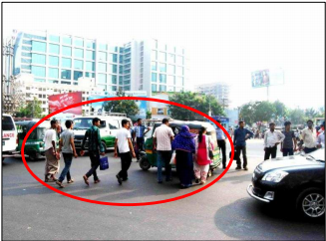
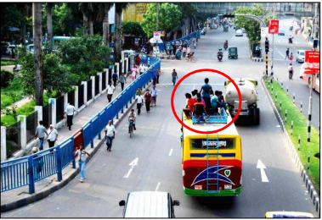
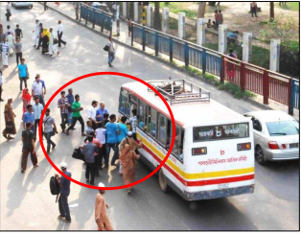
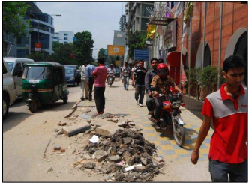
Photo Gallery

Slide 5
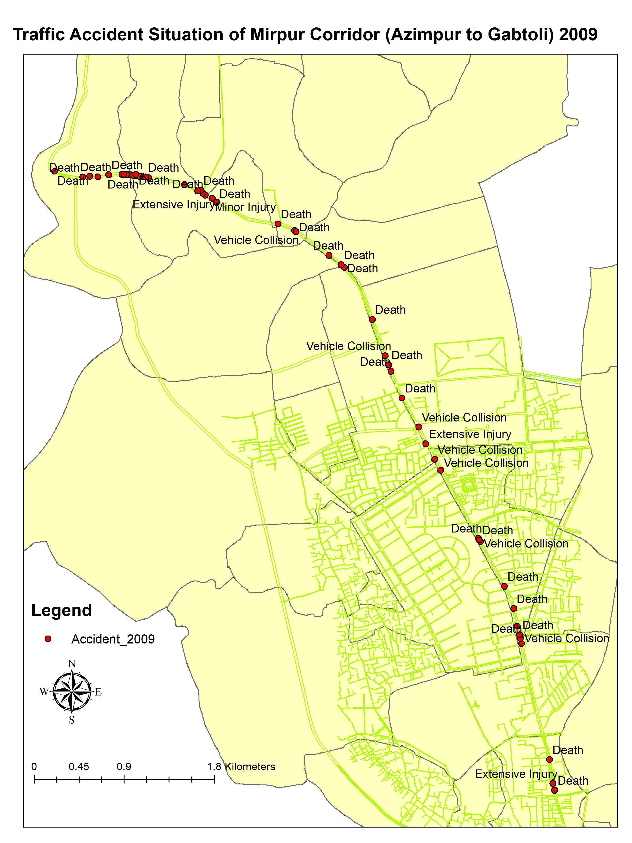
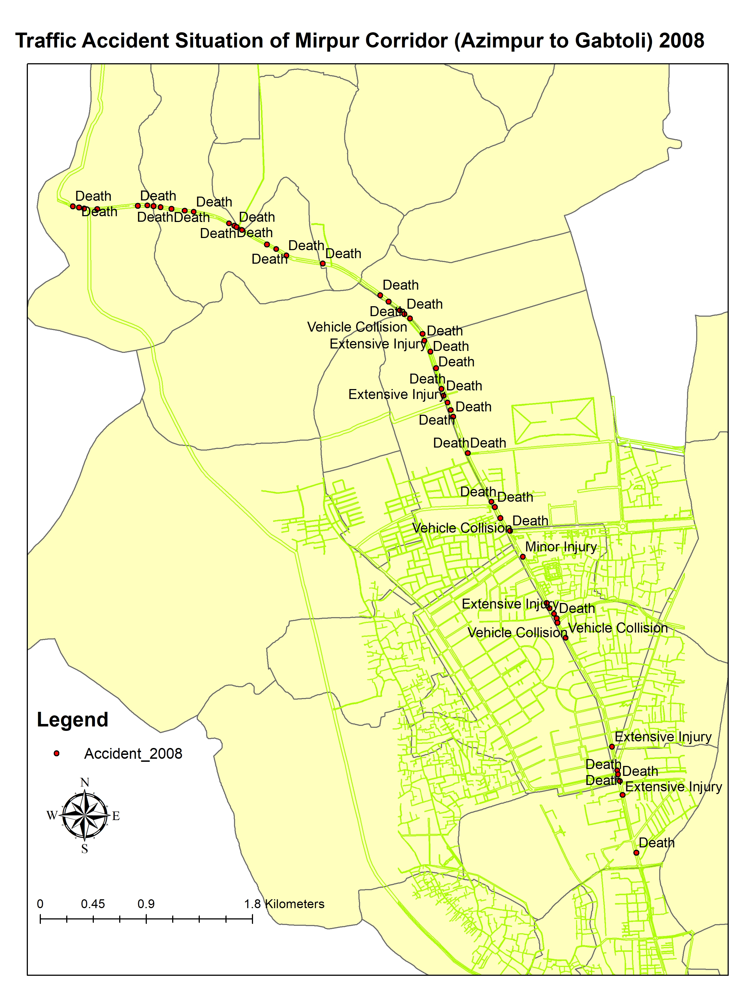
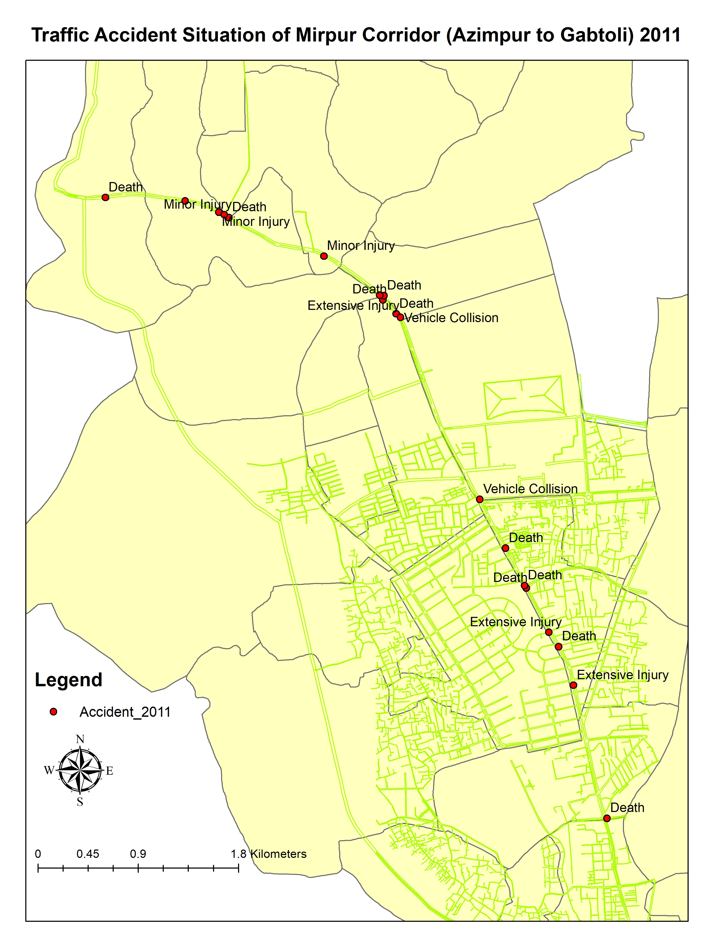
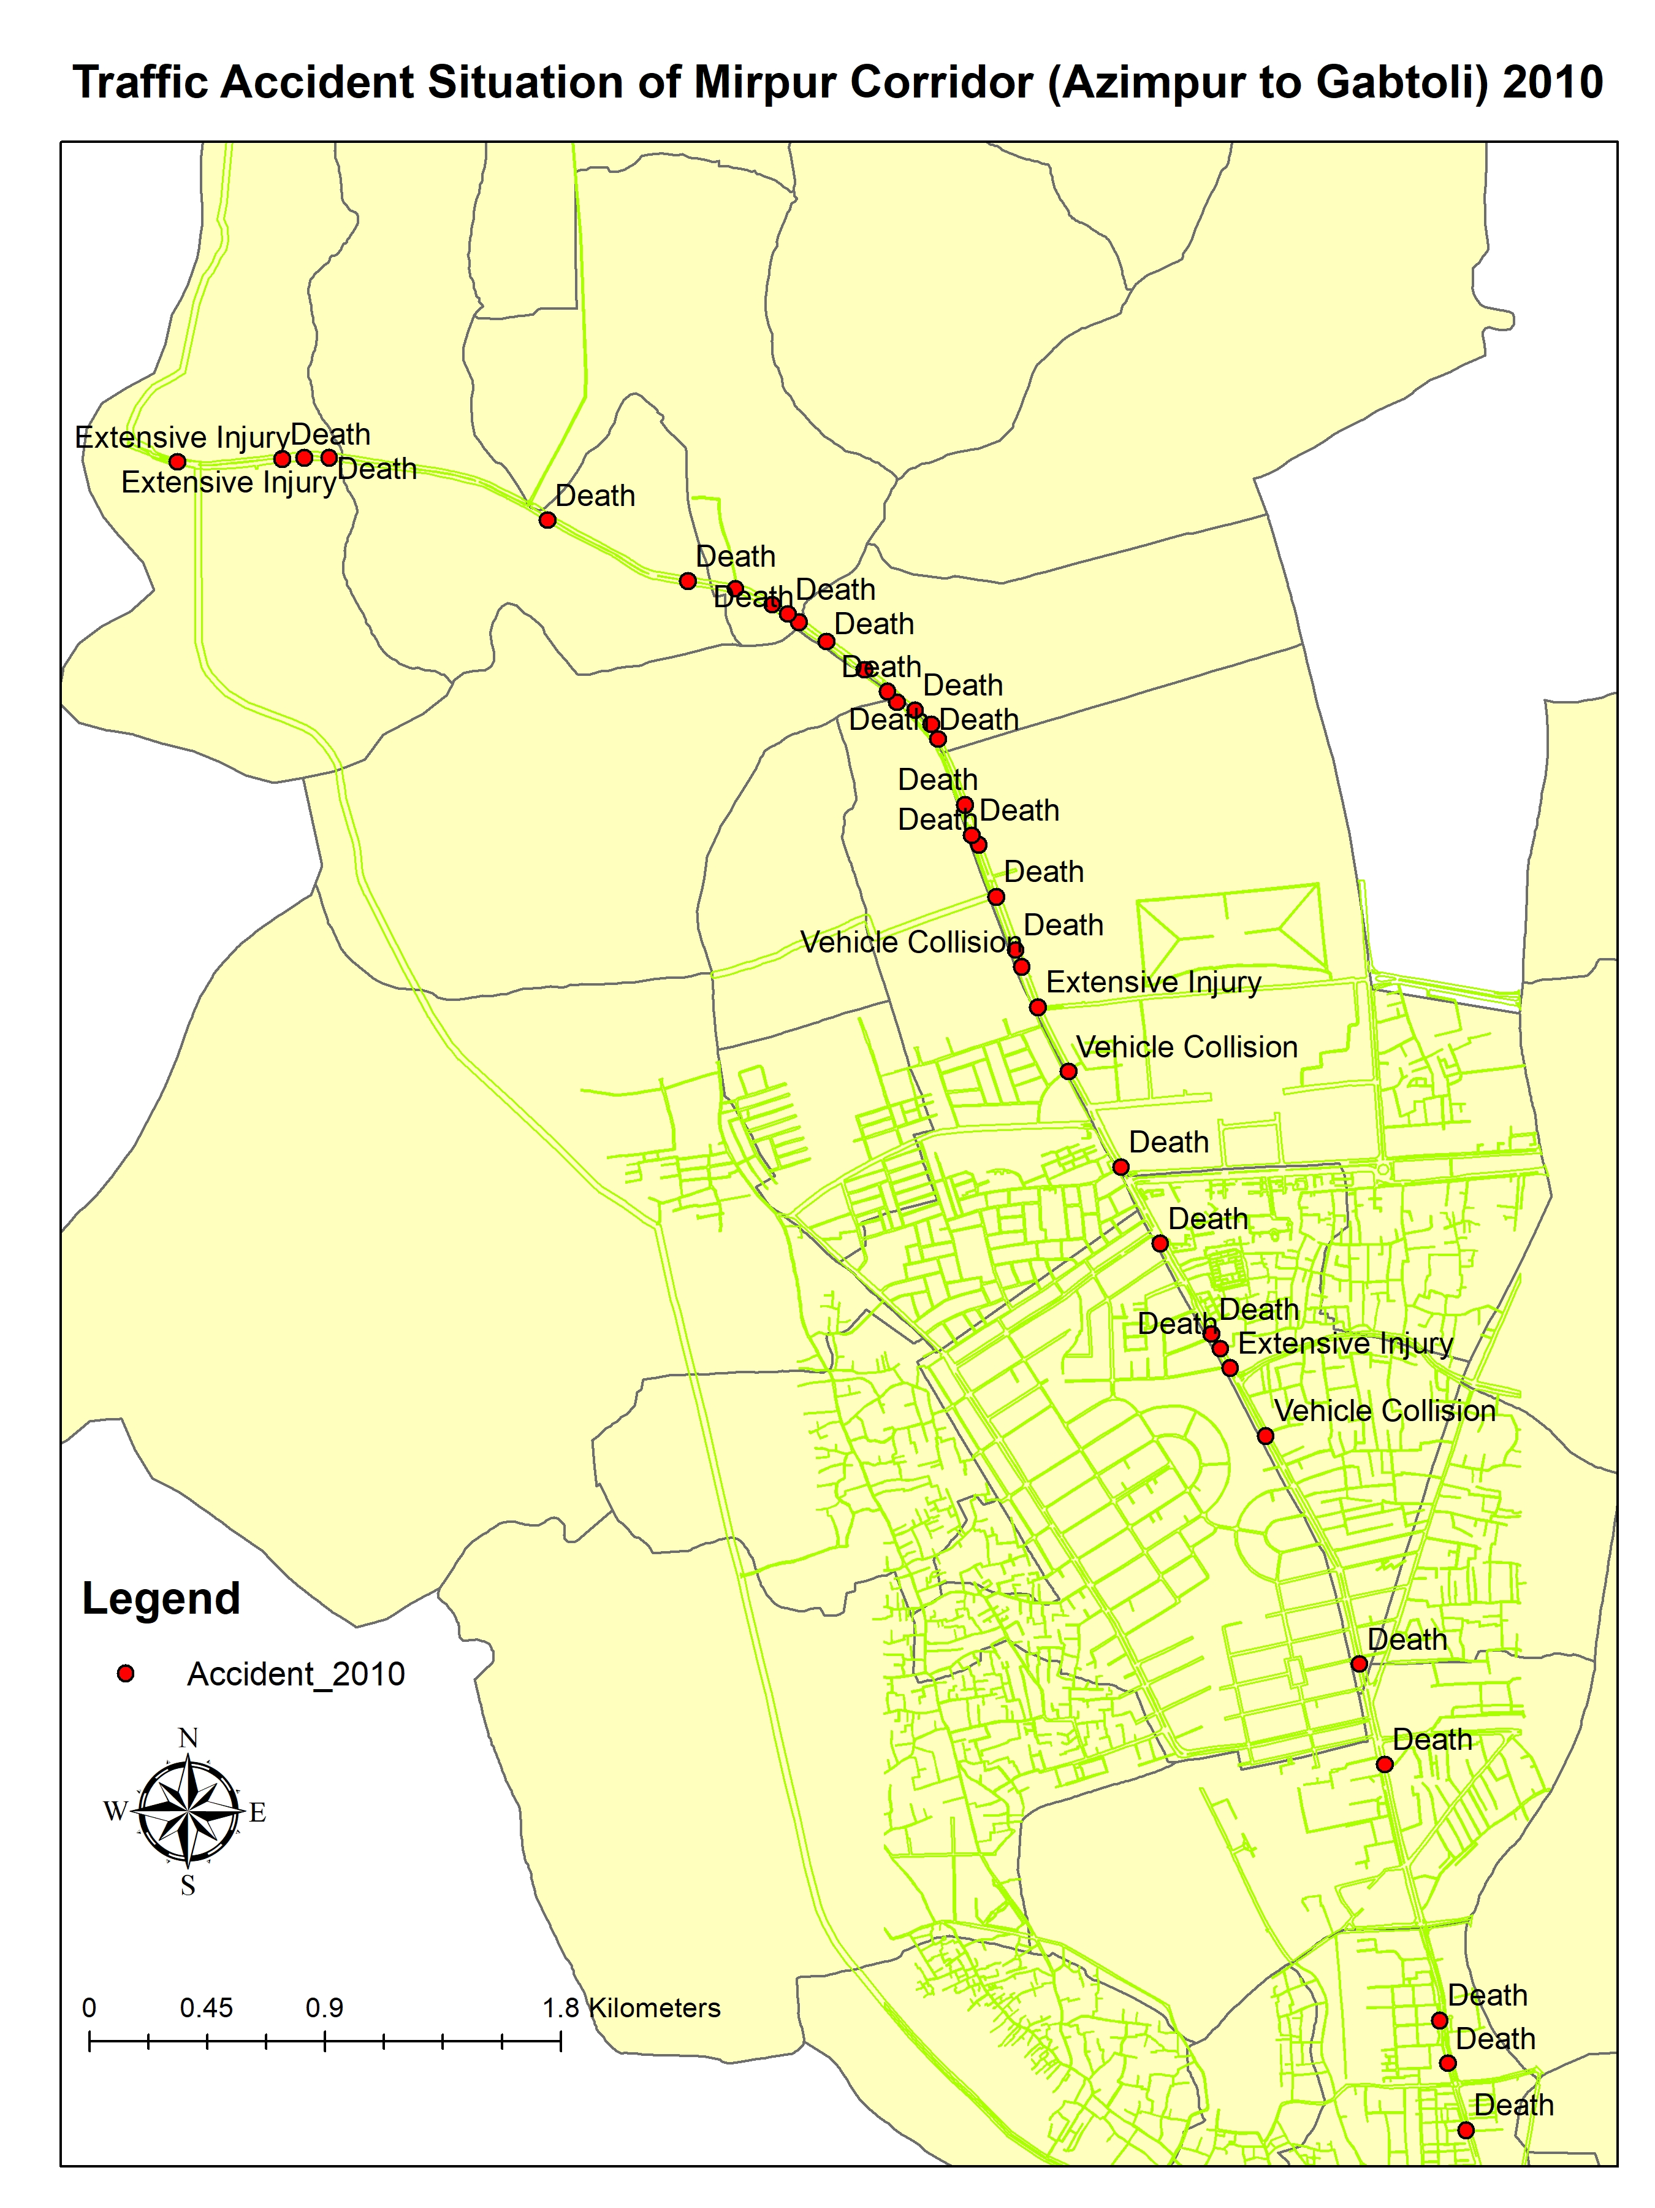
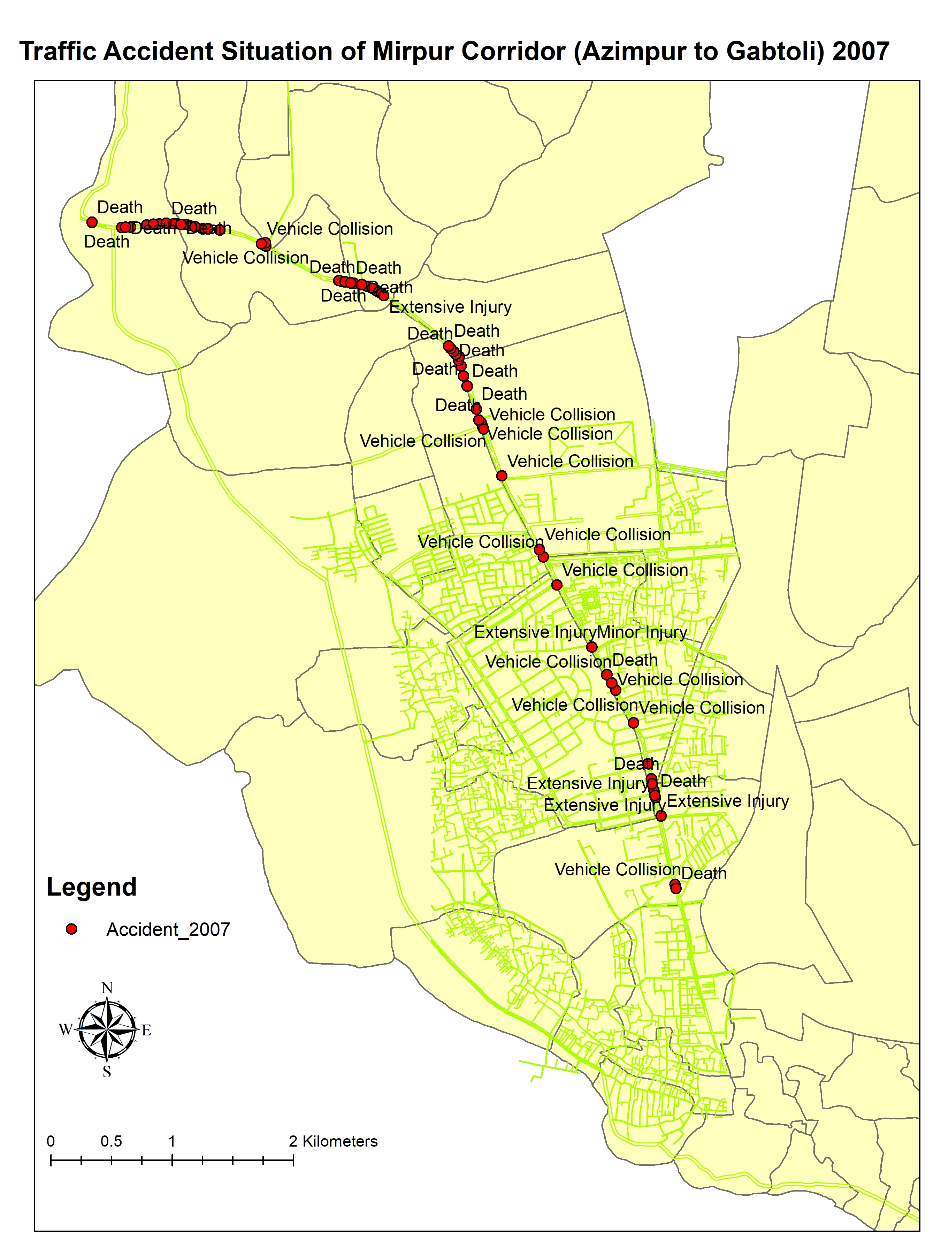
Accident Situations 2007-2011

Slide 6
Accident Situation 2007-2011
 |  | Number of Fatal Accidents |  |  | Number of Major or Minor Injuries
Year | Total Number of Accident Recorded | Pedestrian | Non-Motorized vehicle | Motorized Vehicle | Pedestrian | Non-Motorized vehicle | Motorized Vehicle | Number of Motor Collision
2007 | 731 | 361 | 46 | 47 | 78 | 32 | 59 | 109
2008 | 655 | 367 | 40 | 56 | 20 | 28 | 56 | 88
2009 | 518 | 307 | 26 | 45 | 14 | 23 | 40 | 65
2010 | 434 | 249 | 31 | 32 | 30 | 17 | 48 | 44
2011 | 382 | 197 | 29 | 42 | 41 | 17 | 50 | 28

Slide 7
Goal
To Understand the Spatial distribution pattern and relationship among the accident points on Mirpur Corridor and to develop a Network Kernel Density based accident hotspot or points estimation map.
Objective
To understand the spatial pattern of the accident points.
To Find out correlation among the accident points.
Develop a Network Kernel based density map.
To figure out the most vulnerable ward segments.
Develop a relationship with the vulnerable Ward population and accident points in the ward segments.

Slide 8
Limitation
Time Constraints.
Old Data .
Accuracy of Data Collection in the Field level.
Lack of Information about the Built Environment.

Slide 9
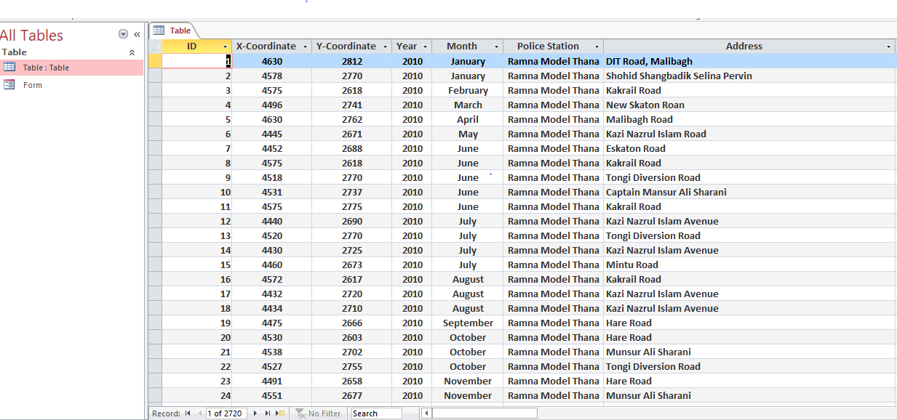
Data Collection
Supplied by the Dhaka Metropolitan Police and collected through a project funded by World Bank entitled “Clean Air And Sustainable Environment (CASE)”
Database includes 2,716 records of accidents.

Slide 10
Research Strategy
Spatial Pattern – Nearest Neighbor Distance Method.
Accident Points Relationship – Moran’s I Index.
Network Kernel Density Mapping - SANET (Spatial analysis along Networks).
Ward Identification- Arc GIS – Count tool.
Population and accident relationship – Spearman’s Correlation.

Slide 11
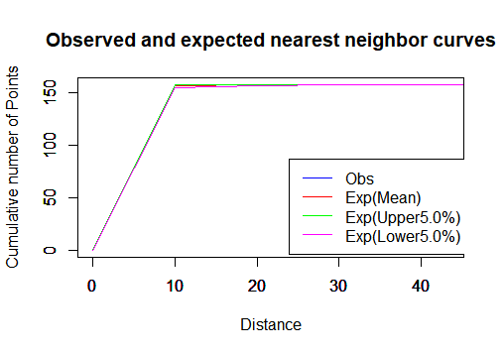
Spatial Pattern – Nearest Neighbor Distance Method.
Expected Value |  |  | Observed Value
Lower | 1.68 |  | Lower value | 0
Upper | 2.13 |  | Upper value | 9.92
ALL AVERAGE | 1.90 |  | Average | 0.64
VARIANCE | 4.36 |  | Variance | 2.00
 |  |  | P value | 0
Z | -17.762221 |  | Clark and Evan Aggregation Index | 0.337059
 | Reject Null Hypothesis |  | Through Monte Carlo Simulations
Decision – As Index <1
Cluster Pattern

Slide 12
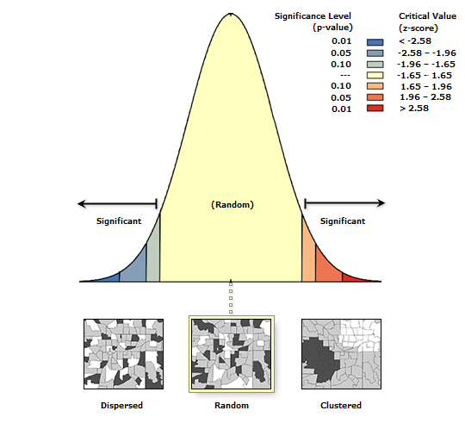
Accident Points Relationship – Moran’s I Index.
Global Moran's I Summary
Moran's Index: | 0.018590
Expected Index: | -0.006369
Variance: | 0.015500
z-score: | 0.200478
p-value: | 0.841107
Accept Null Hypothesis (Z Score in between accept regions at 5% level of significance).
No Significant relationship among the accident points(P values).
Decision- Relationship Random
-1(Dispersed)<.019 (Random) <1 (Clustered)

Slide 13
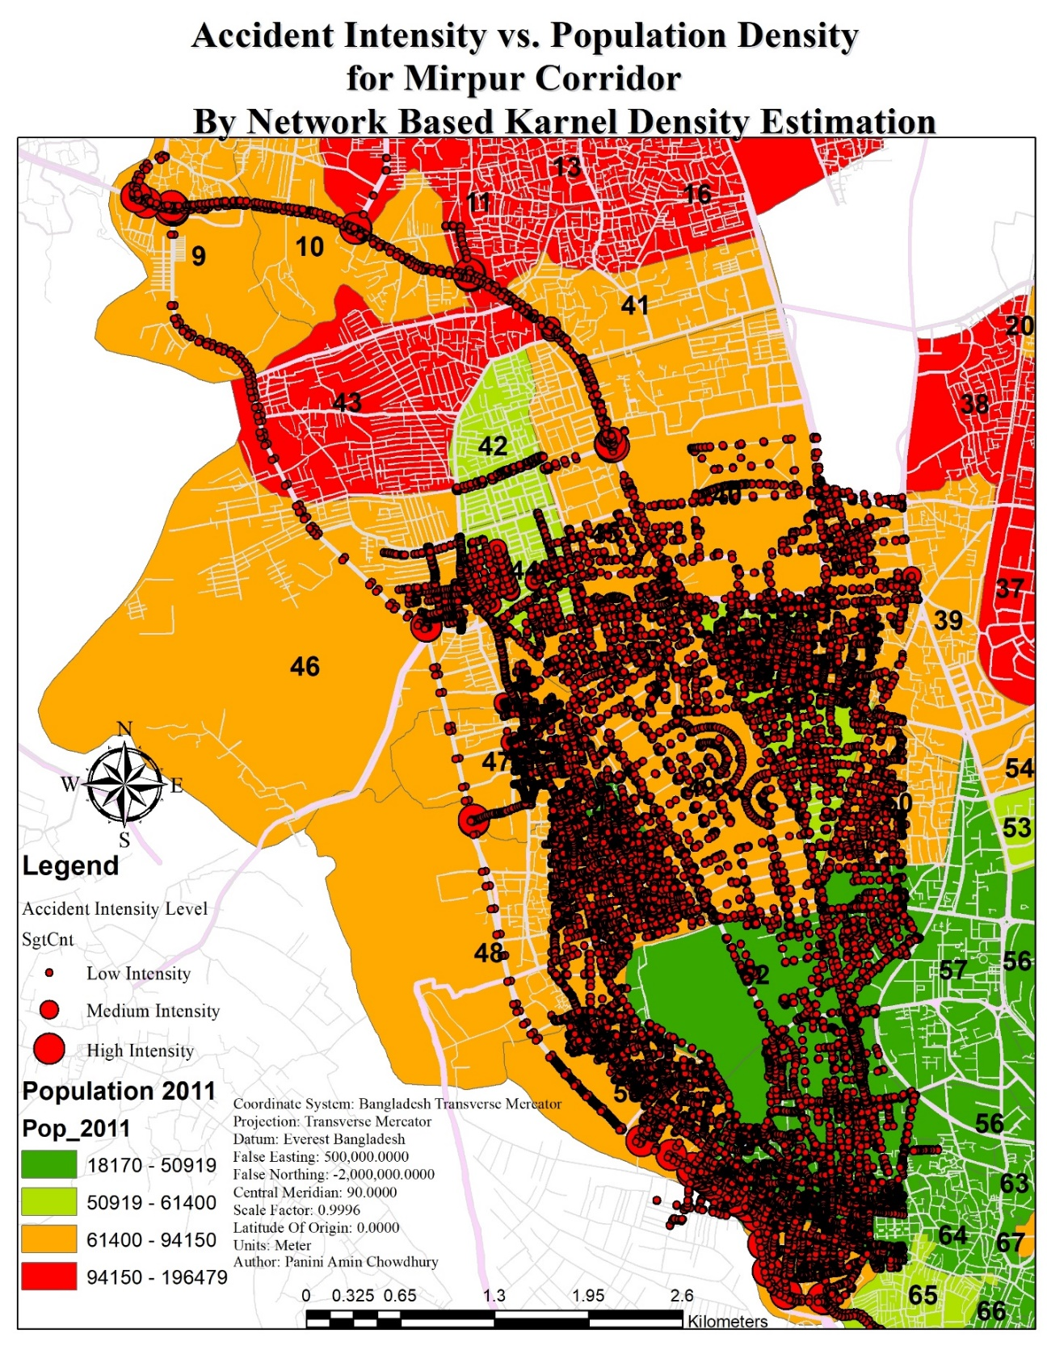
Network Kernel Density Mapping – SANET (Spatial analysis along Networks).
Why NKDE Instead KDE
Kernel Density Estimation
Circular Distance Decay Function based Shortest path Estimate.
Network Kernel Density Estimation
each point’s influence extends a chosen distance along the network where each of the point separately have influence radius.

Slide 14
most vulnerable ward segments
Zoning of the Affected Wards
Ward 9- commercial/Business zoning.
Ward 10,11 - mixed commercial/Educational land use, mostly high schools.
Ward 40 ,41,43, 44 - mixed residential/commercial land use.
Ward 51,52 and 62 - mixed commercial and light industry.
WARD_NO | Count_ | Pop_2011 | AREA
51 | 31 | 58863 | 938422
10 | 30 | 87879 | 1735830
40 | 29 | 90224 | 1045670
9 | 21 | 71260 | 1342320
41 | 15 | 65984 | 3251010
11 | 11 | 97033 | 1947320
52 | 8 | 49523 | 968512
62 | 6 | 44540 | 1496920
45 | 6 | 72973 | 1872490
43 | 1 | 186639 | 2382920

Slide 15
Relationship with the vulnerable Ward population and accident points
Rank_Pop_2011 | Rank Count | WARD_NO
8 | 1 | 51
4 | 2 | 10
3 | 3 | 40
6 | 4 | 9
7 | 5 | 41
2 | 6 | 11
9 | 7 | 52
10 | 9 | 62
5 | 9 | 45
1 | 10 | 43
Spearman's Rho -0.07294866524.
P value - 0.003 ( 95% level of significance)
Decision – Significant negative relationship.

Slide 16
References
Ahsan, H. M.,2012. Road Safety in Bangladesh: Key Issues and Countermeasures. Forum, monthly publication of Daily Star, Vol. 6, No. 7, July.
Ahmed, Bayes, 2013. Traffic Accident Study In Dhaka City (2007-2011). Clean Air And Sustainable Environment (CASE) Project. The World Bank.
Al-Mahmood, S. Z, 2007. Death on the Asphalt. Star Weekend, Daily Star.
Anselin, L, 1995. Local Indicators of Spatial Association – LISA. Geographic Analysis 27,93–115.
Anderson, T.K., 2009. Kernel density estimation and K-means clustering to profile road accident hot spots. Accidental Analysis & Prevention 41, 359–364.
Okabe, A., Yomono, H., Kitamura, M., 1995. Statistical analysis of the distribution of points on a network. Geographic Analysis 27 (2), 152–175.
WHO (World Health Organization). 2004. World Report on Road Traffic Injury
Prevention. http://whqlibdoc.who.int/publications/2004/9241562609.pdf
UNES, 2007. Status Paper on Road Safety Problems in Bangladesh: The Bangladesh Country Paper. United Nations Economic and Social Commission for Asia and the Pacific, Bangkok, Thailand.
Xie, Z.; Yan, J, 2008. Kernel Density Estimation of Traffic Accidents in a Network Space. Computers, Environment & Urban System,35(5), 396–406.
Xie, Zhixiao; Yan, Jun, 2013. Detecting traffic accident clusters with network kernel density estimation and local spatial statistics: an integrated approach. Journal of Transport Geography 31 ,64–71.

Slide 17
Thank you

