Slide 1
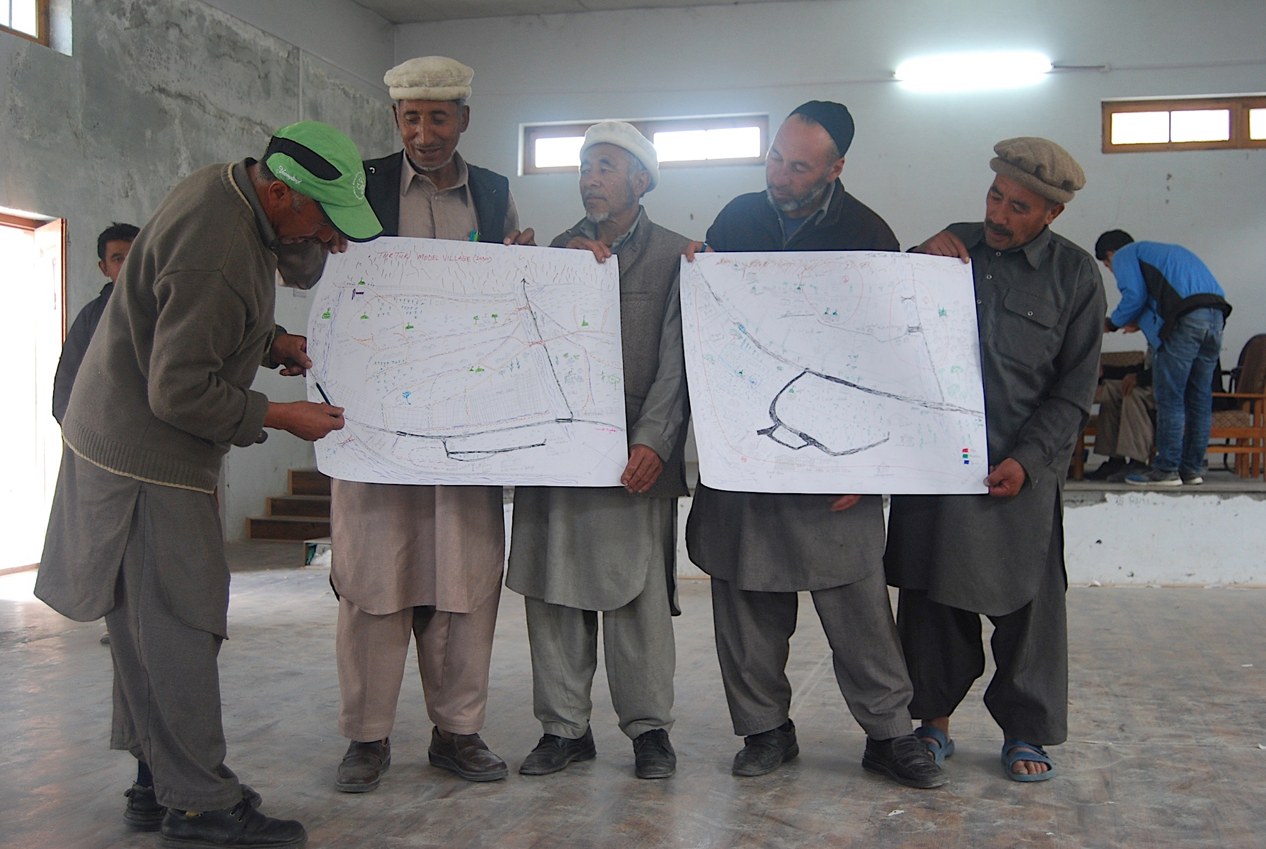


Forensic Workshop – Turtuk
Dr. BAYES AHMED
Research Associate
UCL Humanitarian Institute
20 October 2017

Slide 2
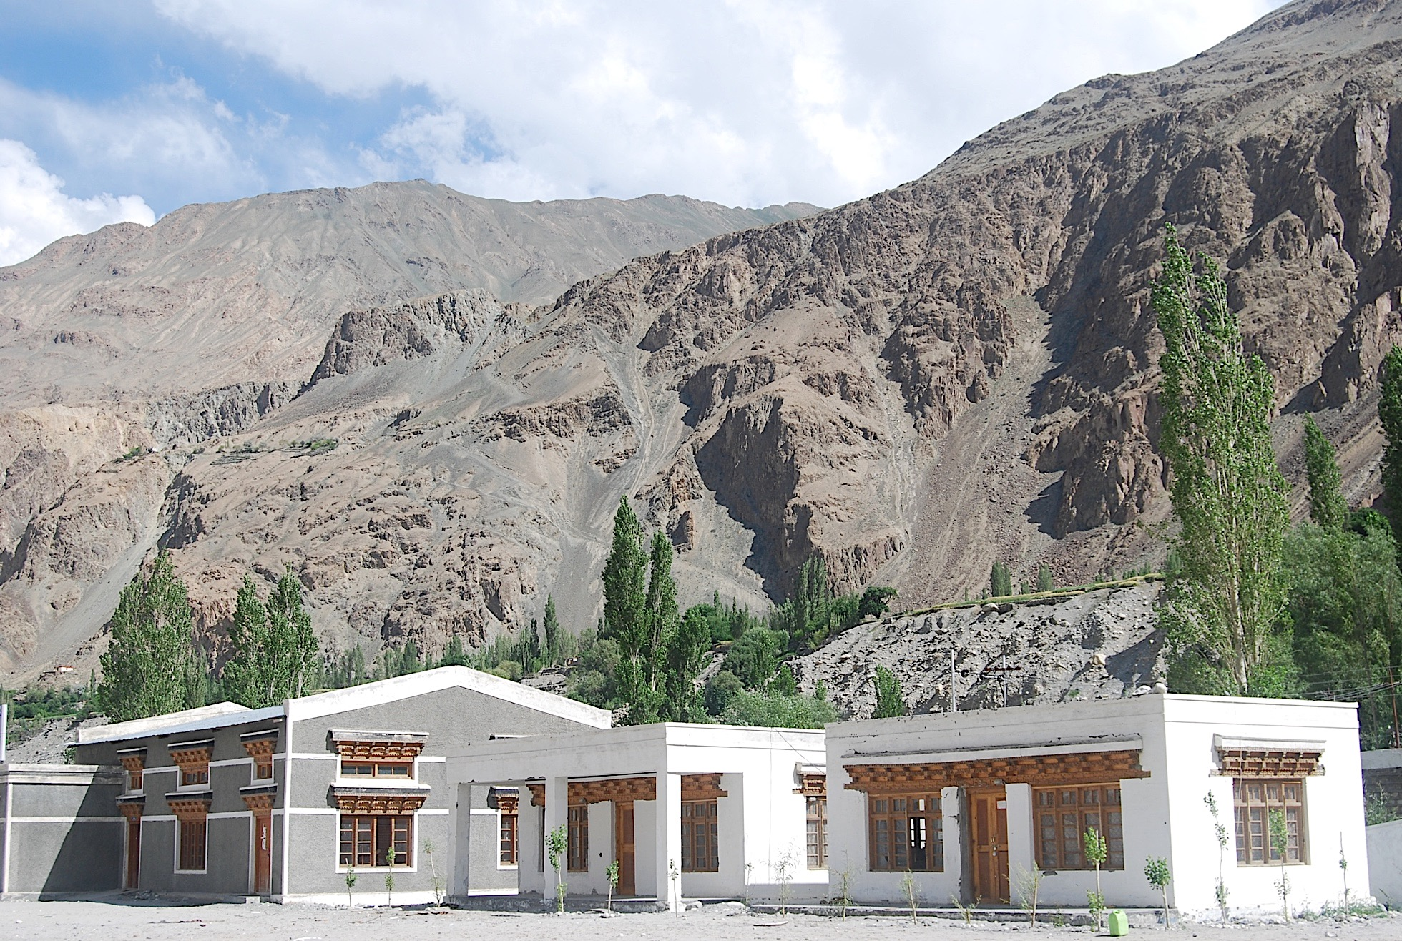
Background
Turtuk Forensic Workshop
6–7 July 2017 (Thursday and Friday)
Forensic – Scientific tests or techniques used in connection
with the detection of crime.
Location: Govt. Higher Secondary School, Turtuk

Slide 3
Aim
The Workshop focused on historic hazard events, in the understanding of social capital, vulnerabilities and their development.
The community and concerned key informants shared ideas, defined problems and vulnerabilities, mapped risk zones, determined priorities, suggested solutions within their remit and talked about future aspirations through active focus group discussions and collaborative activities.

Slide 4
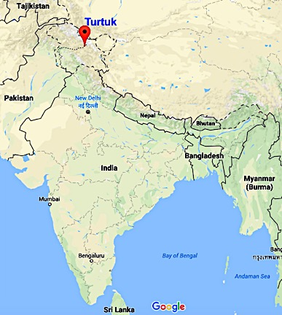
Study Area
Turtuk, the northernmost village in India was selected
Located 3,000 m above sea level in
Leh district in Jammu and Kashmir.
It is predominantly a Muslim village
with a total population of around 3,400.
India took control of this village from Pakistan during the
Indo-Pakistani War of 1971.
Another major conflict with Pakistan during the
Kargil War in 1999. Turtuk is also frequently affected by
flooding and landslides.

Slide 5
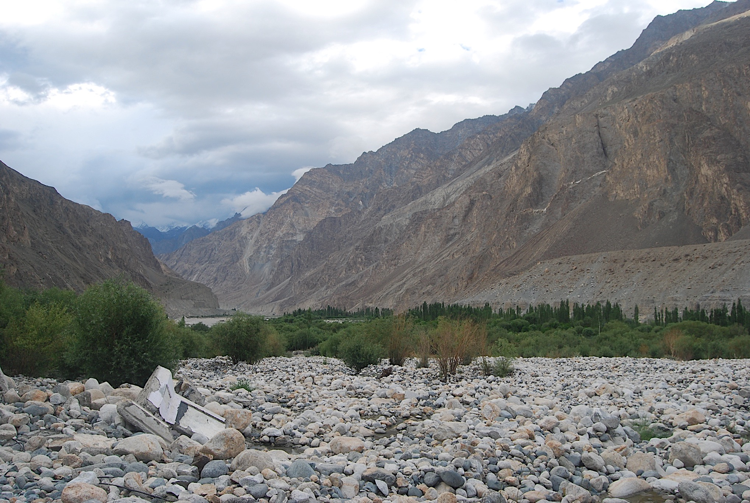
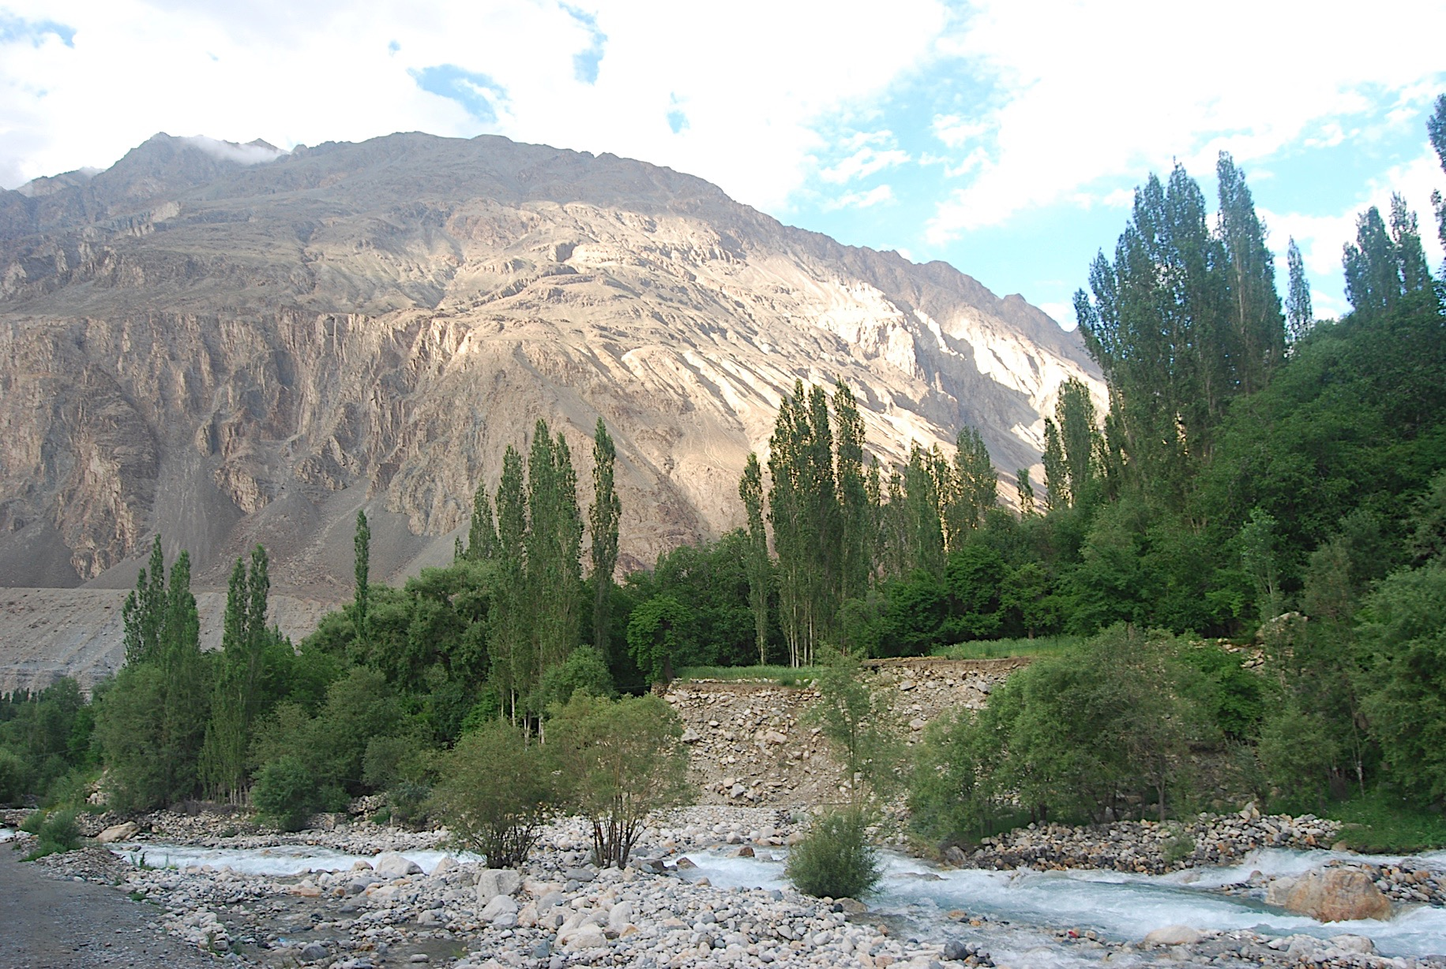
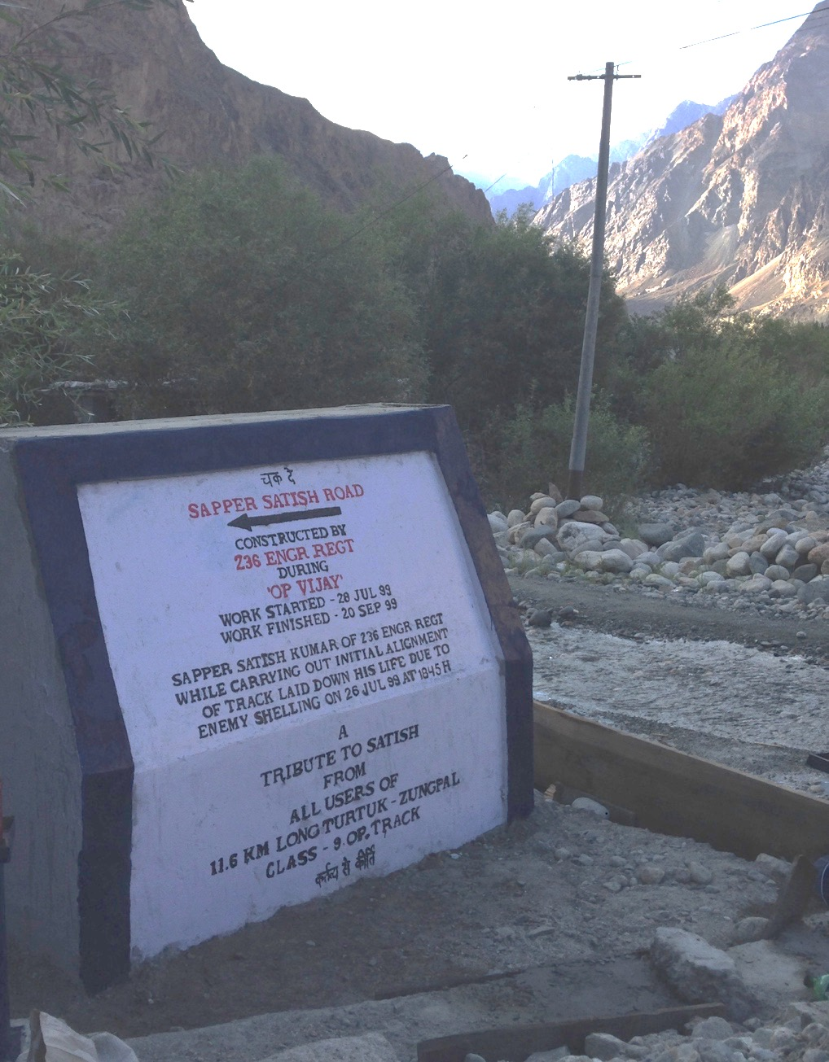
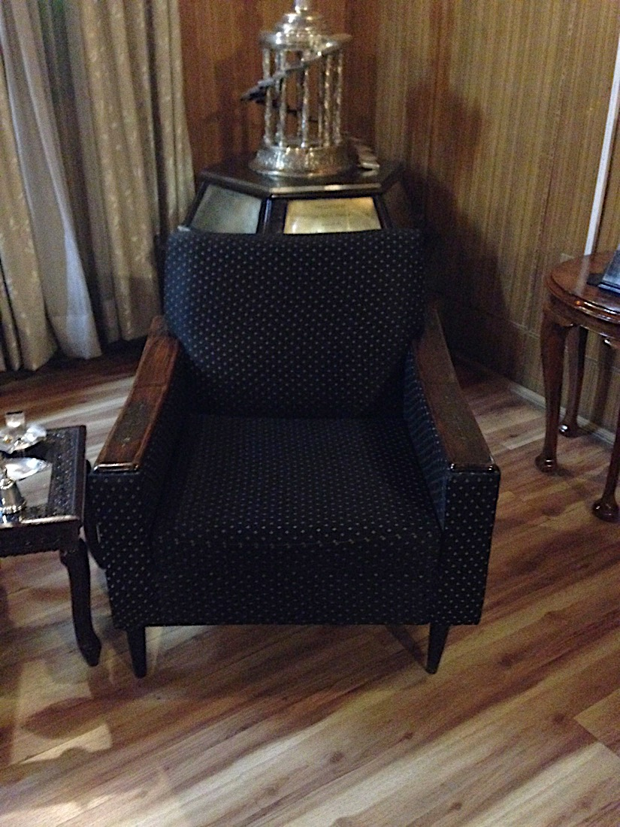
Study Area
18 Soldiers were killed in flash flooding in July 2015

Slide 6
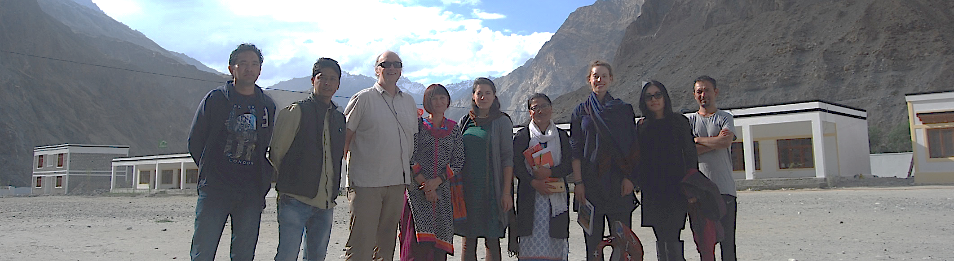
Activities
Ethical Approval: The two days program was described
among the participants and verbal ethical approval was
undertaken to conduct the activities, record audios and
videos, and take decent photographs.
Workshop Facilitators: Professor Peter Sammonds,
Professor Kavita Suri, Virginie Le Masson, Bayes Ahmed,
Naomi Saville, Tsering Jolden, Kuenga Wangmo, Angchuk
and Gulzar. [Limitations]

Slide 7
Program Structure
A participatory approach has been adopted –
to understand people’s risk perception.
Around 40 local people participated in the workshop.
Local officials from relevant govt./non-govt./autonomous
institutions, school teachers, health care officials, Army
officers, project team members from UCL and University
of Jammu, and community people.
The participants were divided into 4 groups:
Local Men
Local Women
Political Leaders
Administrative Officials

Slide 8
Program Structure
Three community based participatory activities were
conducted.
Timeline [PAST]: To understand the previous major events
including environmental hazards, conflicts, economic
and infrastructure interventions.
Hazard Mapping [PRESENT]: To map the basic services,
community facilities, and infrastructure within the community
and map high, medium and low risk zones.
Dream Mapping [FUTURE]: To map the aspirations and future
risk perceptions of local people in terms of addressing social,
economic, cultural, environmental/ecological, political/
institutional and physical aspects.

Slide 9
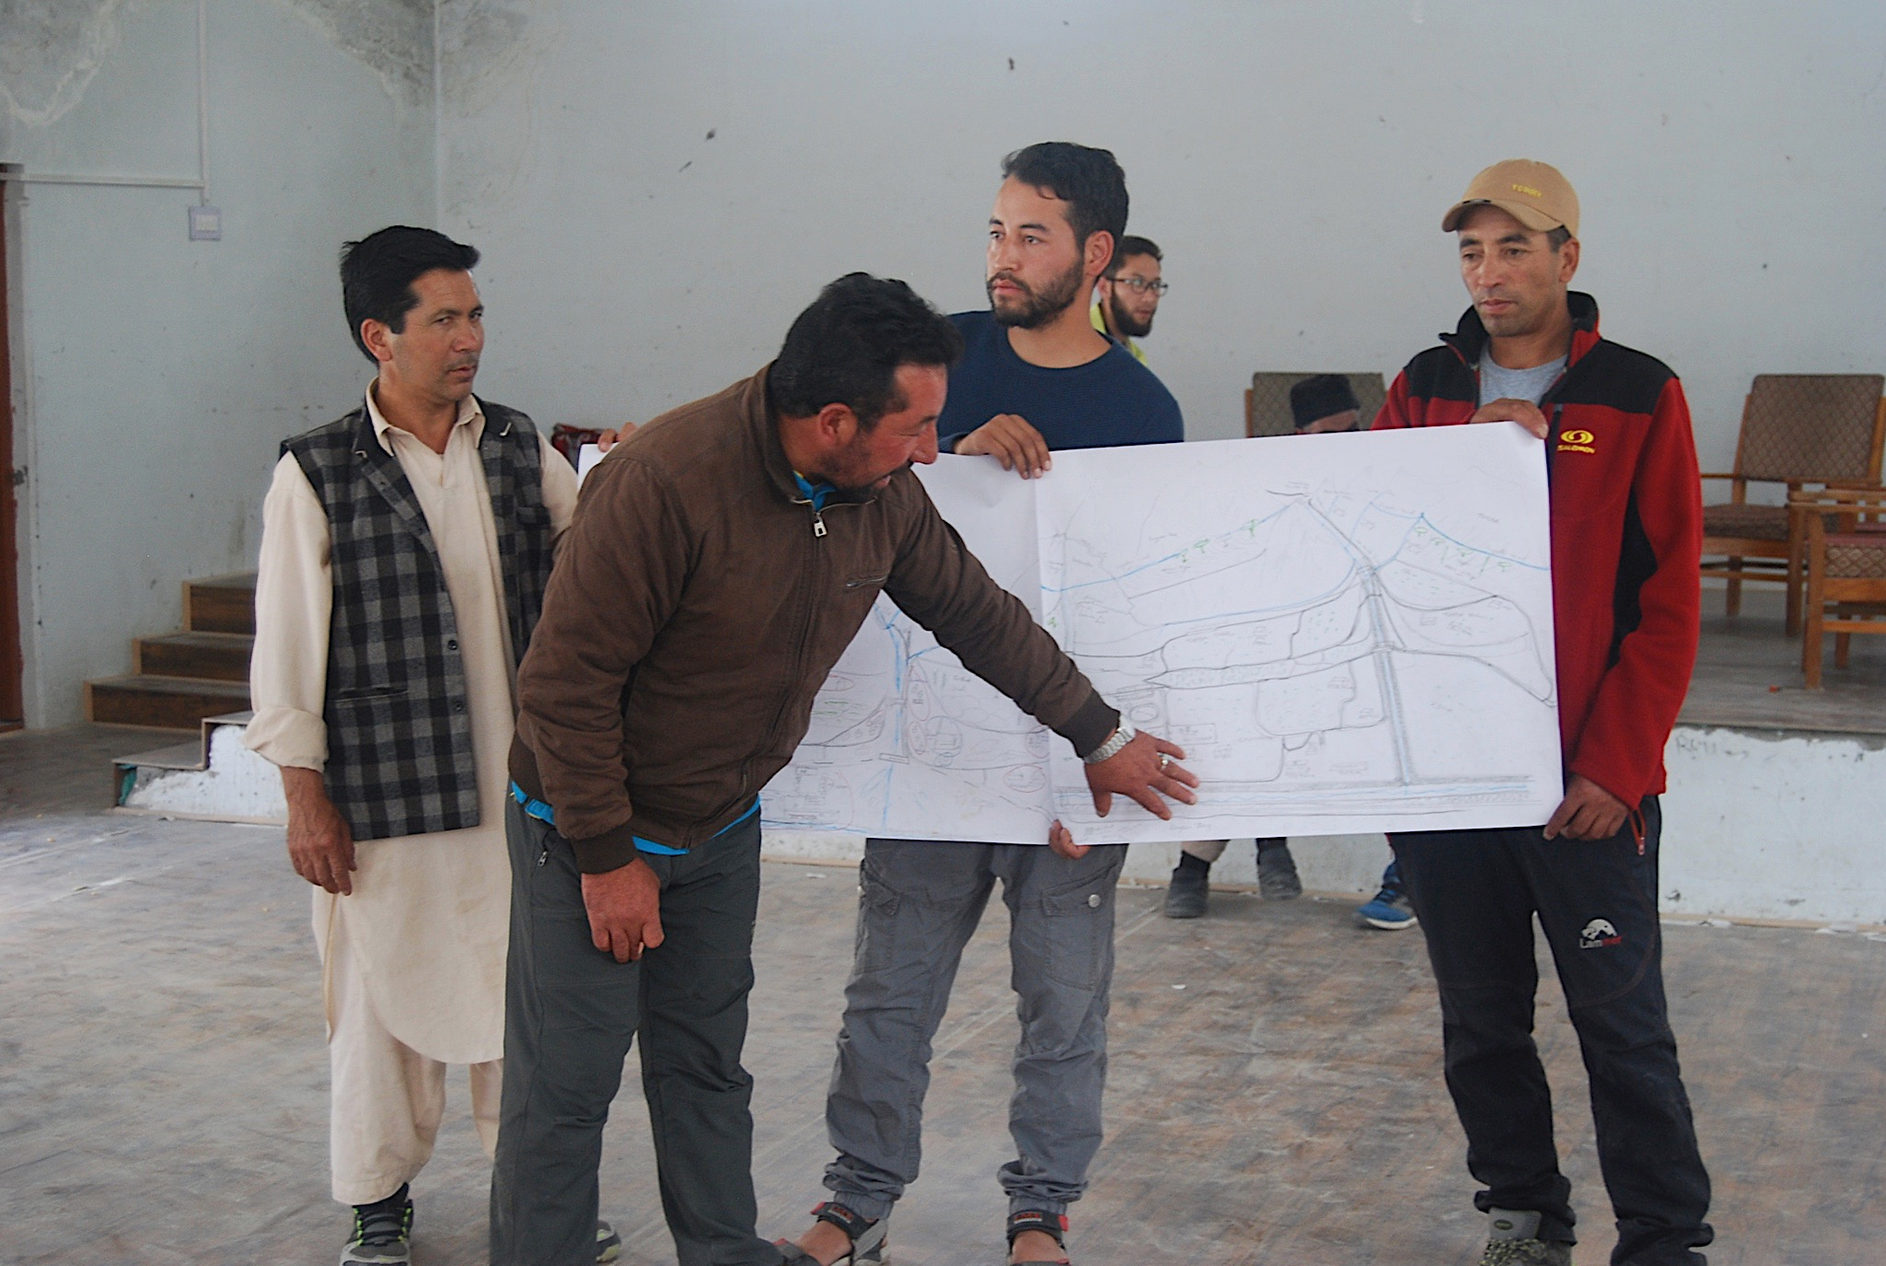
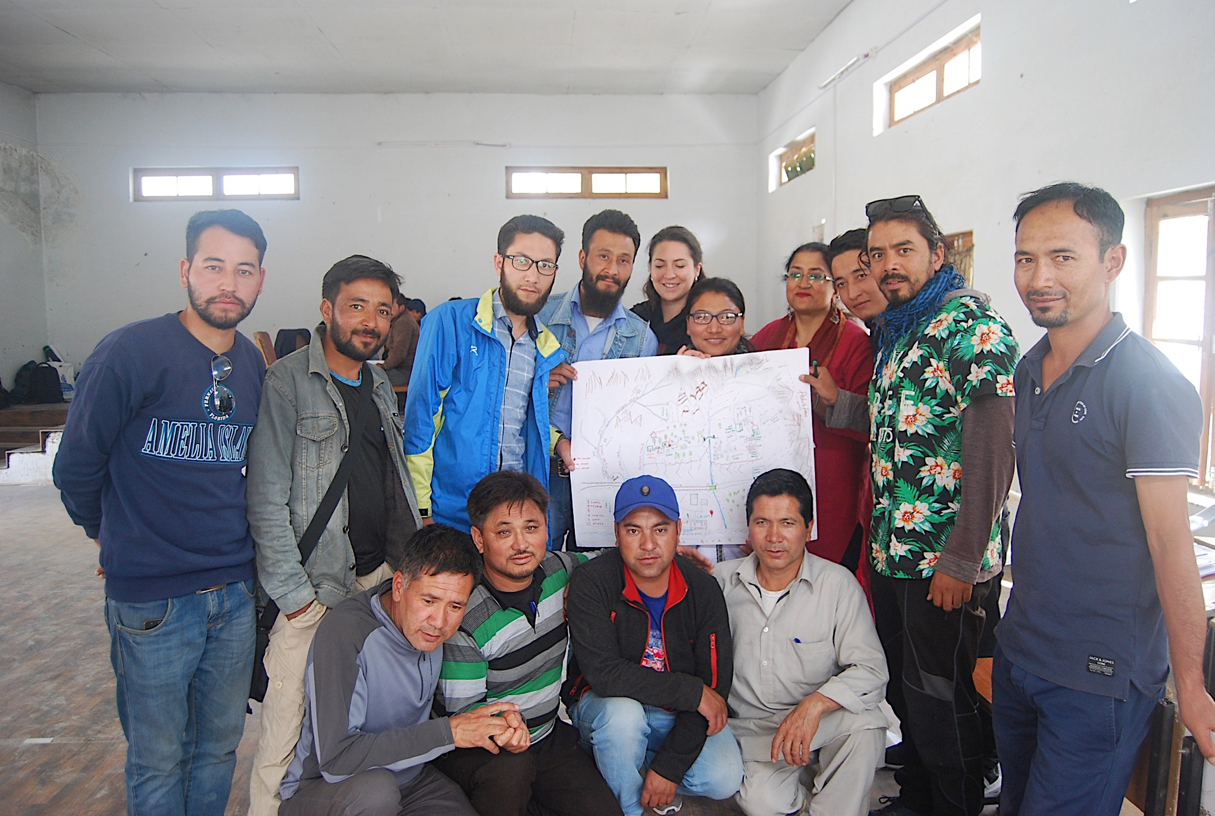
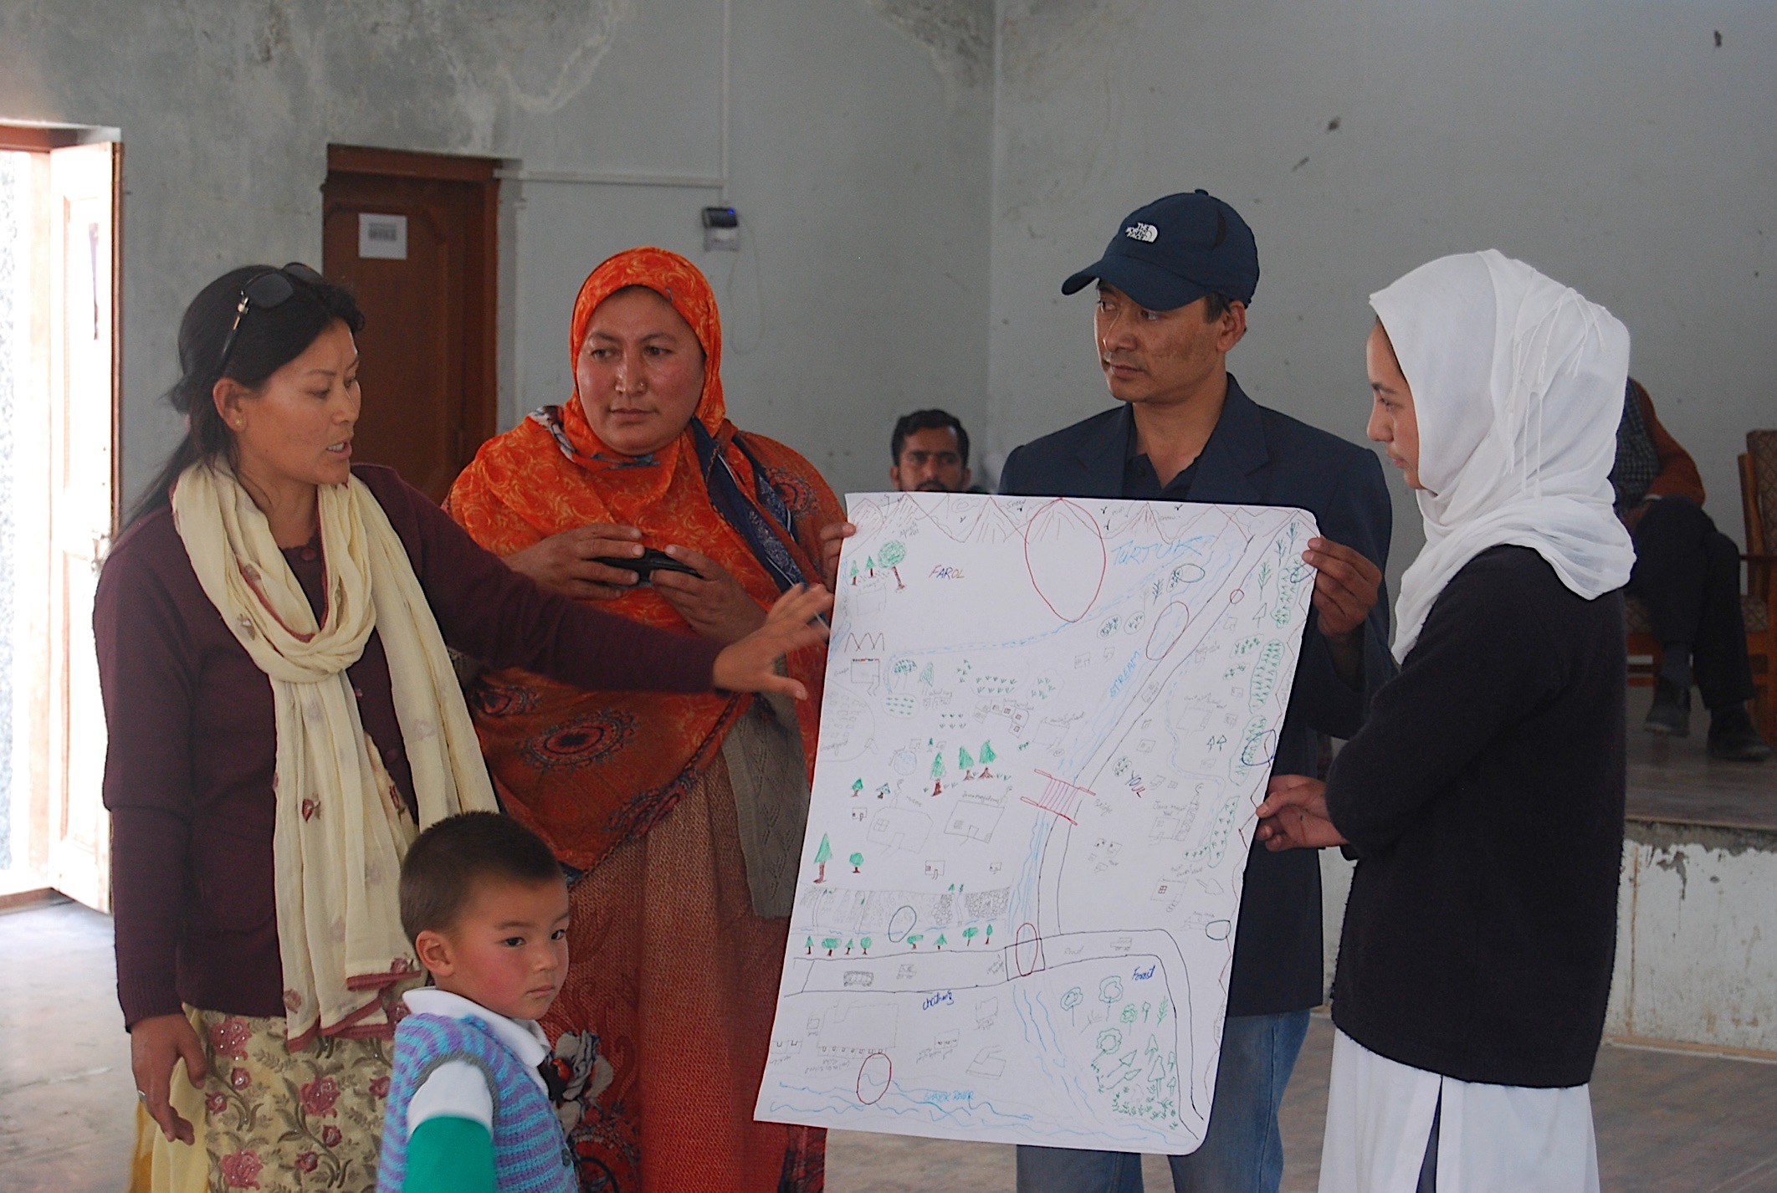
Activities

Slide 10
Timeline Diagram – Hazard Identification
 | Death, Injuries | House damage | Field damage/ loss | Infra. damage | Evacuation | Isolation | Insecurity/ fear | Env changes | Cult. changes
Cloudburst | + | + | + | + | + | + | +
Conflict | + |  |  |  | + | + | +
Heavy rains |  | + | + | + |  | + | + | +
River flooding | + | + | + | + |  | + | + | +
Falling rocks | + | + | + | + |  | +
Climate change |  |  |  |  |  |  |  | +
Population increase |  |  | + |  |  |  |  | +
Tourism |  |  | + |  |  |  |  | + | +
Earthquake | + | + |  | + |  | +

Slide 11
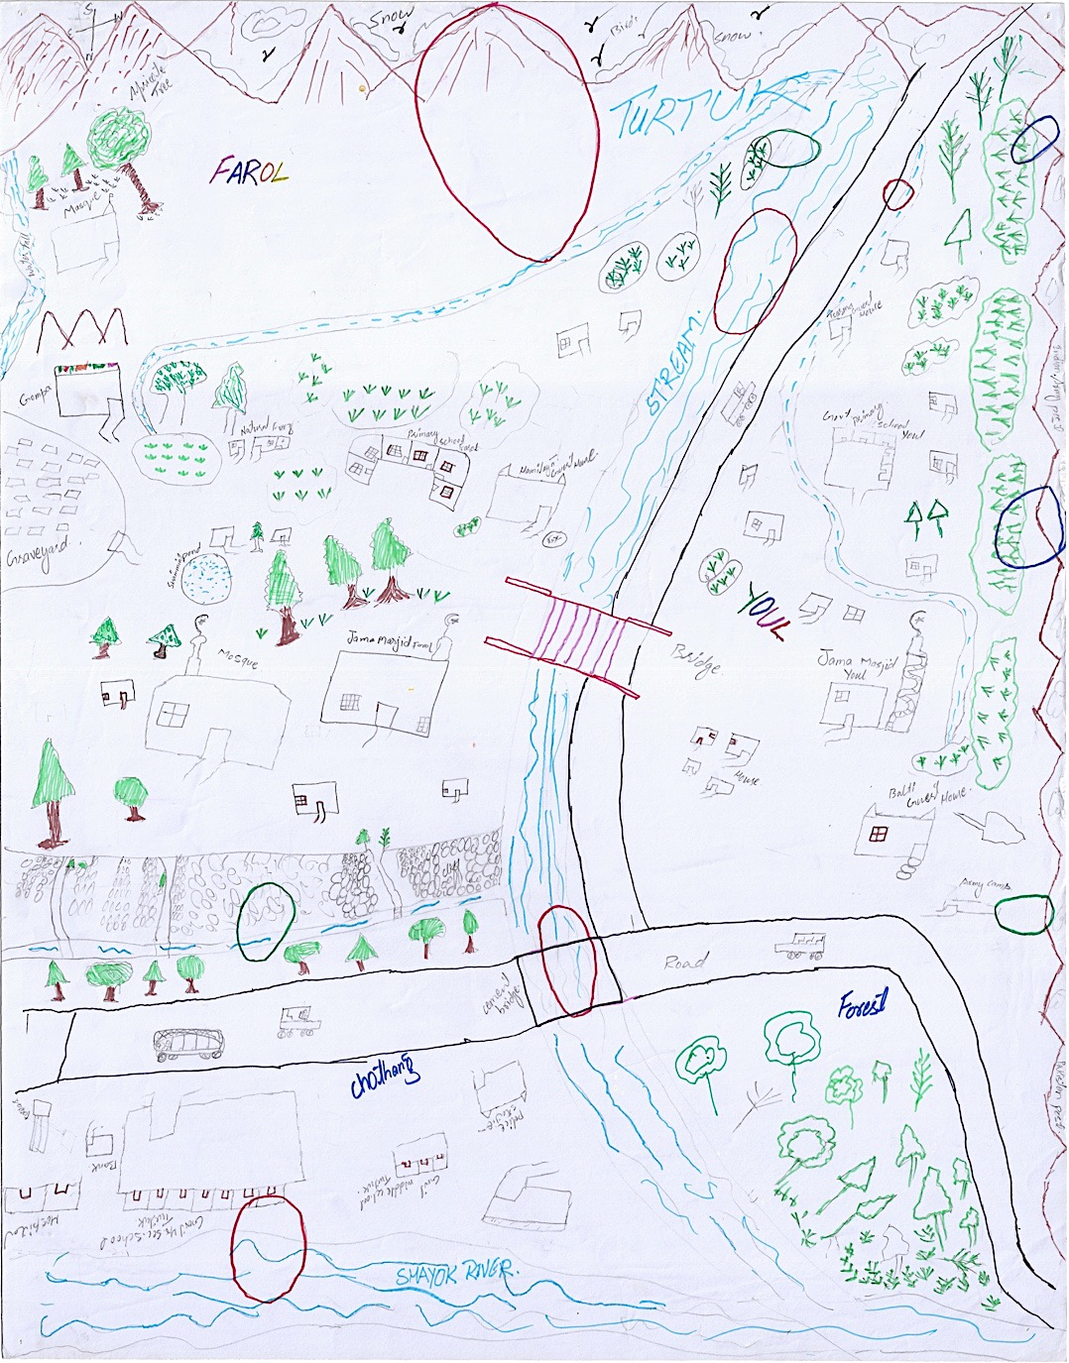
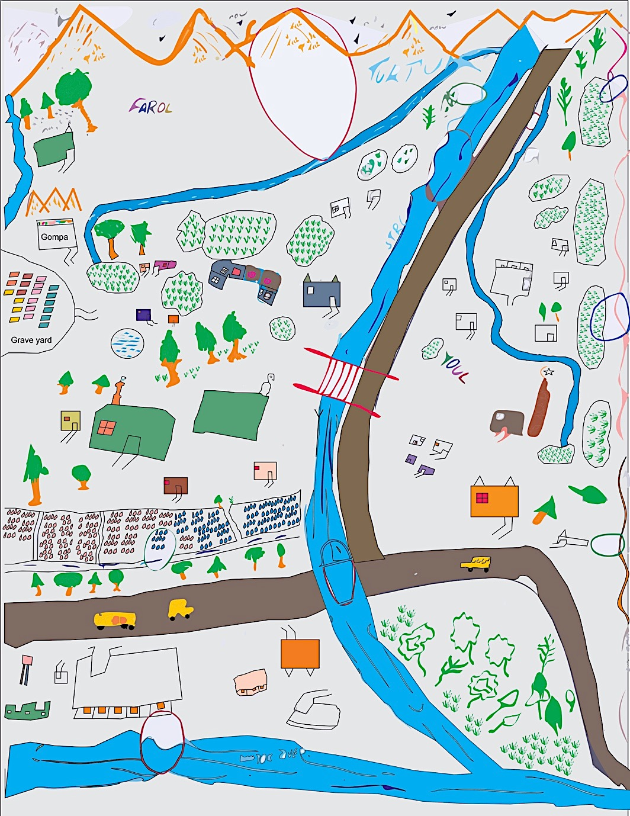
Map Preparation

Slide 12
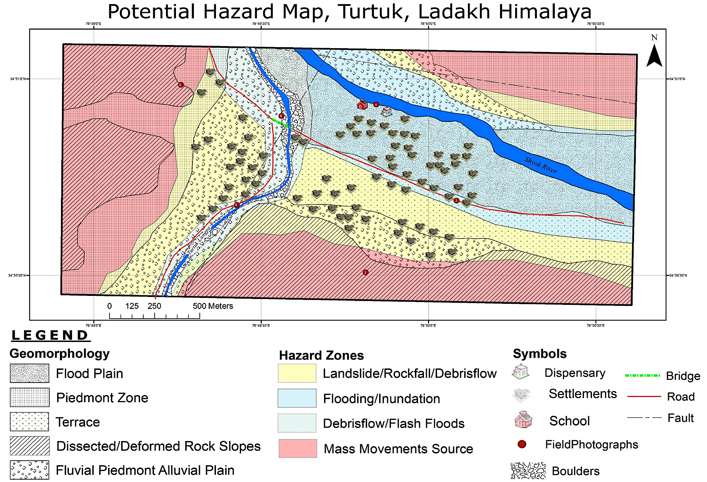
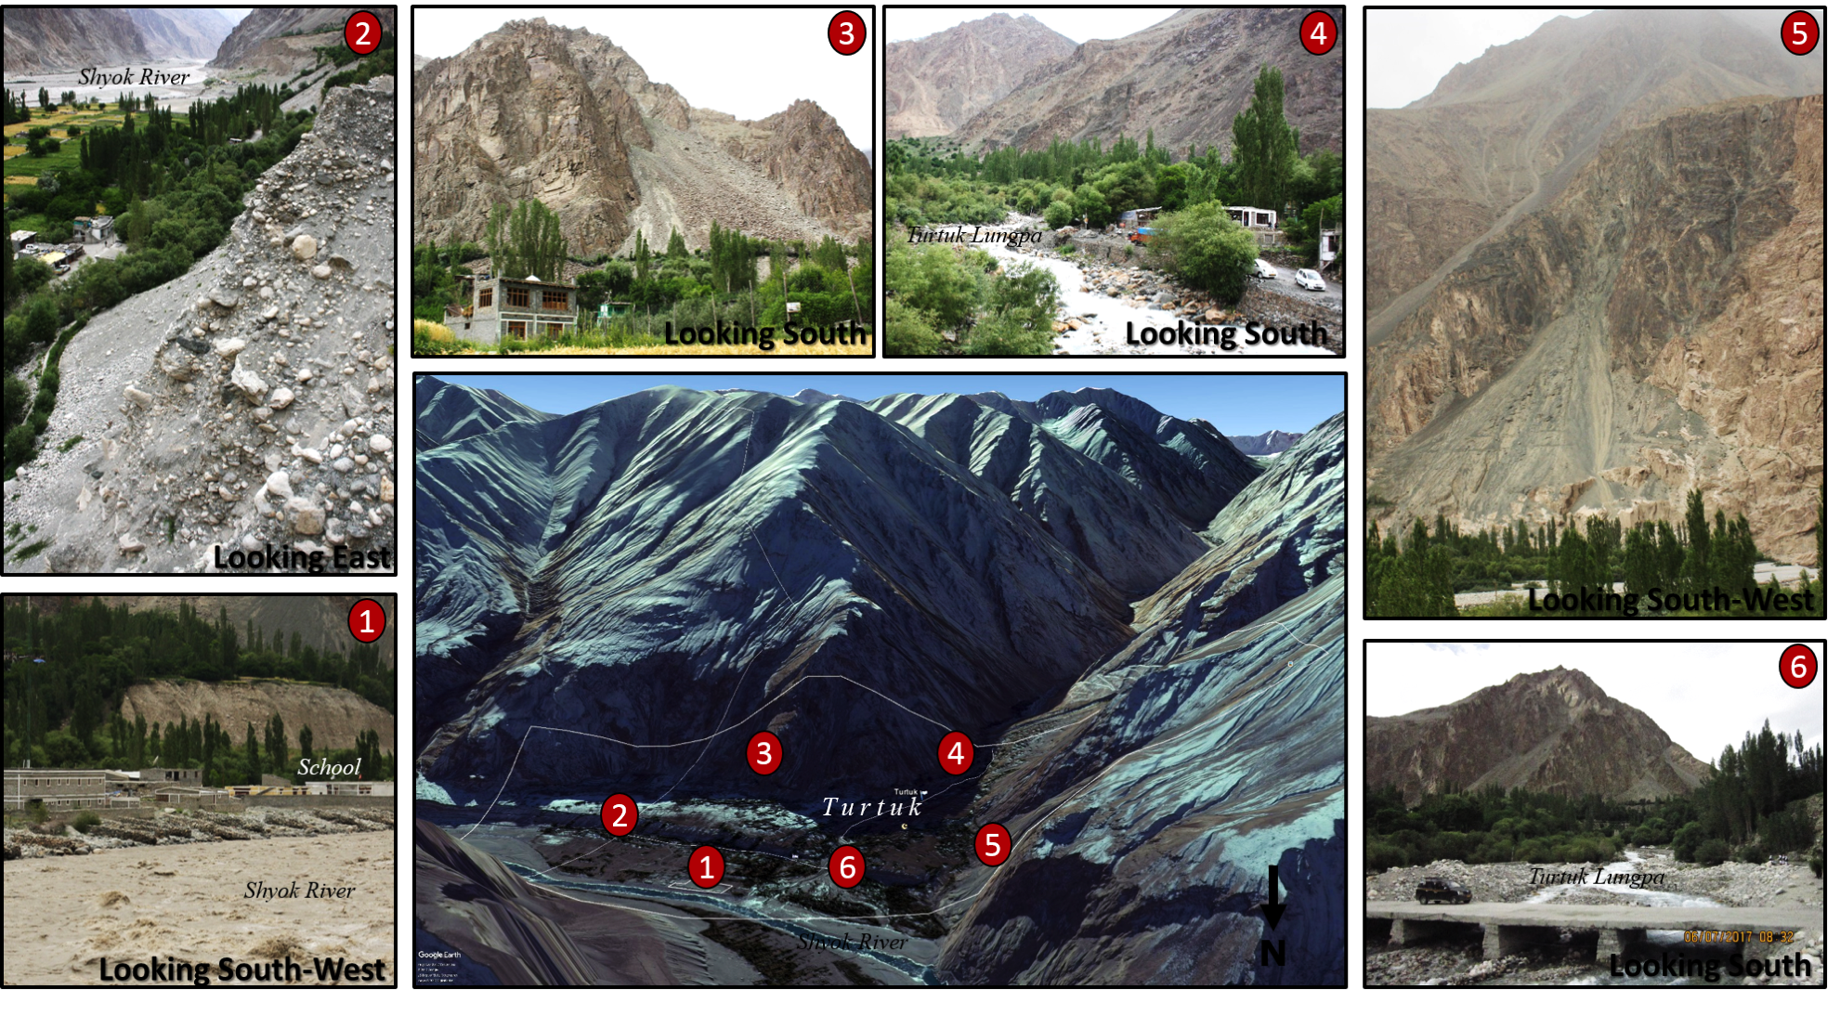
Actual Hazard Map

Slide 13
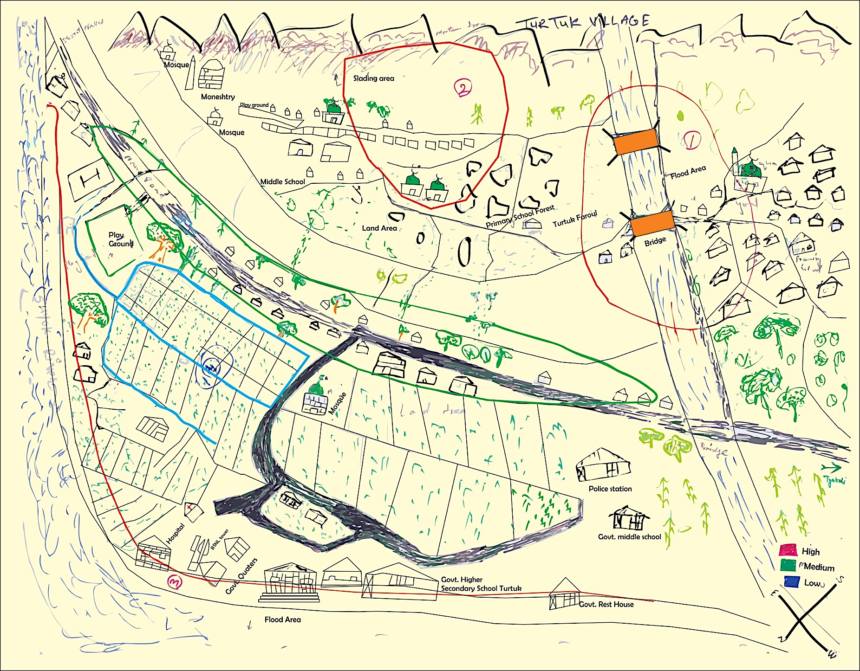
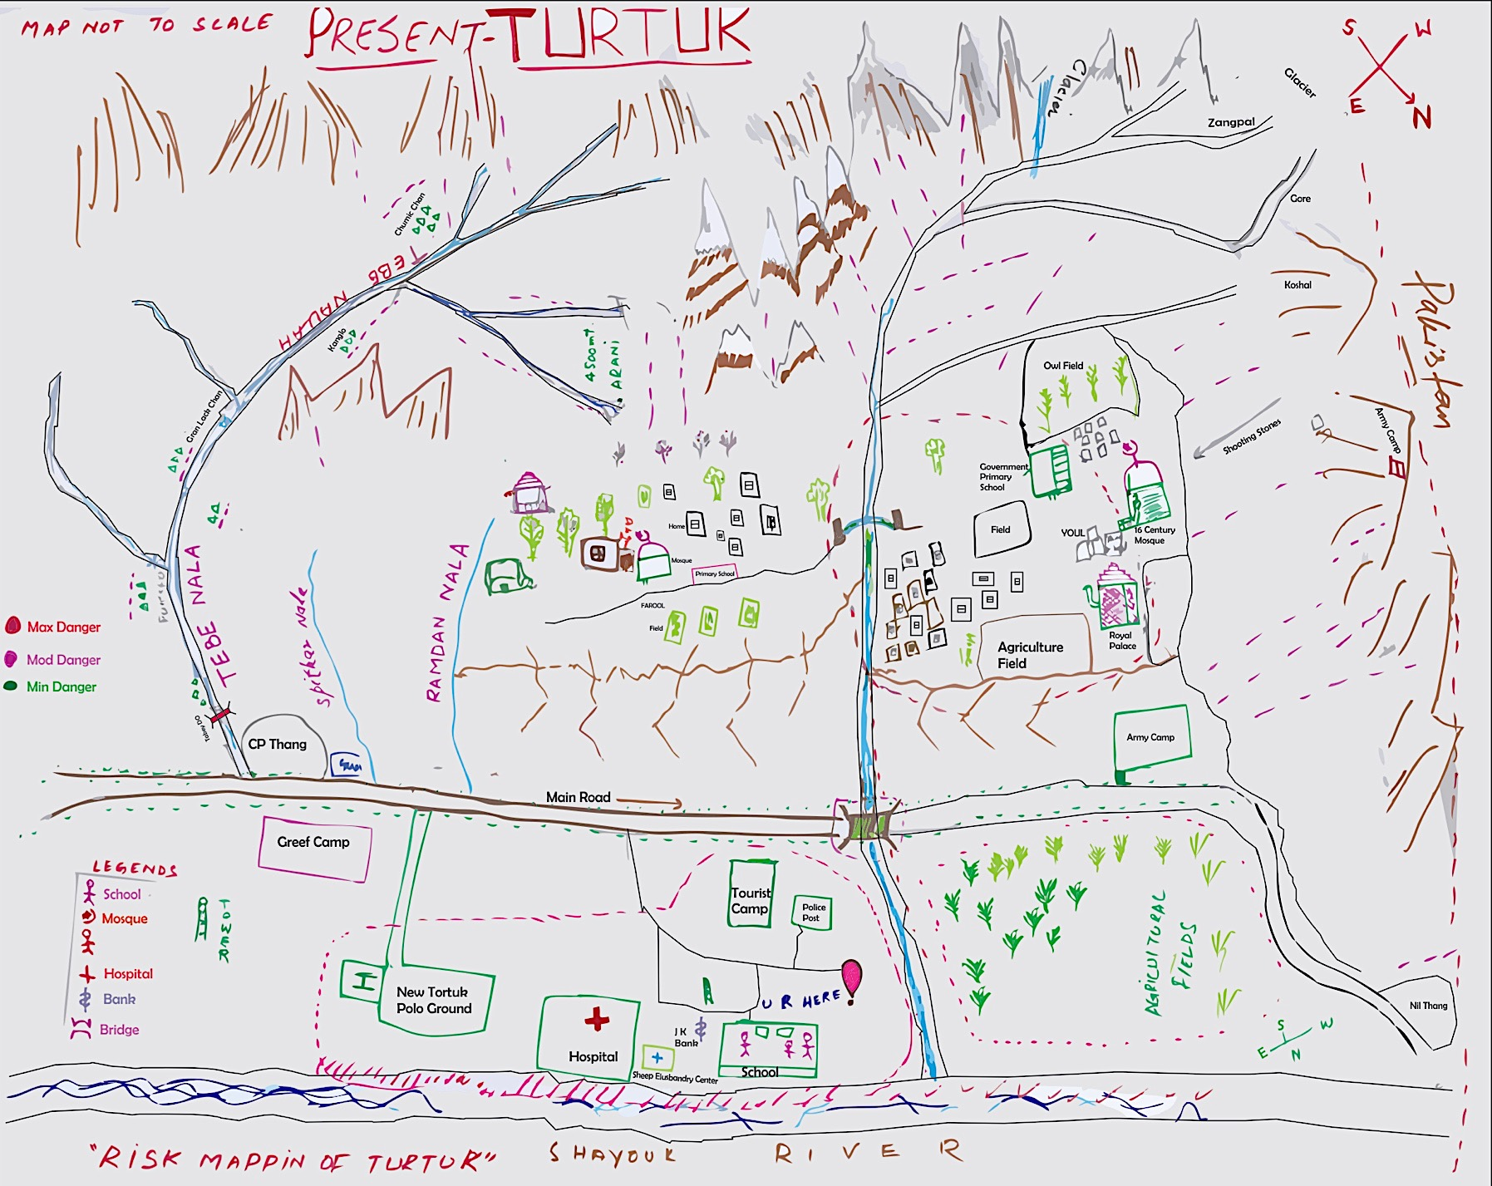
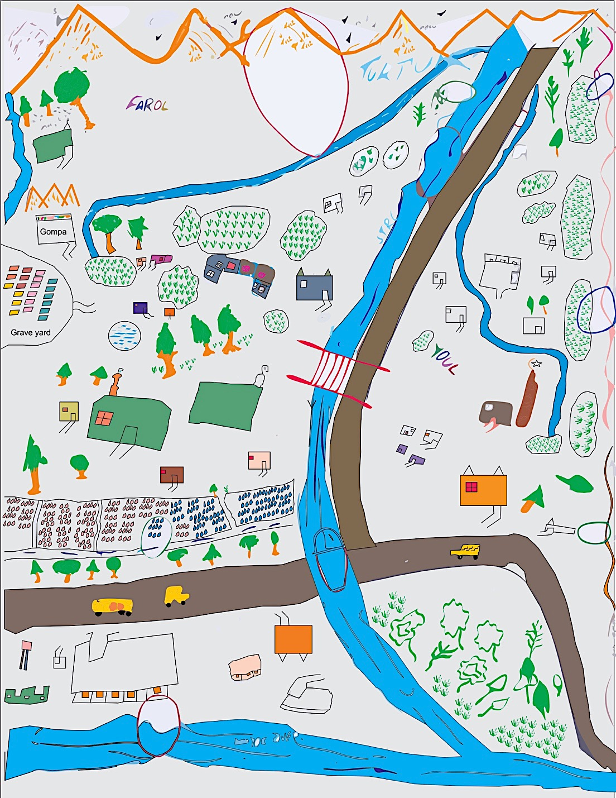
PRA Hazard Maps

Slide 14
Problems
Settlements in highly hazard-prone areas (increase risk due to absence of land-use planning)
Inappropriate building techniques and construction materials
Lack of alternative escape routes (dead-end valley)
Lack of critical facilities and equipment in case of a disaster (24h electricity, surgical unit, etc.)
Limited awareness of earthquake risks and adaptation measures
Limited family planning (rapid increase of population, infant mortality rate was high, etc.)
Exposure to multiple hazards not just in Turtuk, but along the main and only communication link

Slide 15
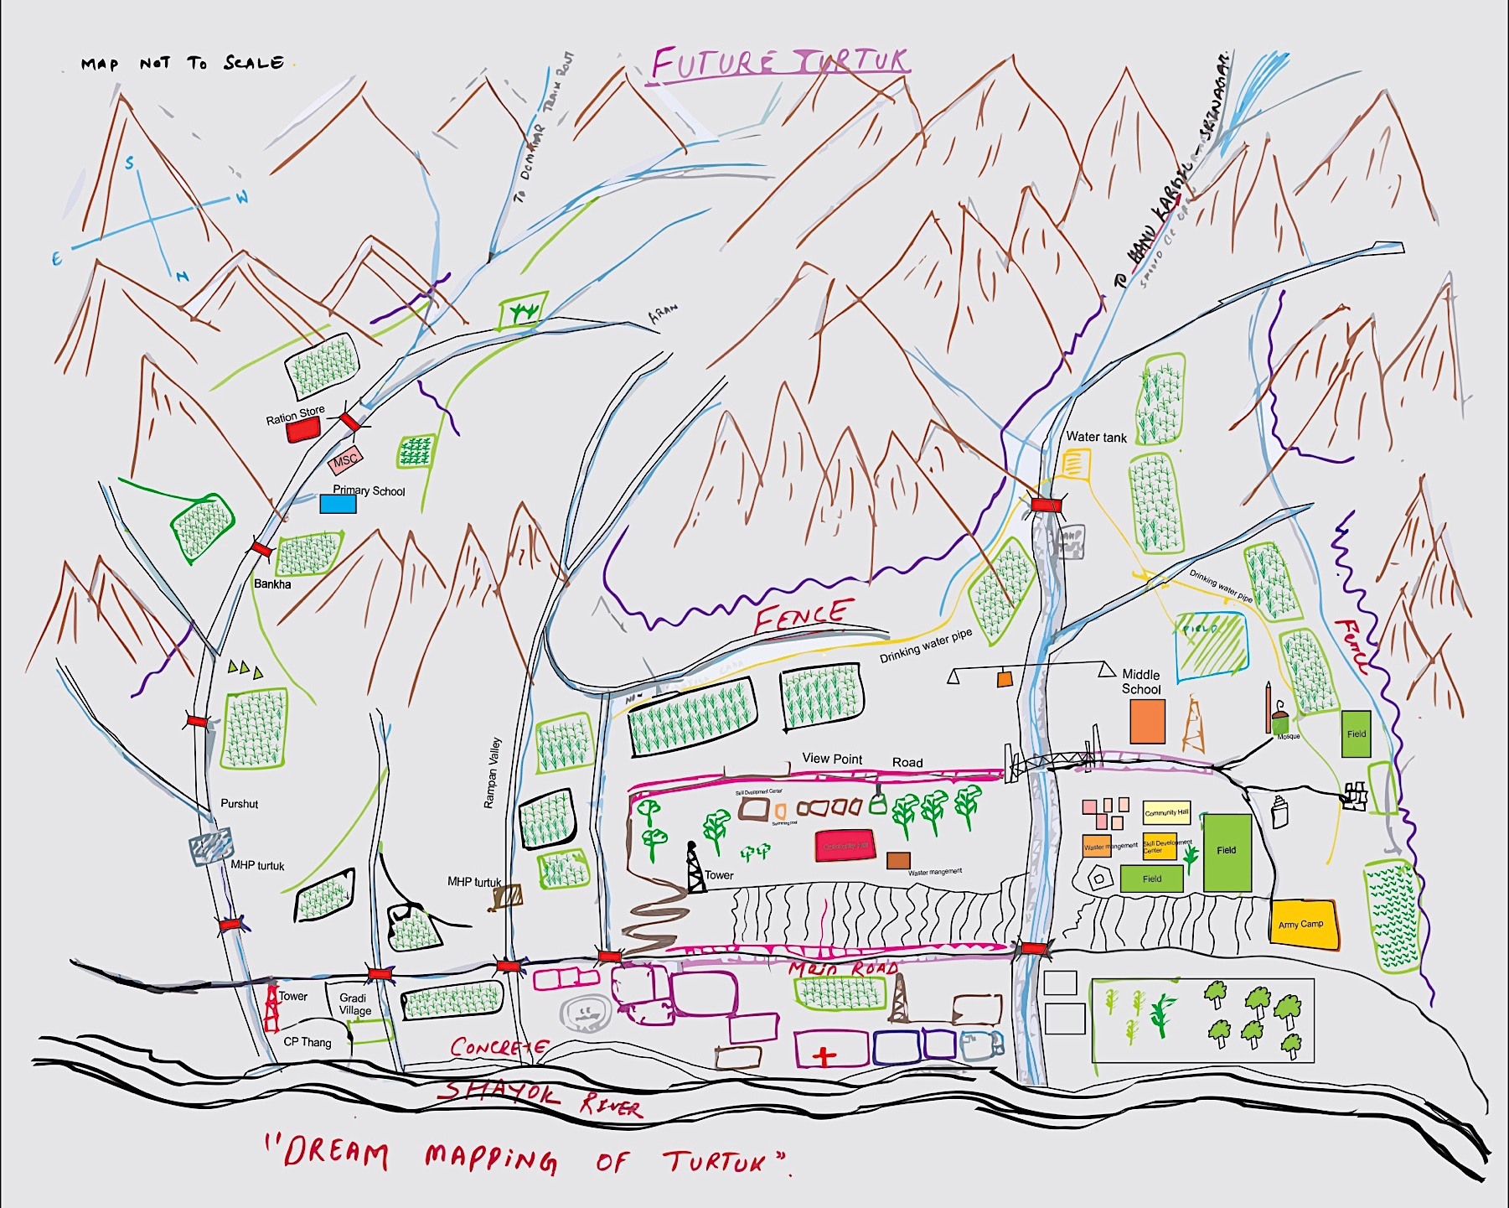
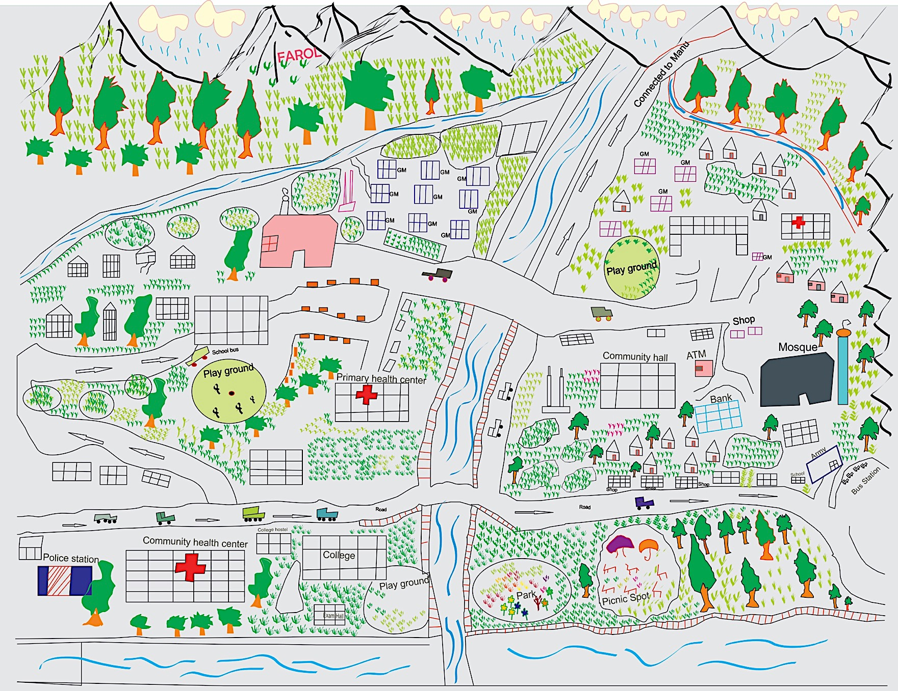
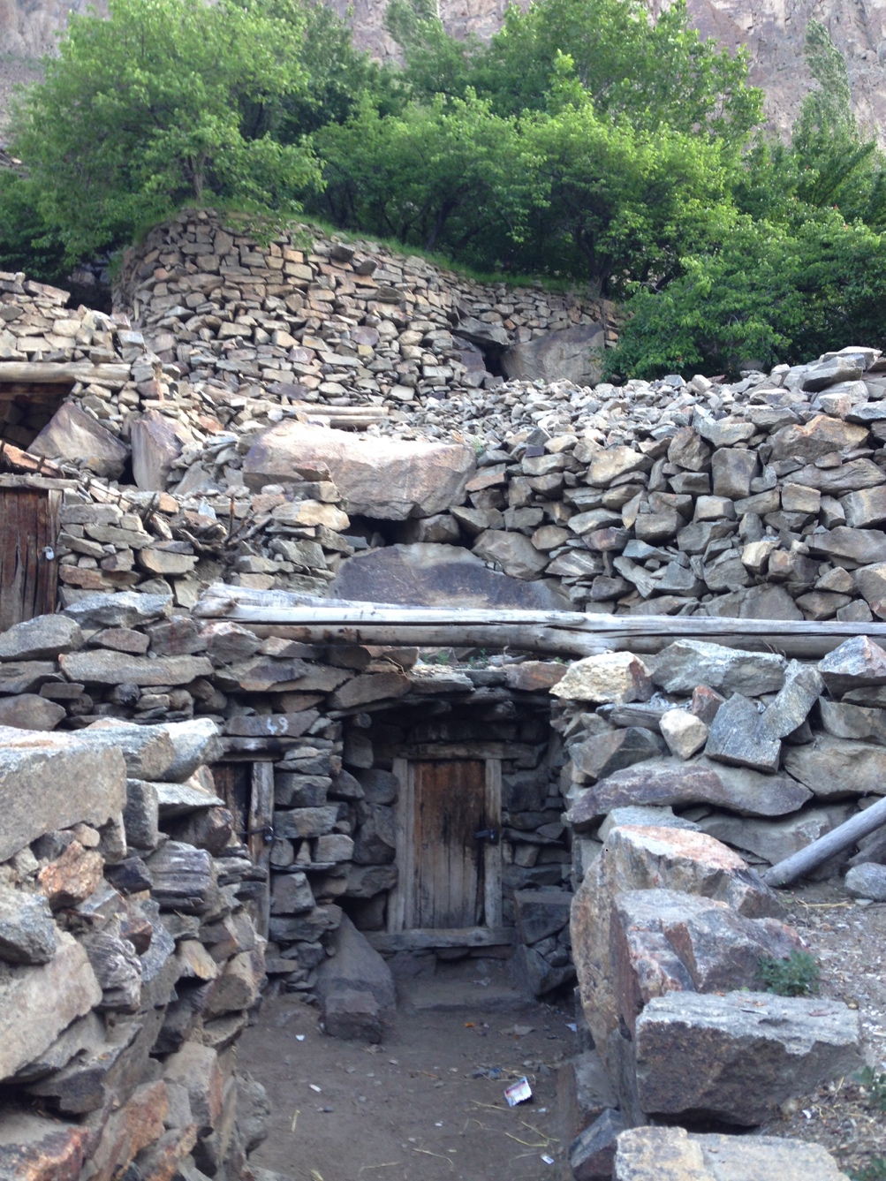
Dream Map

Slide 16
Capacity
Community solidarity in everyday life and during disasters
Local knowledge of past disaster events (which has limited new constructions along the main river banks)
Existing module on DRM in school curriculum (but limited follow up)
Presence and support from the Army (to provide relief, transport, communication BUT it also creates pollution)
Awareness of the importance of forest and vegetation coverage
The presence of the local doctor in the health centre
Willingness to invest in education, training and income generation activities

Slide 17
Thanks to –
The local people
Jammu Team
Indian Army
Facilitators
BAYES AHMED
Email: bayes.ahmed@ucl.ac.uk

