Slide 1
Community Risk Perception After the Mw7.8 Muisne Earthquake, Ecuador of 16 April 2016
BAYES AHMED, PhD
Research Associate, Institute for Risk and Disaster Reduction, University College London (UCL), UK

Slide 2
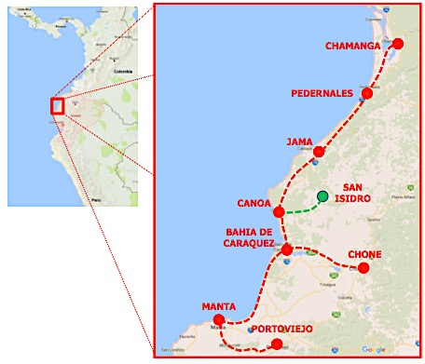
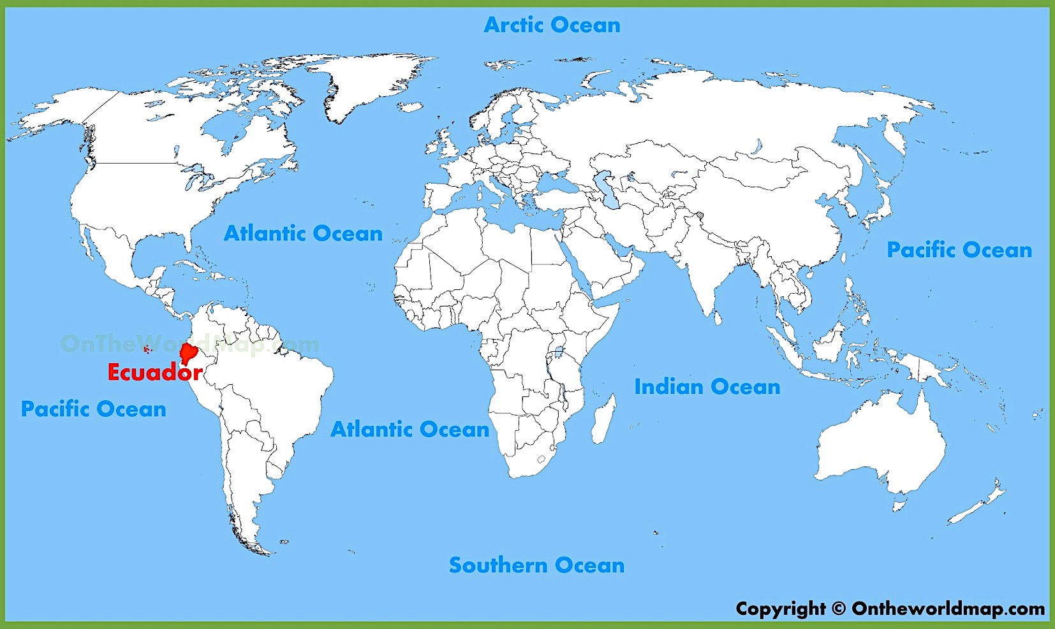
Mission
DATE | ACTIVITY
APRIL 16 | EVENT OCCURS
APRIL 22 | LEAD IDENTIFED
MAY 5 | TEAM IDENTIFIED
MAY 24-27 | TEAM ARRIVES
MAY 28-30 | MANTA PORTOVIEJO
MAY 31 | BAHIA CANOA
JUNE 1 | CANOA-JAMA SAN ISIDRO
JUNE 2-3 | PEDERNALES
JUNE 3-5 | CHAMANGA CANOA CHONE
JUNE 5-9 | MANTA PORTOVIEJO TEAM LEAVES
The Earthquake Engineering Field Investigation Team (EEFIT) – The Institution of Structural Engineers, UK

Slide 3
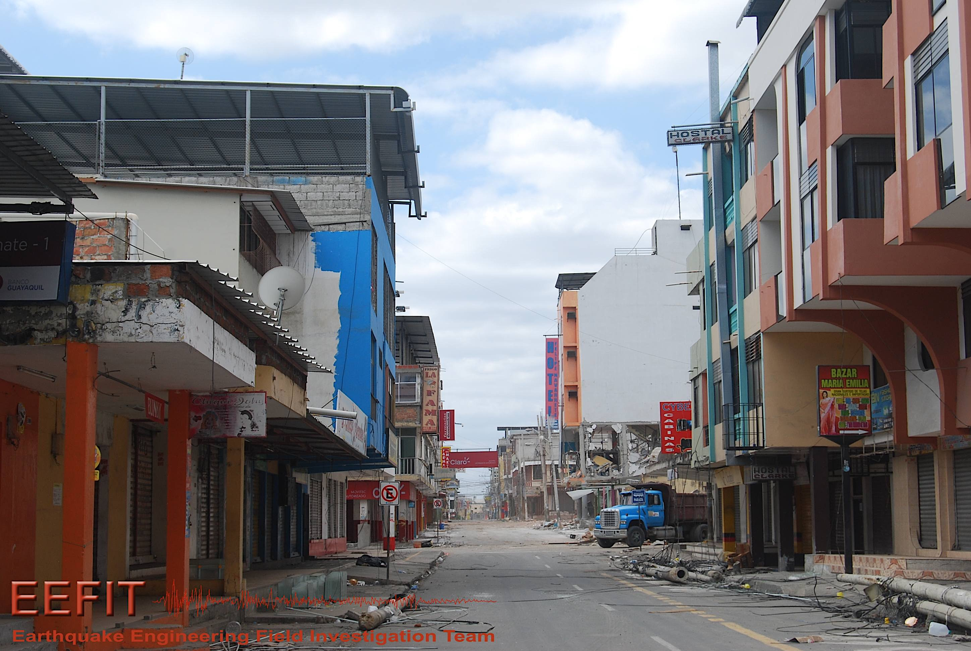
Impact
At least 676 people were killed and 16,600 people injured. The President declared a state of emergency; 13,500 military personnel and police officers were dispatched for recovery operations.

Slide 4
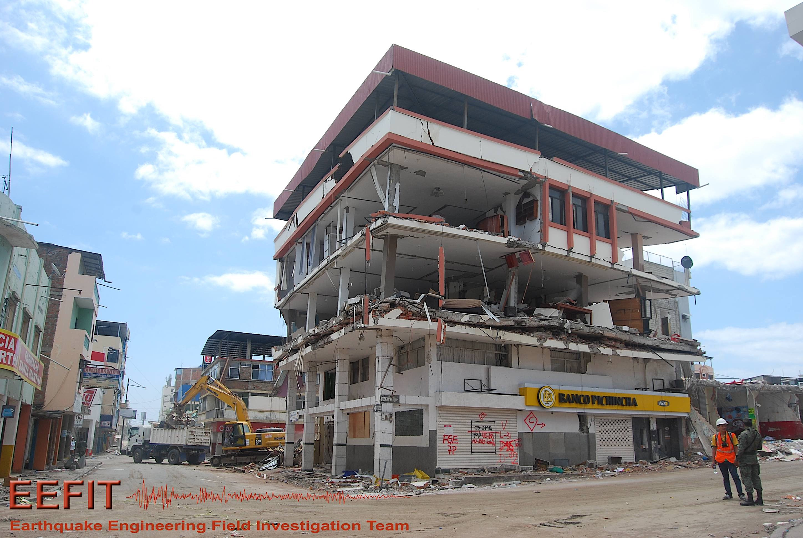
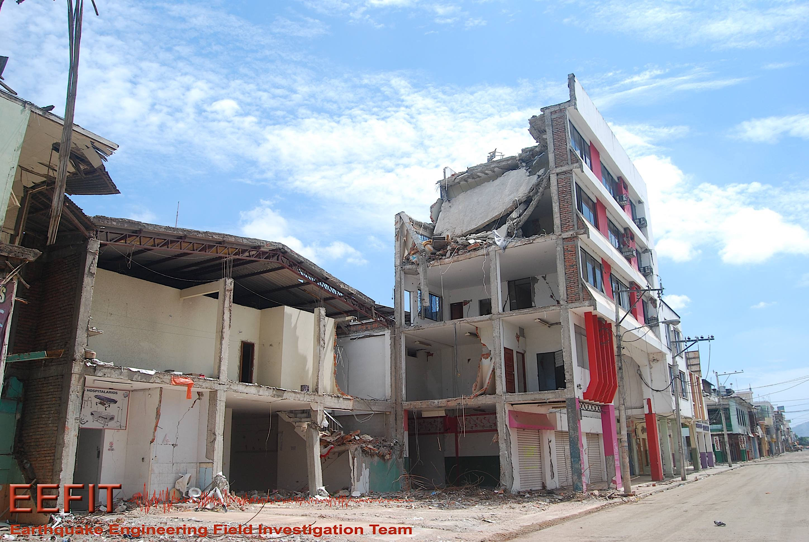
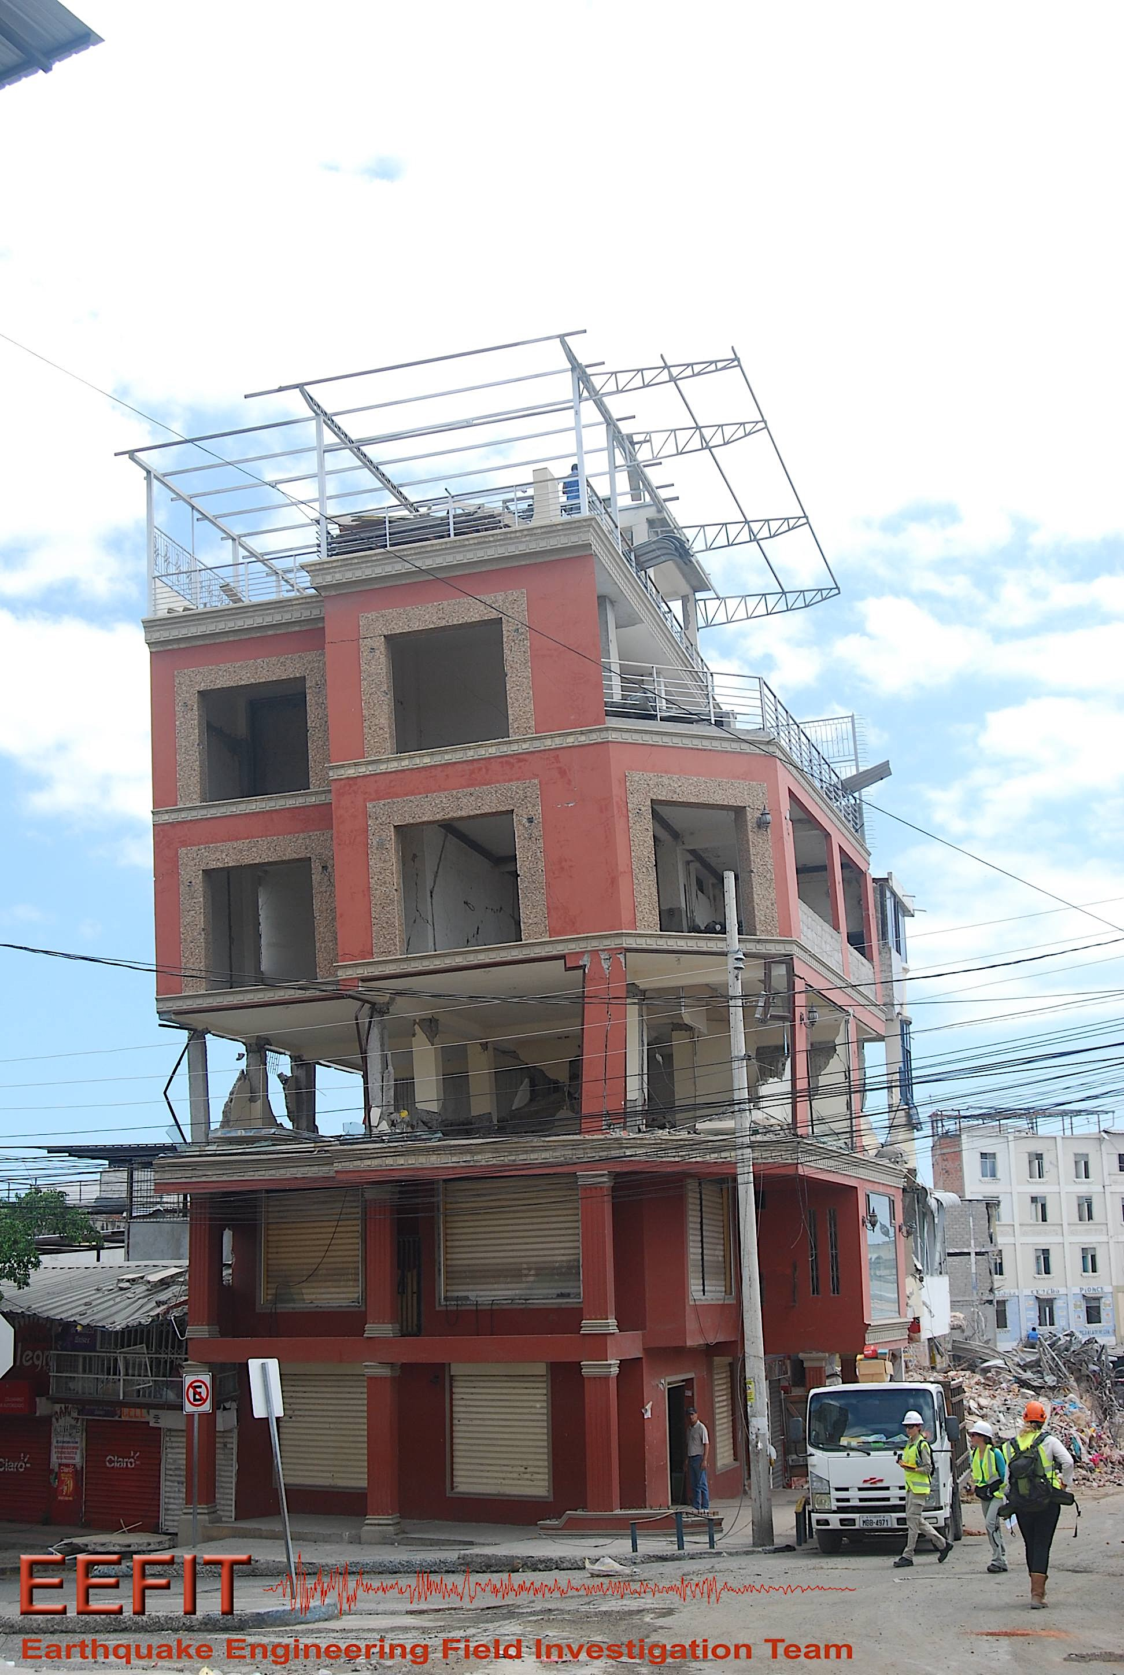
Damage

Slide 5
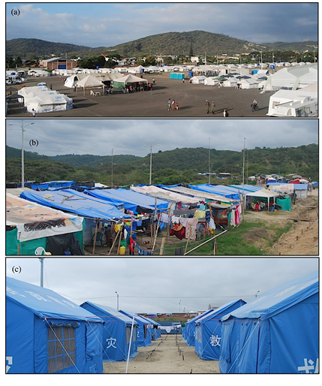
Rehabilitation and Post-Earthquake Crisis Management
PORTOVIEJO
Conduct qualitative observations on the shelter situation
Conduct preliminary interviews
Design a questionnaire on site adapted to the local situation
Total of 120 families surveyed
CANOA
PEDERNALES

Slide 6
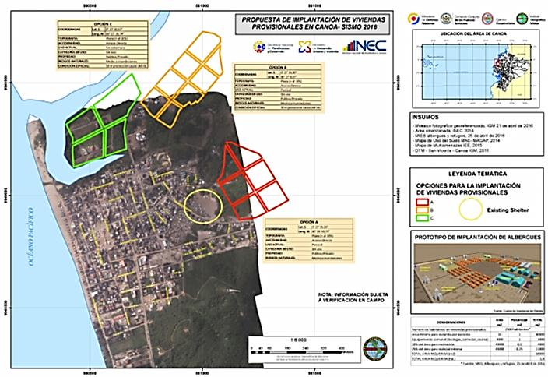
Canoa Temporary Housing Plans

Slide 7
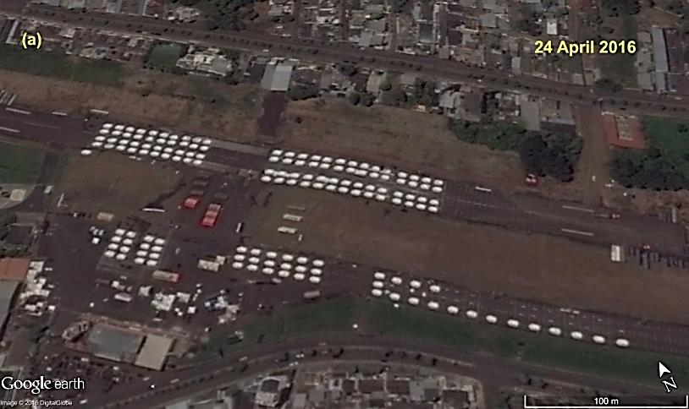
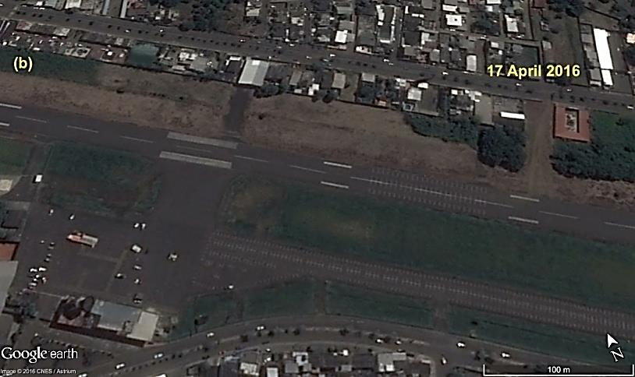
Before & After Scenarios

Slide 8
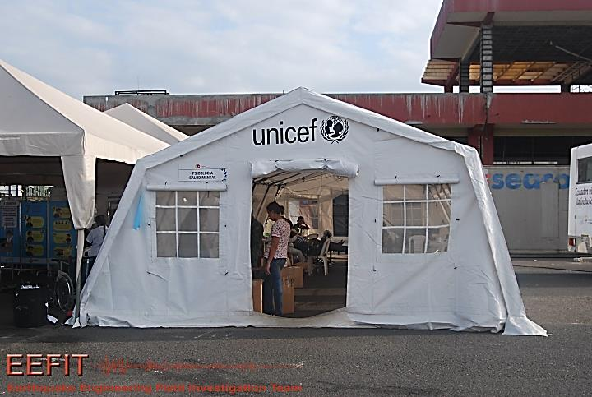
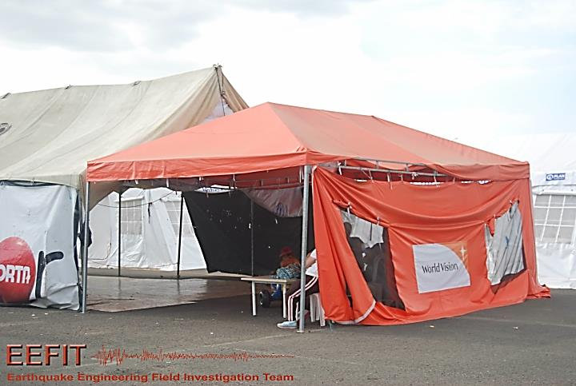
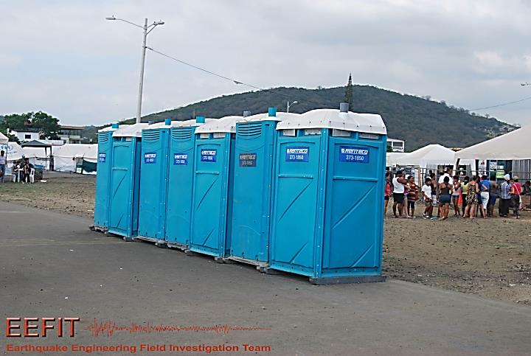
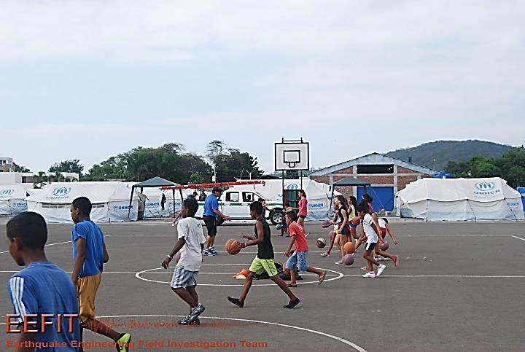
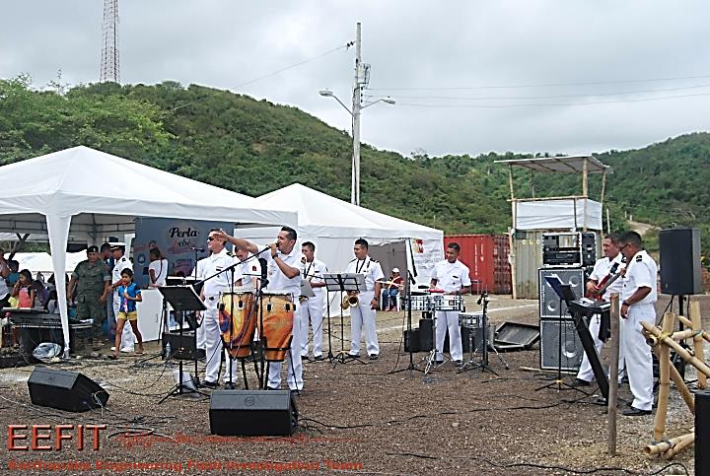
Camp Facilities

Slide 9
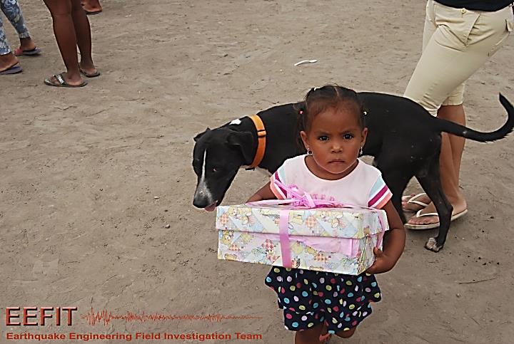
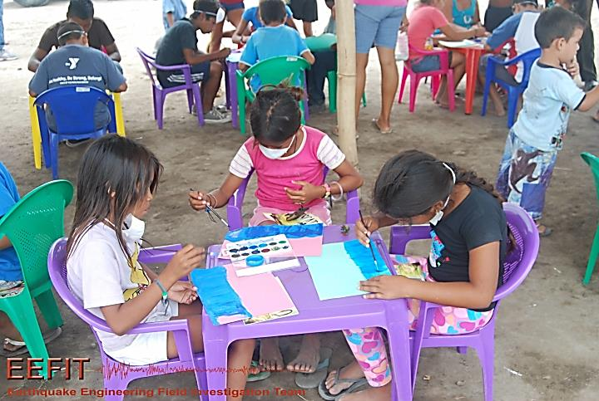
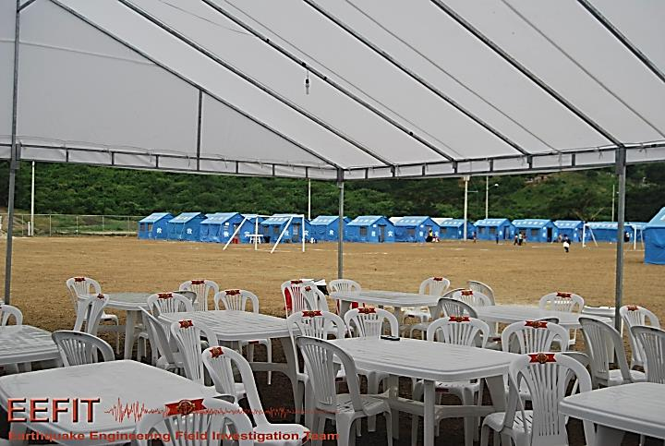
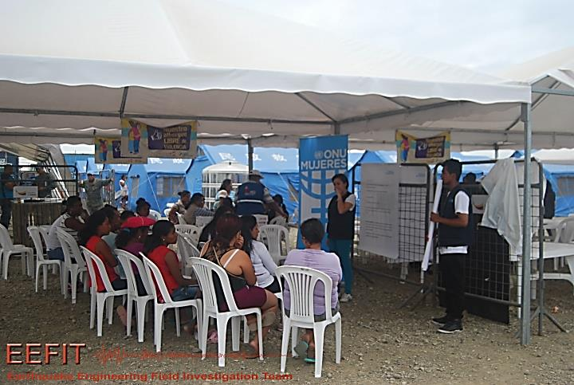
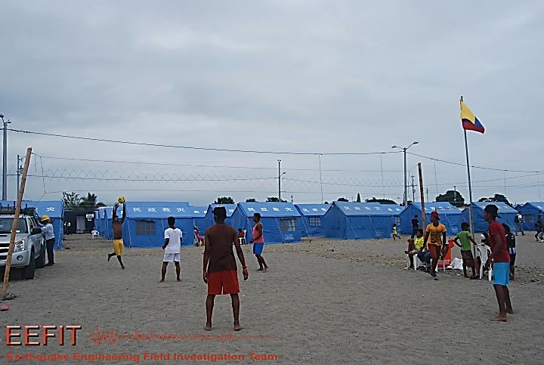
Camp Facilities

Slide 10
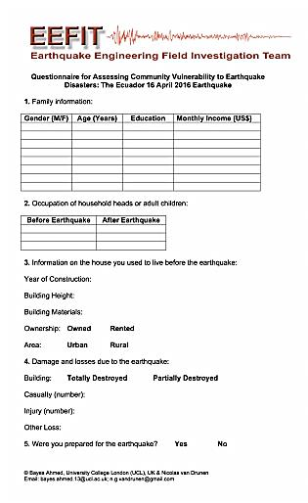
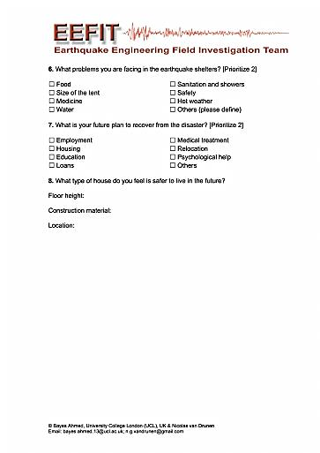
Questionnaire Design

Slide 11
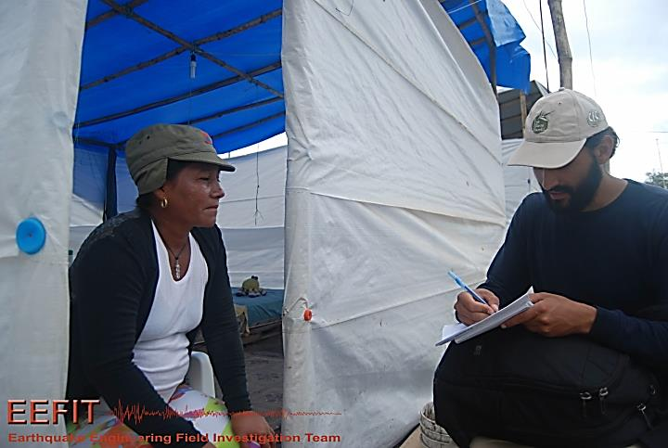
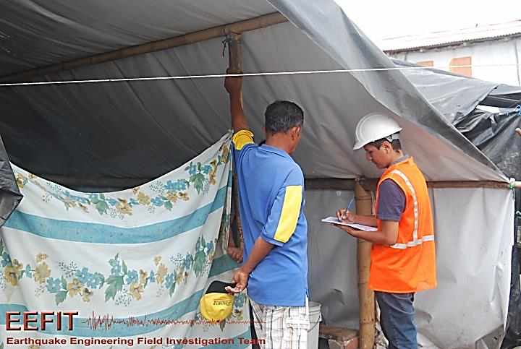
Questionnaire Surveying

Slide 12
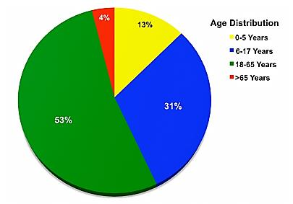
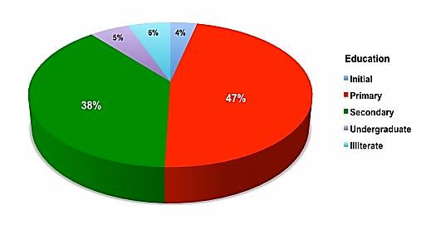
Age & Education
BY AGE
BY EDUCATION

Slide 13
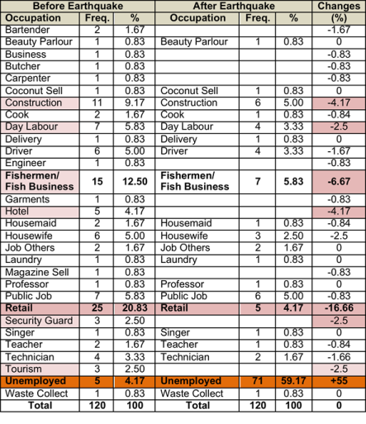
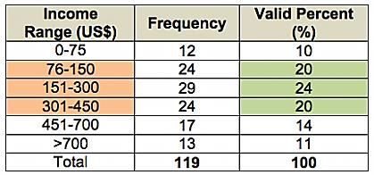
Income & Occupations
OCCUPATIONS
INCOME

Slide 14
Property & Preparedness
PROPERTY OWNERSHIP
DISASTER PREPAREDNESS

Slide 15
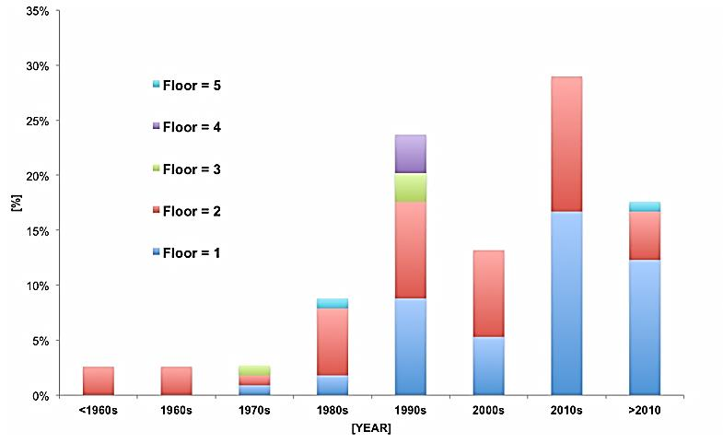
Dwellings

Slide 16
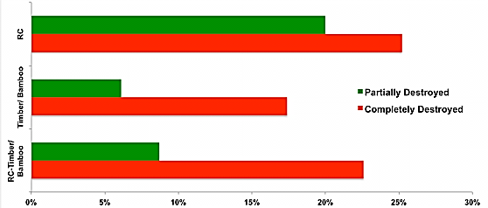
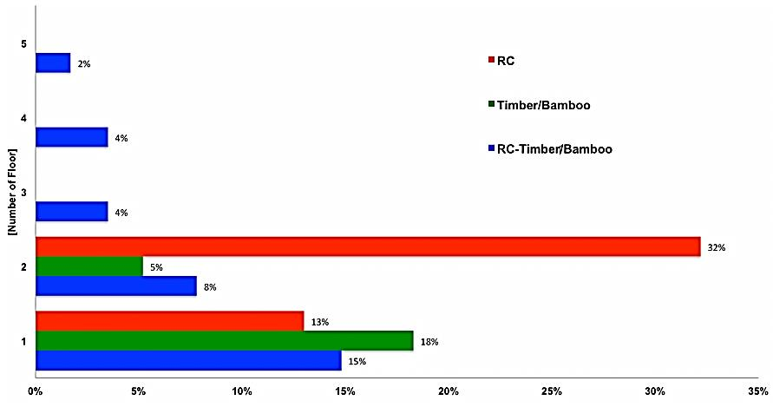
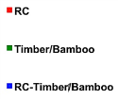
Construction Material

Slide 17
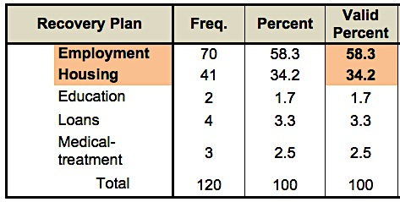
Recovery Plans

Slide 18
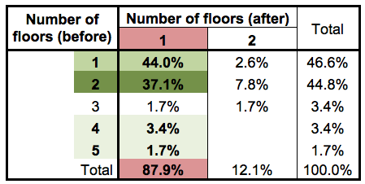
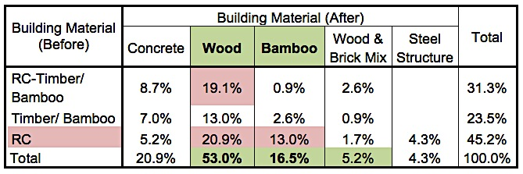
Reconstruction Strategy

Slide 19
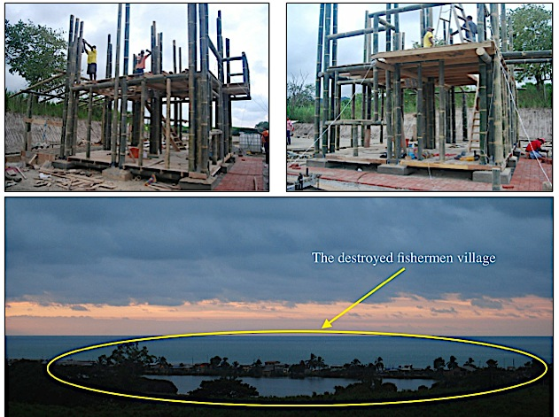
Reconstruction with Bamboo
Chorrera, Pedernales

Slide 20
Thank You!
Bayes Ahmed
Email: bayes.ahmed@ucl.ac.uk

