Slide 1
Welcome to the Presentation
Vulnerability 2 resilience
- Bangladesh
Presented by-
Bayes Ahmed
University College London (UCL)
19 April 2016

Slide 2
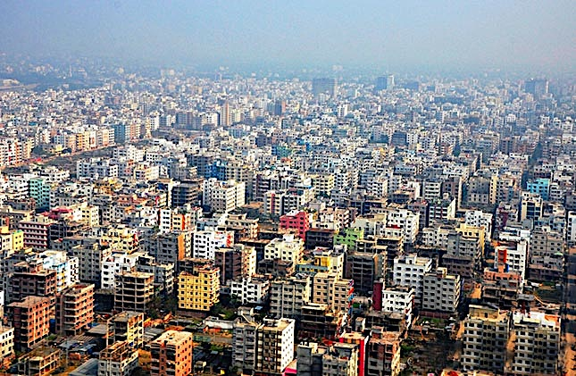
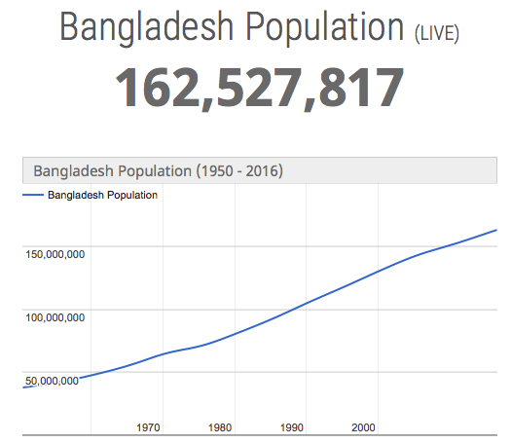
Bangladesh at a Glance
Population Density:
Bangladesh = 1,222 per Km² [9th in the world]
UK = 267 per Km²
[Source: The World Bank, 2016]

Slide 3
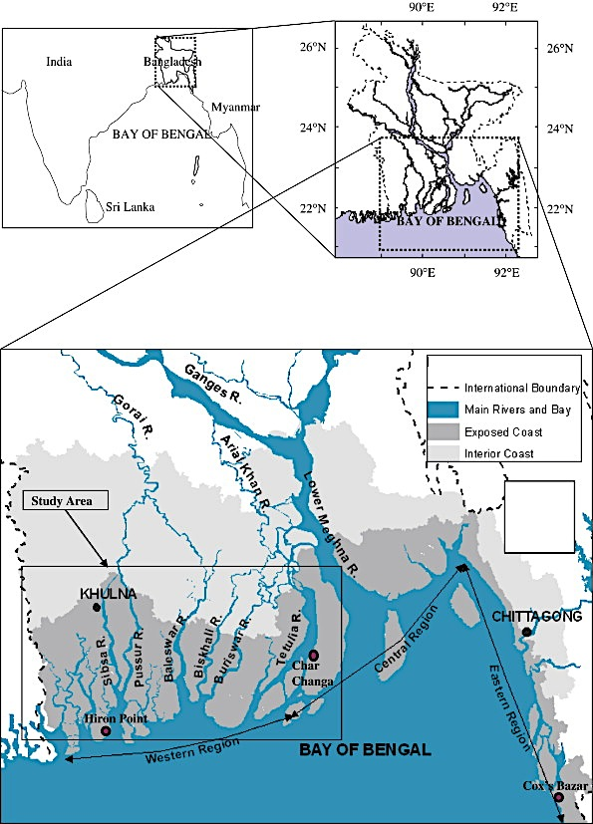
Coastal Region of Bangladesh
Bangladesh has 580 km of coastline boundary between the land area (including islands) and the sea ranking 102 in the world (CIA, 2016).
The coastal region or zone of Bangladesh is accommodating 28 million people with an average density of 853 per Km².
Most importantly, there is no place to go for this costal population. They are also dependent for Livelihoods!

Slide 4
Problem Identification
Bangladesh will be among the most affected countries in South Asia by an expected 2°C rise in the world’s average temperatures in the next decades, with rising sea levels and more extreme heat and more intense cyclones threatening food production, livelihoods, and infrastructure as well as slowing the reduction on poverty (The World Bank, 2013).
Bangladesh is ranked as the world’s 6th most disaster prone country. In recent time (from 1994-2013), at least 24,376 people were killed and 129 million people were reportedly affected by disasters in Bangladesh (World Disasters Report, 2014).
The dominating disasters were cyclones and associated storm surges in the coastal region of Bangladesh.

Slide 5
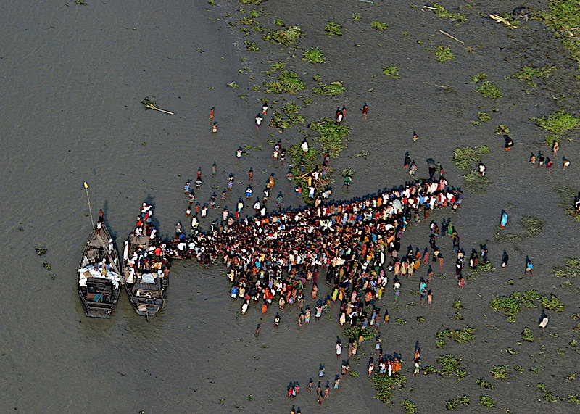
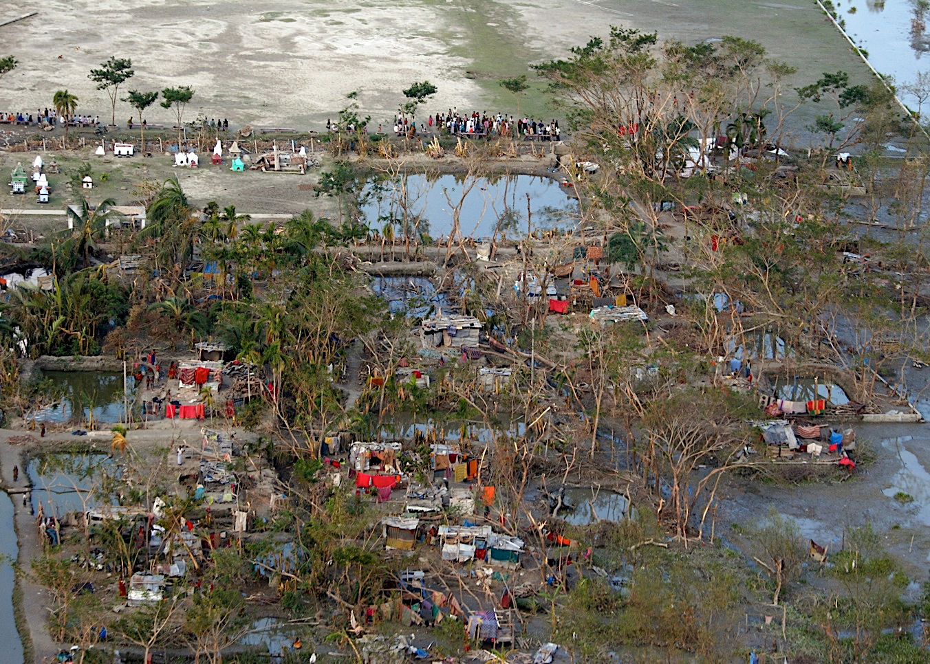
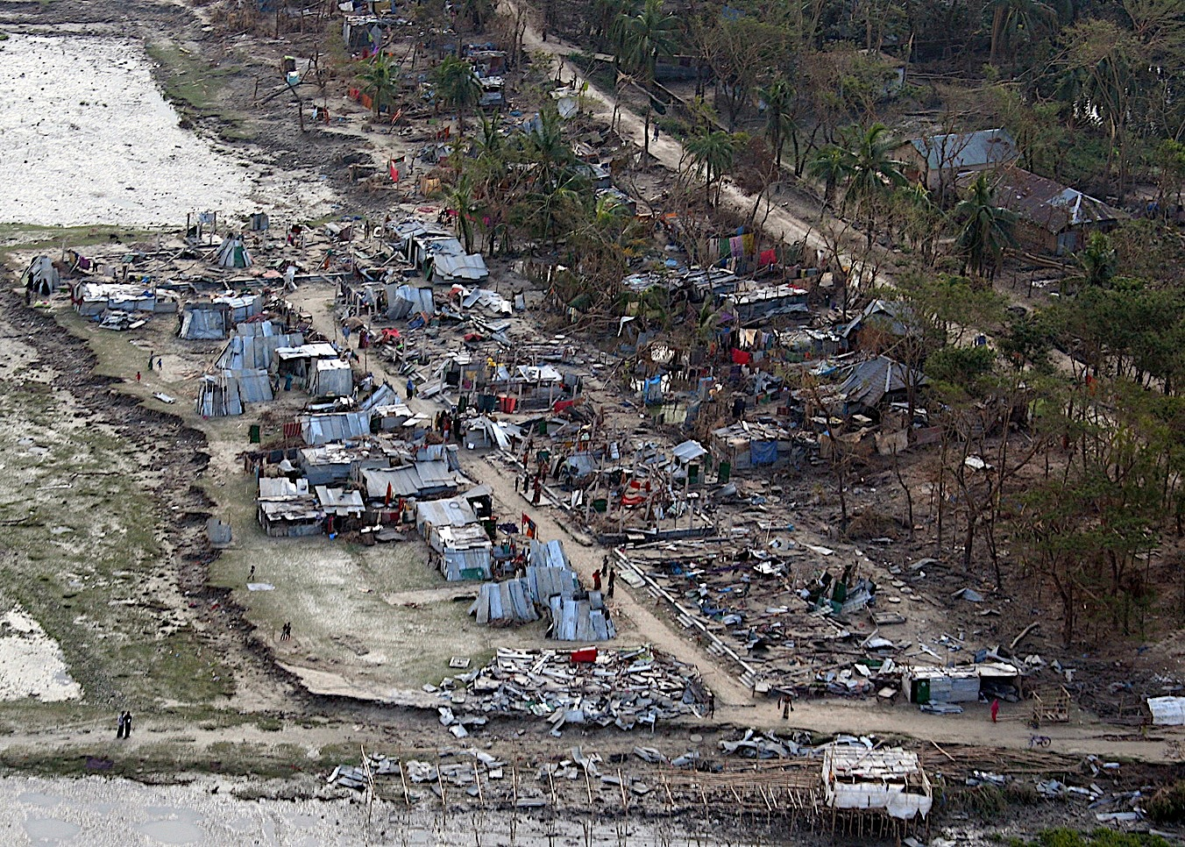
Cyclone Sidr Devastation (November 2007)
While climate change is expected to increase the intensity of Bay of Bengal cyclones, it is also expected to decrease frequency. This change could increase vulnerability, if people experience fewer cyclones, so they are less prepared--and then experience one which is more intense.
Wind speeds = 240 km/hour
Tidal wave = 6 meters
Human casualties = 3,406
Missing = 1,001
Injured = over 55,000
Houses damaged/destroyed = about 2.3 million
Cropland = 2.5 million acres
Affected = around 8.9 million people,
Damages and losses = US$ 1.7 billion.
Source: US Navy

Slide 6
Vulnerability to Resilience (V2R) Programme
Barguna and Patuakhali districts sit on the coast of the Bay of Bengal and are exposed to tropical cyclones which bring storm surges.
Most of the population in these areas depends on agriculture and fishing for their livelihoods. These areas were badly affected by super cyclone Sidr in 2007 and cyclone Aila in 2009.
Before 2007, the 52% poverty rate in this region, called Barisal, was already the highest in the country, where the national average was 40%. For example, in Kalapara sub-district of Patuakhali district 64.50% of population are rated to live in extreme poverty [Bangladesh Bureau of Statistics, 2005].

Slide 7
Vulnerability to Resilience (V2R) Programme
The goal of the V2R project is to reduce vulnerability and increase resilience of target communities by supporting strategies that enable them to prepare for, mitigate, and respond to multiple hazards.
Its covering 27 communities in 2 districts in South West Bangladesh: Barguna and Patuakhali.
The inception phase of this particular V2R programme ended on 31 December 2012 leading to a 3.5-year implementation period which concludes on 30 April 2016.

Slide 8
Objectives of this Study
Team: Dr. Ilan Kelman & Bayes Ahmed from UCL; with BRC Dhaka Office assisted in fieldwork.
The project objectives are:
To measure whether the selected communities have achieved the resilience characteristics set out by V2R.
To conduct a cost-benefit analysis for the V2R intervention.
To analyse V2R’s impact on the communities in terms of DRR and Sustainable Livelihood.

Slide 9
Study Area
It is a pilot study conducted on two highly vulnerable communities in Patuakhali district.
Nowapara and Pashurbunia communities are selected for this research because of their extreme geographical location (i.e. close to Bay of Bengal), economic instability (i.e. living behind poverty line) and vulnerability to cyclone disasters.
The communities are located about 0-30 cm above Mean Sea Level (MSL) and are protected by an embankment. Early warning is not effective here in case of sudden embankment damage due to heavy rainfall or tidal waves.

Slide 10
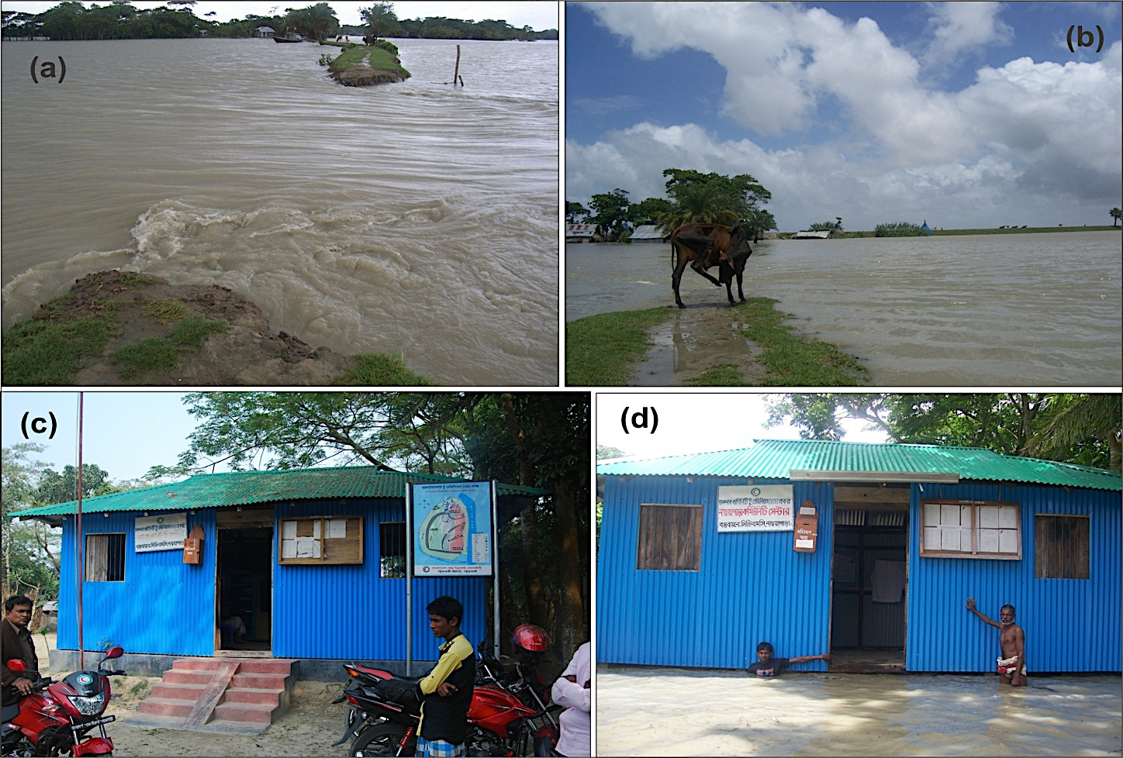
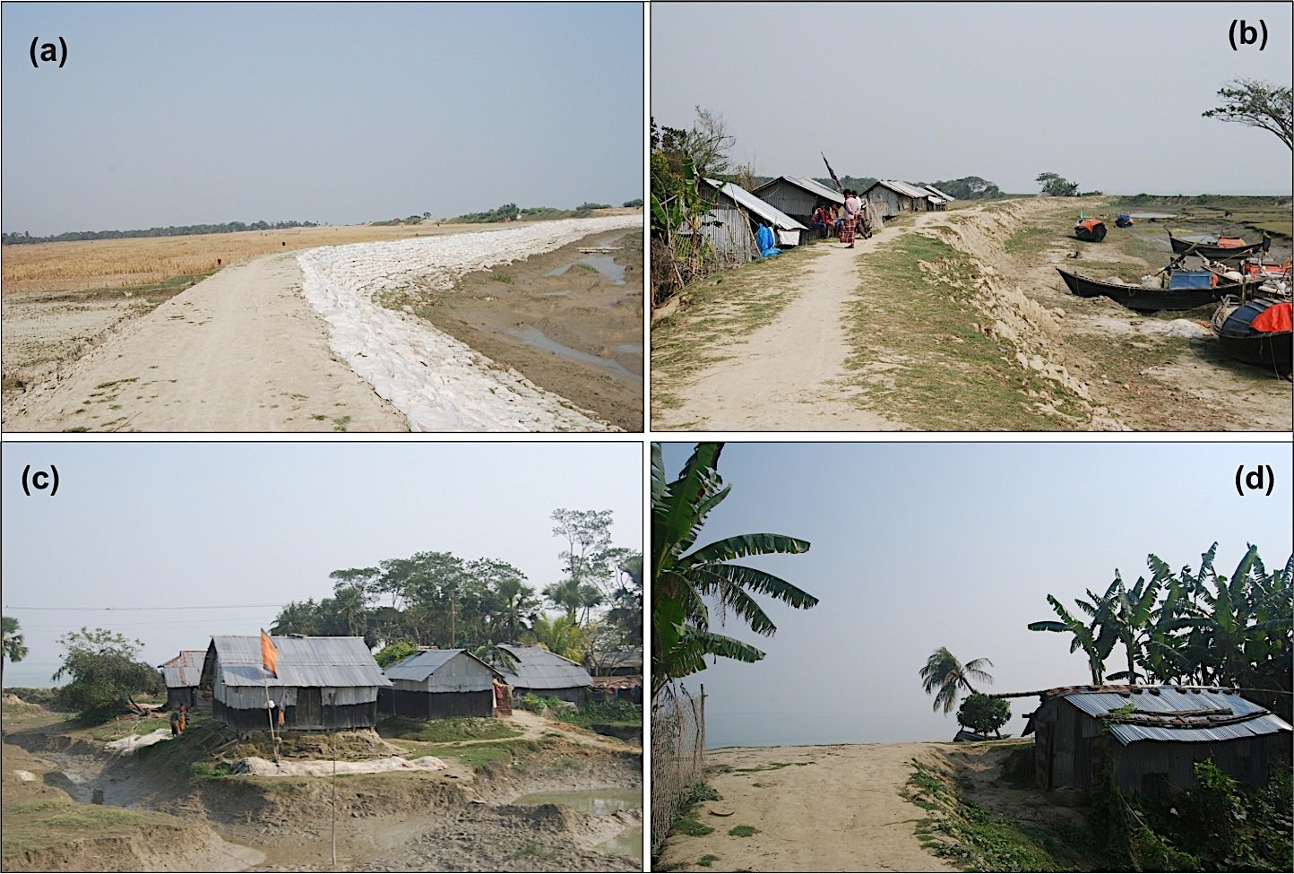
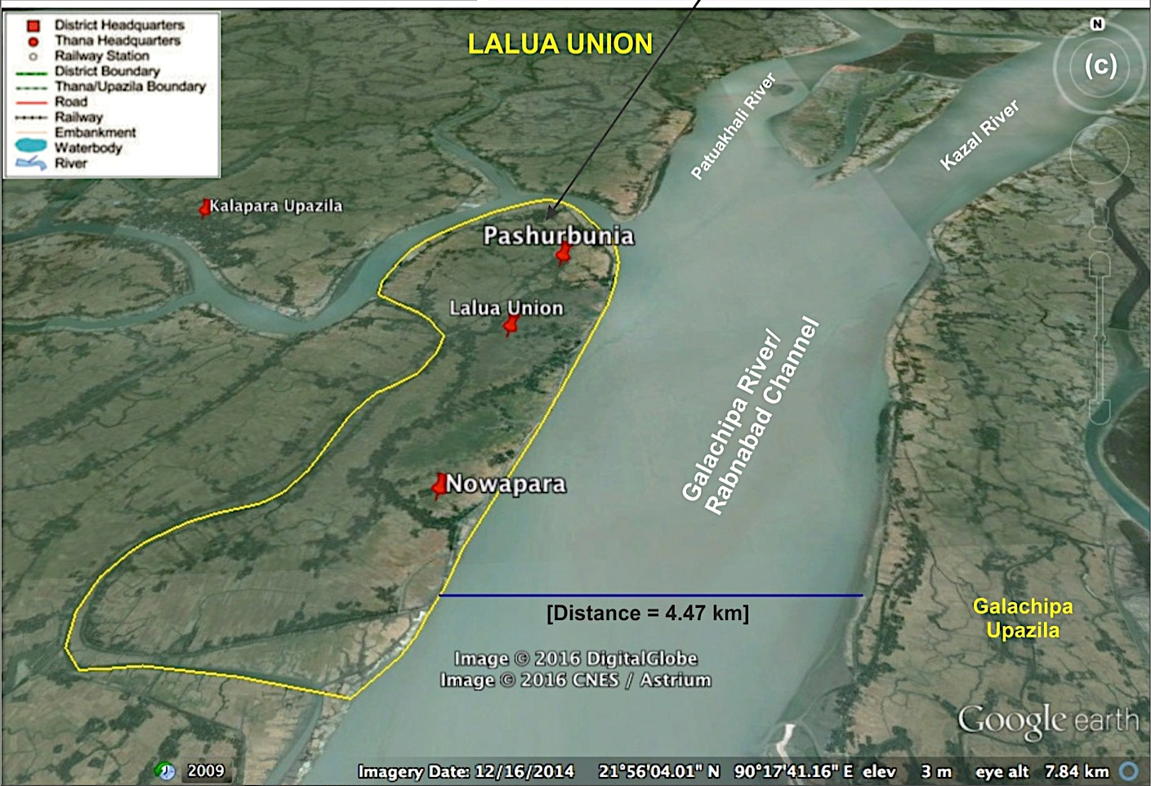
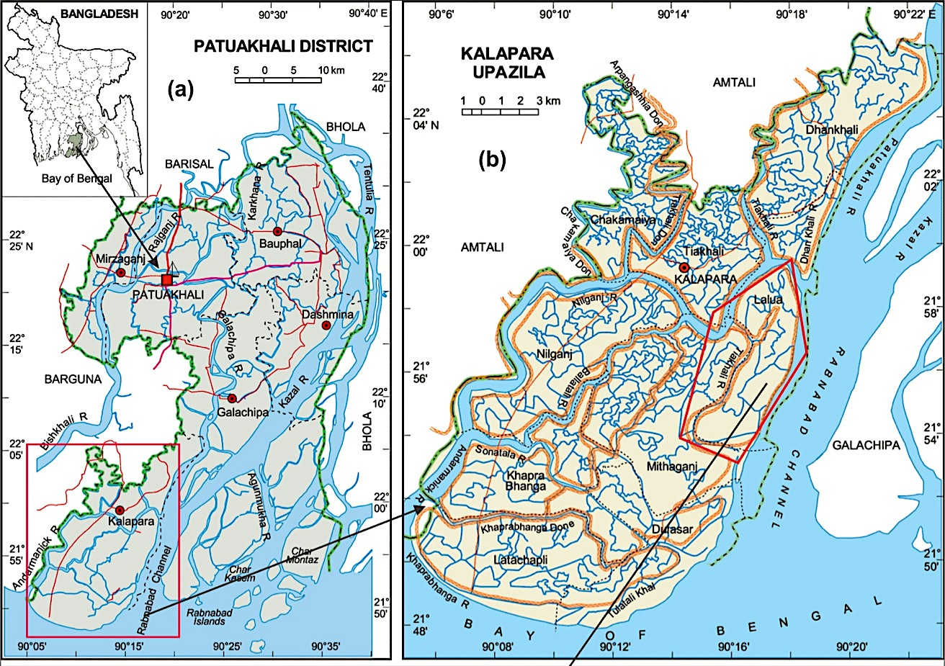
Study Area
Flood- 2014

Slide 11
V2R Project Activities
The V2R project consists of three major sub-components:
Livelihood,
Water, Sanitation and Hygiene (WASH); and
DRR.
Under the sub-components a range of activities were carried out: e.g. cash for work (for construction of community access road), cash for starting poultry, fishery, vegetation and grocery business; and buying animals, sewing machine etc.; establishment of sanitary latrine and tube-wells, provided safety equipment for the fishermen etc. Technical and market access trainings were provided to all producer groups with respect to their particular specialism. Other workshops and training were conducted to enhance the capacity.

Slide 12
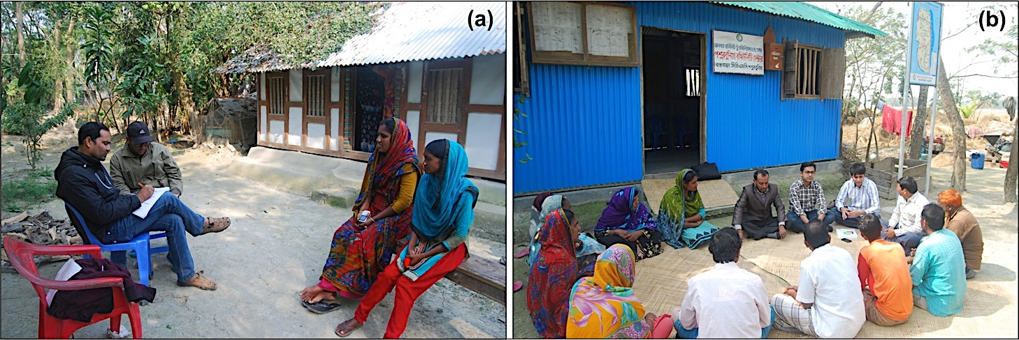
Surveying Method
A total of 90 households (i.e. 10% sampling and 45 from each community) were surveyed using stratified random sampling method. In addition, community-based focus group discussions were conducted in each community to collect generalized information about the project intervention and get ideas on non-monetary/ indirect benefits.

Slide 13
Results – Highlights
Average family size = 4
We performed a before and after scenario analysis (2013-2016) considering 35 parameters of changes.
Number of school going pupil has increased by 55.22%.
Secondary earning sources have increased dramatically (67.77%) .
The total value of household assets and agricultural products has increased 222.65%.

Slide 14
Results – Highlights
40% of households are now (in 2016) earning within the range of £55 - £80 that was only 8.89% back in 2013.
Most of them (63.33%) now go to the Govt. line departments for advice on agriculture, livestock and fisheries etc. This figure was only 4.44% in 2013.
87.78% households own a sanitary latrine and the rest use shared latrine. In 2013, only 42.22% households had latrines and mostly (remaining 43.61%) used to defecate openly.
85.56% of households dispose of their household waste in refuse pit. The figure was only 2.22% in 2013.

Slide 15
Results – Highlights
75.82% of households confirmed that there are not facing any water-borne diseases anymore that was only 20.41% in 2013.
88.89% of households were affected by disasters in the past 3 years.
98.89% of households now get early warnings for all the disasters. This figure was 73.33% in 2013 (i.e. 25.56% increment). Now the community people are mostly getting reliable warnings (48.18%) from the CDMC committee.

Slide 16
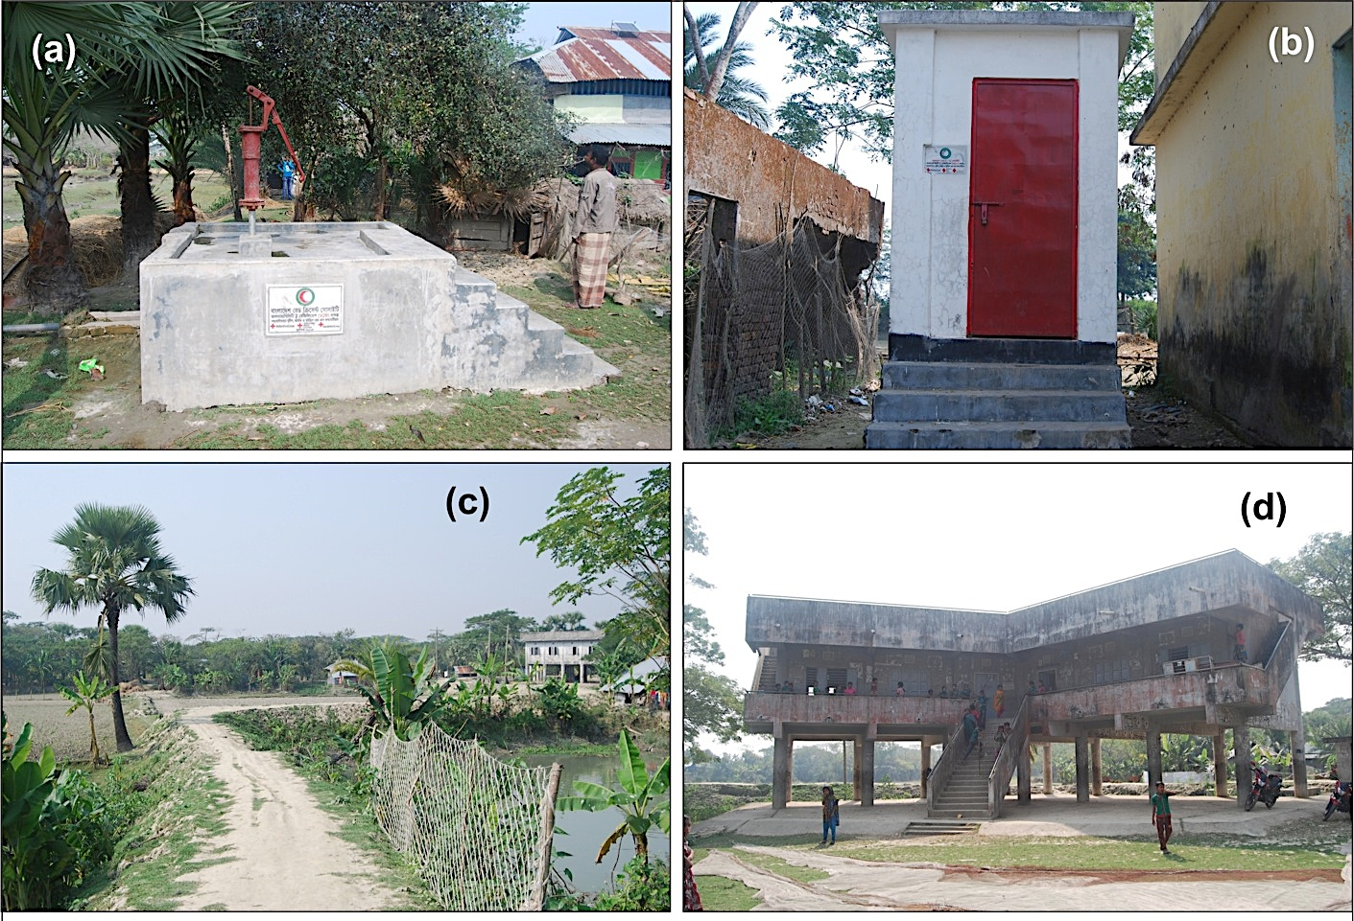
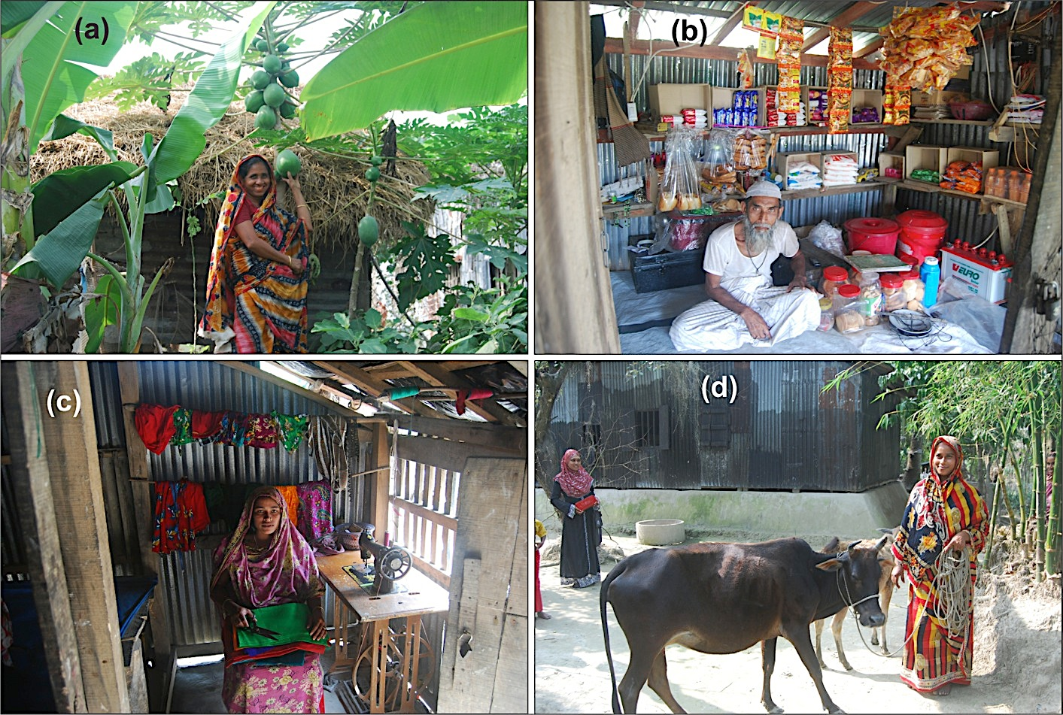
Results – Highlights
After getting early warnings:
73.33% households go to nearby cyclone shelters (i.e. 17.77% increment), 13.33% go to well-constructed public schools (6.66% increment), and 13.33% take shelter in raised plinths (was 0% in 2013).
Previously, 24.44% people used to stay at home and 11.11% used to go to relatives house after getting early warning. Now the figure is 0%.
It means the community people are now more aware of where to take shelter in emergency situation.

Slide 17
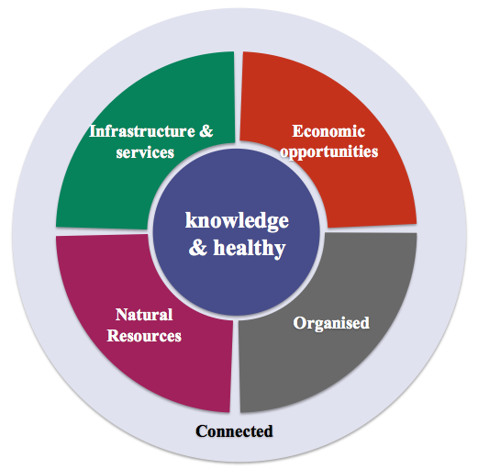
Community Resilience
The IFRC defines resilience as, “the ability of individuals, communities, organizations or countries exposed to disasters, crises and underlying vulnerabilities to anticipate, prepare for, reduce the impact of, cope with and recover from the effects of shocks and stresses without compromising their long-term prospects.”
Six characteristics of a safe and resilient community:

Slide 18
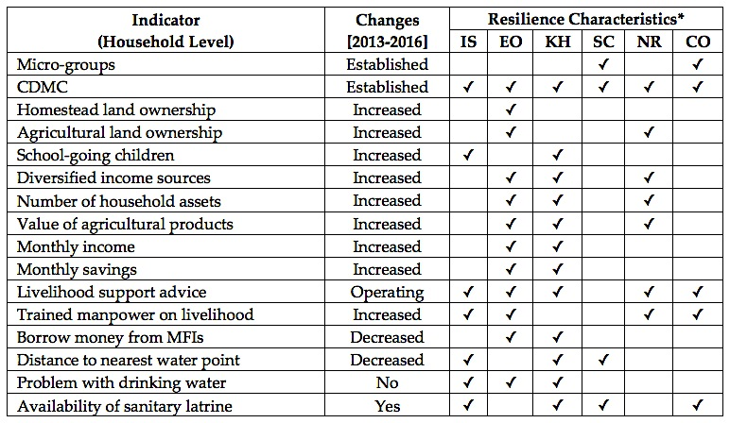
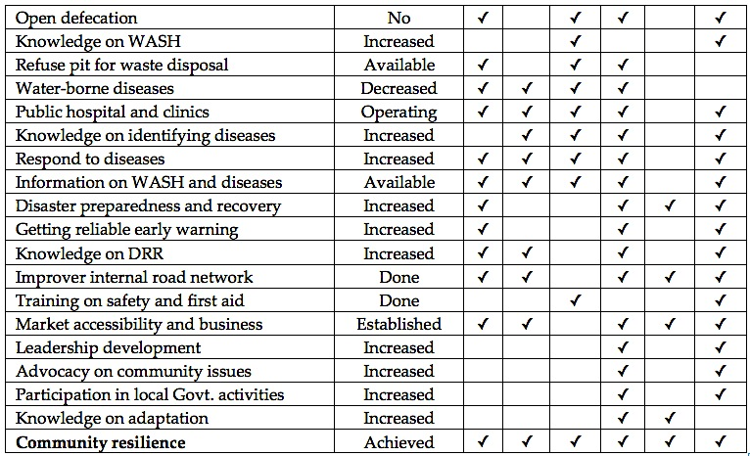
Community Resilience
*IS = Accessible Infrastructures & Services; EO = Economic Opportunities; KH = Knowledgeable, Healthy & Meet Basic Needs; SC = Socially Cohesive/ Organized; NA = Managing Natural Assets; and CO = Connected.

Slide 19
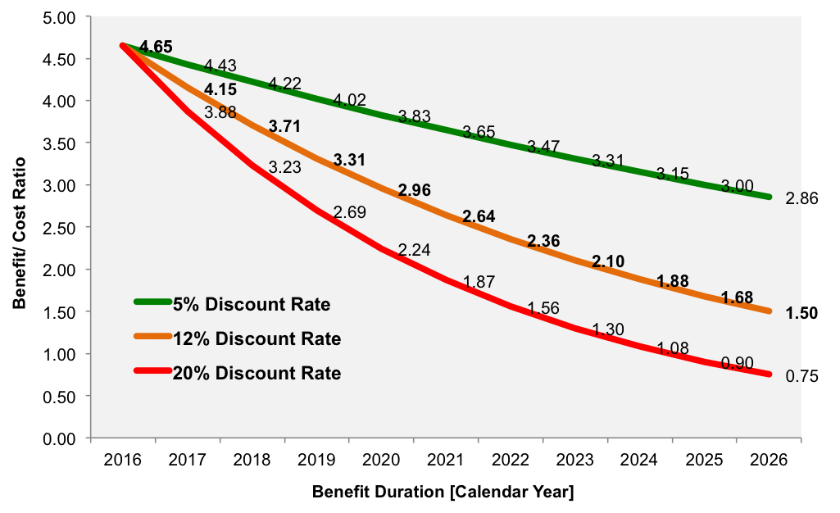
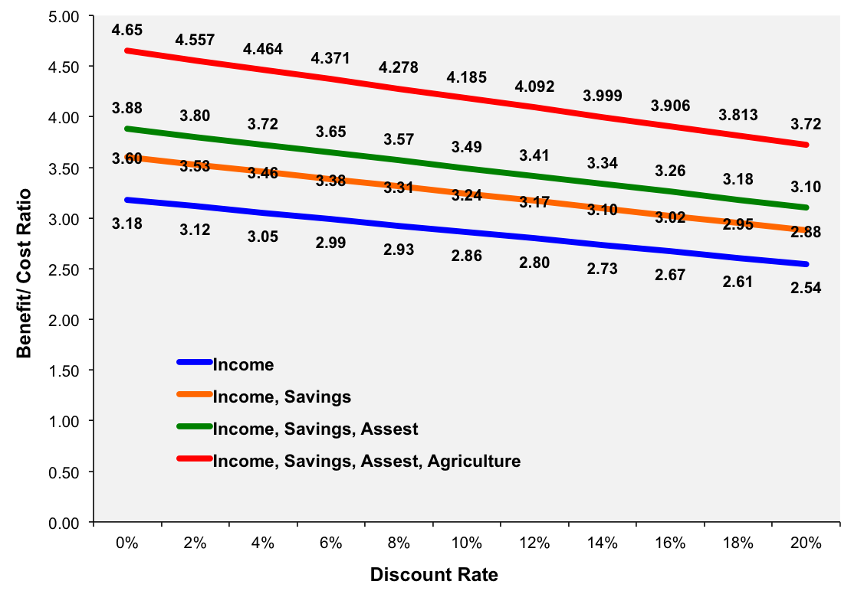
Cost-Benefit Analysis
Average cost per household = 8640000/ 900 = 9,600 BDT. The BCR is calculated considering four different scenarios (increment) as follows:
(a) Considering Household Income
Avg. yearly income for each household = 30532.20 BDT
BCR = 30532.2/9600 = 3.18
(b) Considering Household Income and Savings
Avg. yearly income for each household = 34582.86 BDT
BCR = 34582.86/9600 = 3.60
(c) Considering household income, savings and asset values
Avg. yearly income for each household = 37266.92 BDT
BCR = 37266.92/9600 = 3.88
(d) Considering Household Income, Savings, Asset and Agricultural Product Values
Avg. yearly income for each household = 44671.92 BDT
BCR = 44671.92/9600 = 4.65.

Slide 20
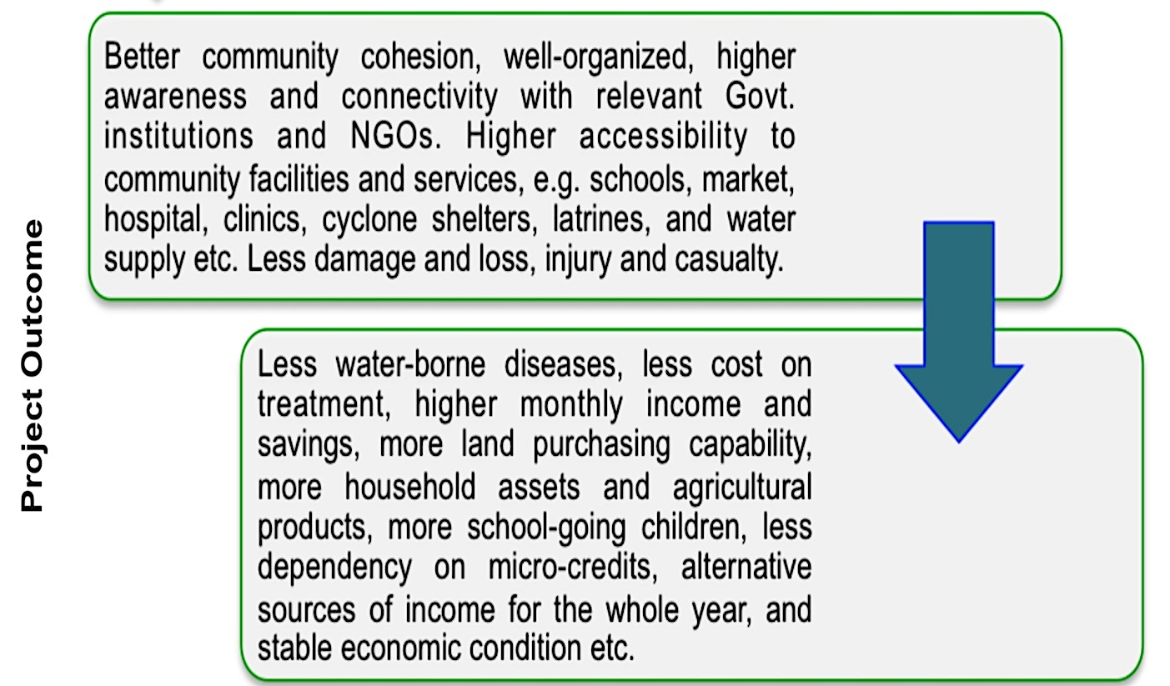
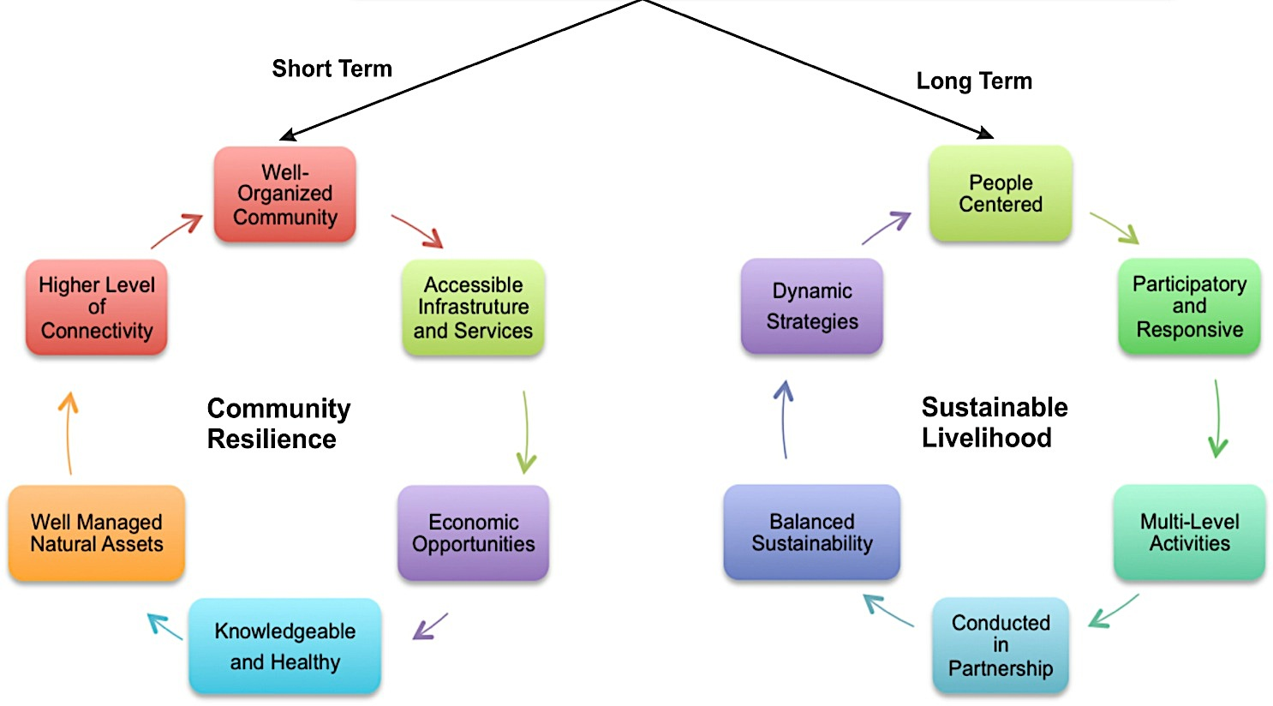
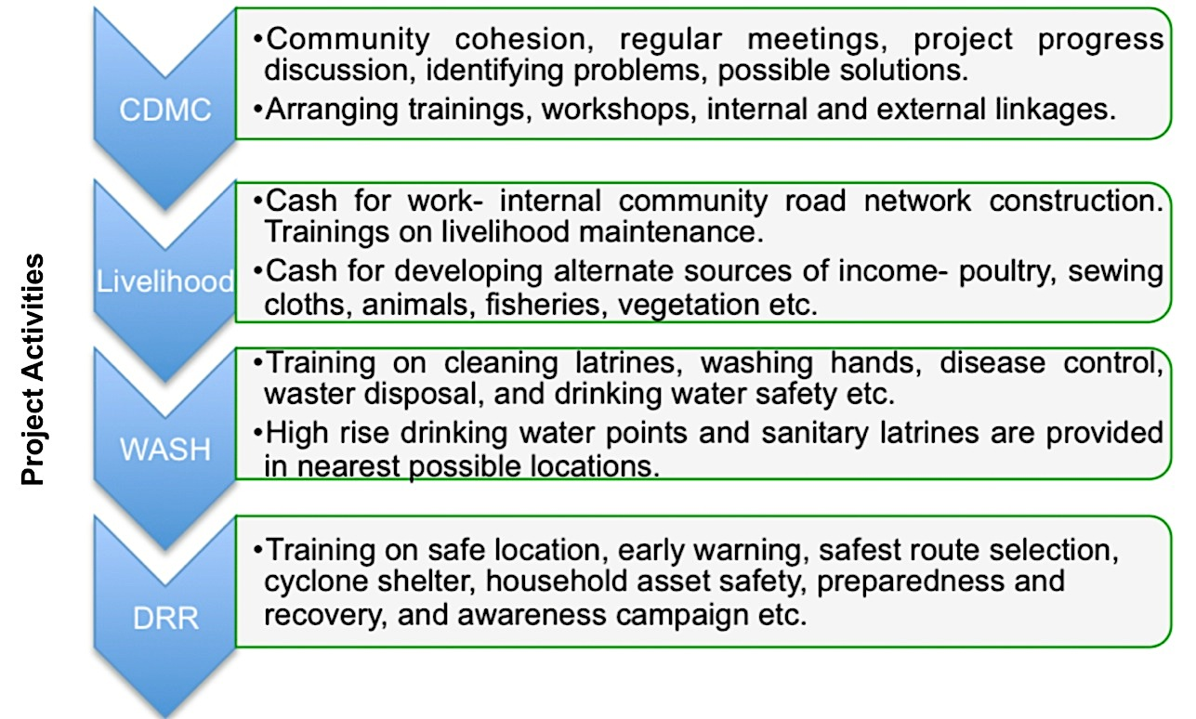
Project Output

Slide 21
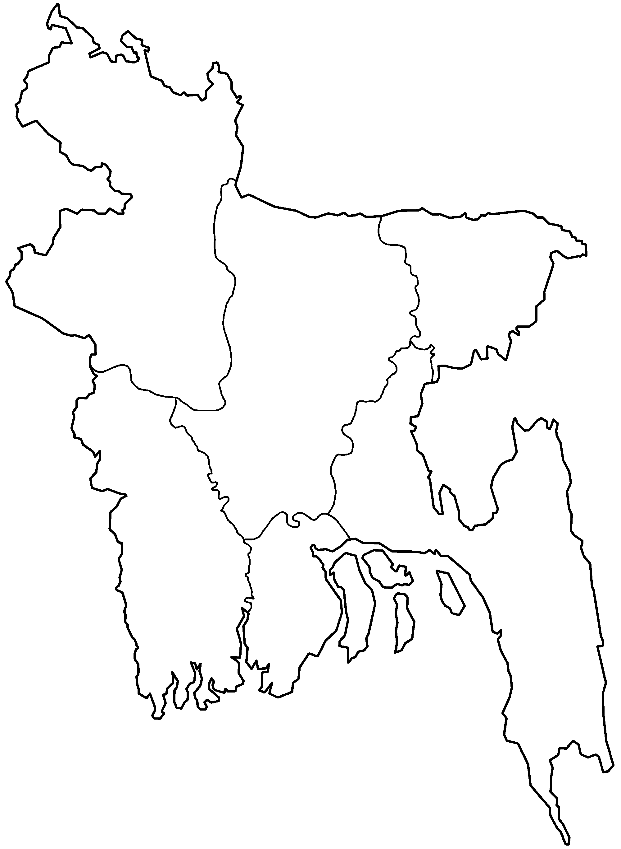
Future Direction
Drought
Cyclones, Sea Level
Rise & Storm Surges
DHAKA
Hills

Slide 22
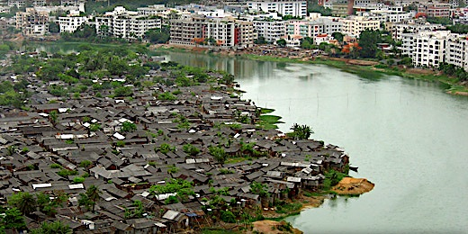
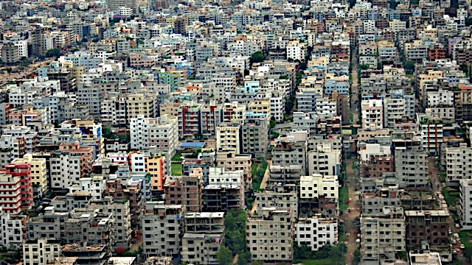
Urban Vulnerability
Community Resilience & Sustainable Livelihood at Rural Bangladesh = Tool for Urban Decentralization

Slide 23
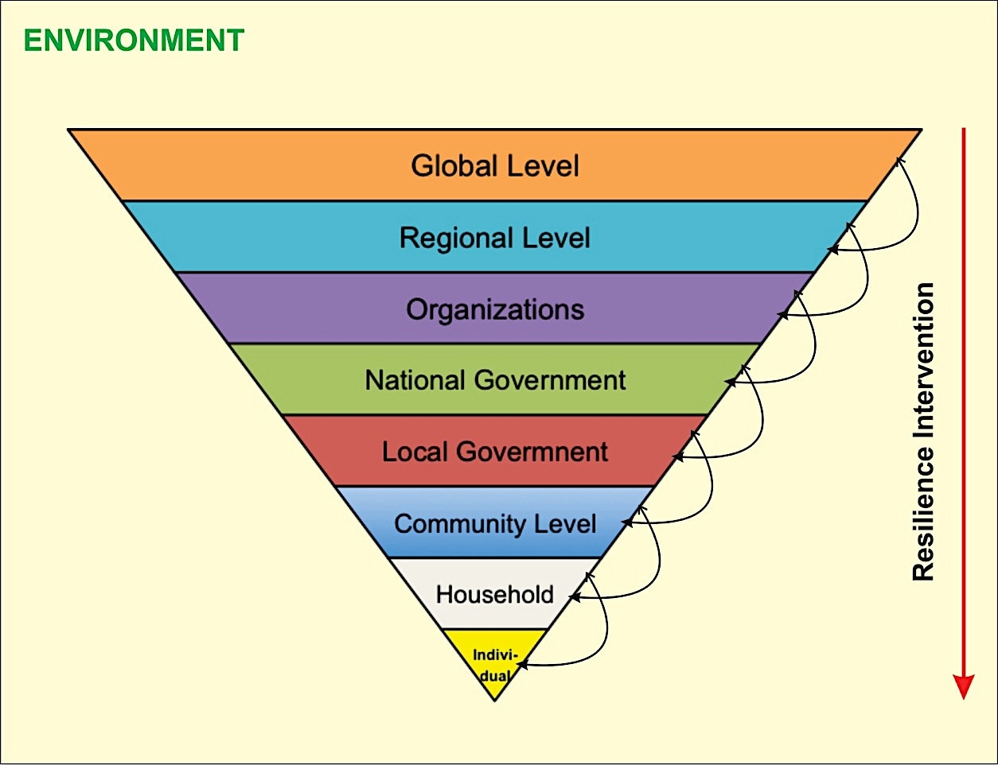
A Holistic Approach
Long-Term Monitoring

Slide 24
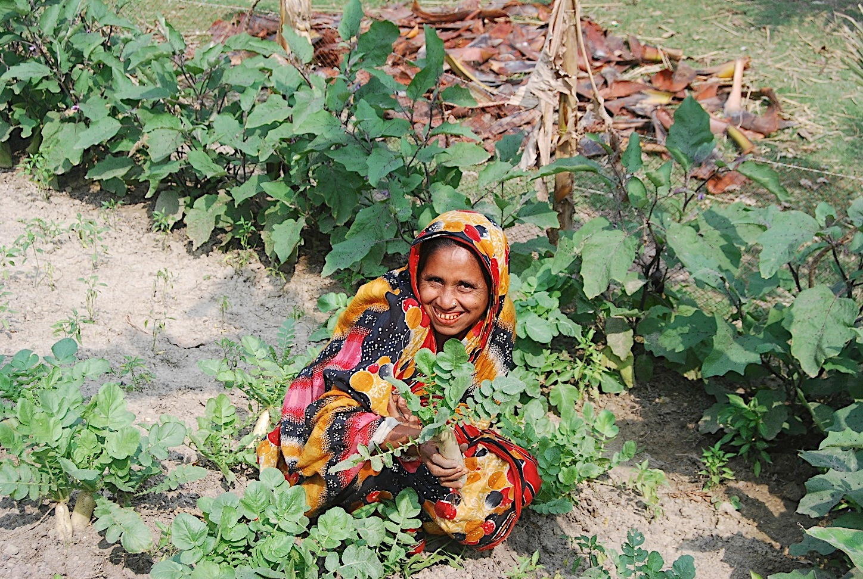
Thank you all!
Email: bayes.ahmed.13@ucl.ac.uk

