Slide 1
The Mw7.8 Muisne Earthquake, Ecuador of 16 April 2016 Observations from the EEFIT Reconnaissance Mission
Guillermo Franco
Harriette Stone
Bayes Ahmed
Siau Chen Chian
Fiona Hughes
Nina Jirouskova
Sebastian Kaminski
Jorge Lopez
With Manuel Querembas, Carlos Molina Hutt & Nicolas van Drunen

Slide 2
Preliminaries PART 1 Regional Seismology & Event Characterisation PART 2 Geotechnical Aspects PART 3 Structural Aspects Introduction & description of the building stock Qualitative overview of building damage Structural damage survey analysis The tagging process and its shortcomings PART 4 Social Aspects PART 5 Concluding Remarks

Slide 3
Our Team & Our Roles
GUILLERMO
LEAD
HARRIETTE
STRUCT
BLOG
DEPUTY LEAD
JORGE
STRUCT
SEBASTIAN
STRUCT
LOGISTICS
NINA
GEOTECH
SEISMO
FIONA
GEOTECH
PHOTO ARCHIVAL
DARREN
GEOTECH
SEISMO
REMOTE SUPPORT
BAYES
SOCIAL
PRESENTS INTRO & PART 5
PRESENT PART 3
PRESENT PARTS 1-2
PRESENTS PART 4
MANUEL
LOCAL LEAD
CARLOS
STRUCT
LOCAL SUPPORT
NICOLAS
SOCIAL
STRUCT
LOCAL SUPPORT
PRESENTS PART 3 - TAGGING
Notes:
Very few studies on active faulting in the region, though these EQs may have spurred revived efforts in that direction. Some of the observations, including San Isidro which Fiona will talk about may be utilised in validation efforts of the work by Eguez (2003). Reyes (2008) and others suggest that there may very well be currently unsuspected active faults in the region.

Slide 4
Publications
FIRST PUBLICATION FOR WCEE16 AVAILABLE SINCE JUNE 15 2016
7 days after returning from the field
Shared with local authorities
To be presented by Franco & Stone
Final report expected in October 2016

Slide 5
Collaborations
Armed Forces of Ecuador
Designated a local lead to support the EEFIT Team (Major Manuel Querembas, director of the Army School of Civil Engineering)
Provided open access to all affected areas
Supported team with a van, a boat, and additional logistics
Arup
Provided advance local information from their own deployment
European Commission – Civil Protection Team
Provided advance local information from their own deployment

Slide 6
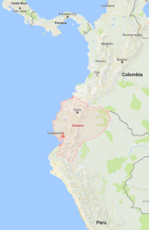
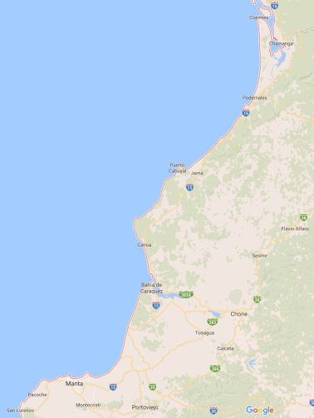
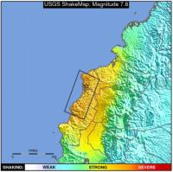
Mission
DATE | ACTIVITY
APRIL 16 | EVENT OCCURS
APRIL 22 | LEAD IDENTIFED
MAY 5 | TEAM IDENTIFIED
MAY 24-27 | TEAM ARRIVES
MAY 28-30 | MANTA PORTOVIEJO
MAY 31 | BAHIA CANOA
JUNE 1 | CANOA-JAMA SAN ISIDRO
JUNE 2-3 | PEDERNALES
JUNE 3-5 | CHAMANGA CANOA CHONE
JUNE 5-9 | MANTA PORTOVIEJO TEAM LEAVES
JUNE 15 | WCEE16 PAPER SUBMITTED
CHAMANGA
PEDERNALES
JAMA
SAN ISIDRO
CANOA
BAHIA DE CARAQUEZ
CHONE
MANTA
PORTOVIEJO
2 months “event-to-paper”

Slide 7
Ecuadorian Context
Ecuador has about 15m population, US$100b GDP, relatively high inequality
Level of development similar (somewhat lower) to neighbours
Manabi is the 3rd most populated region in the country
Economic importance: shrimp farming, agriculture, and tourism
Ecuador is suffering from low oil prices
Recent rains and floods prior to earthquake
Cliffs and mountains in rural areas and along roads
Number of informal settlements constructed in hazardous areas
A time of delicate political context between government and military
Scarcity of mechanisms for financial response
Earthquake occurs on a Saturday at around 7pm local time
New building code introduced in 2014 for seismic design (NEC-15)
Push for seismic risk preparedness within SARA project (mainly Quito)
Prompt and effective response from the Armed Forces
Exacerbating factors
Attenuating
Notes:
Time of earthquake: Saturday, 18:58 ECT (no school or work but in their house and some displaced people had to sleep outside in the rain.)
Rainy season / floods - After extremely high floods starting in January 2016 aggravated by El Nino (418 people evacuated in the province, 604 houses affected/destroyed).
Flooding was reported in at least seven cantons on 13 April, leaving people in need of water (Government 13/04/2016). Food security and livelihoods in Manabi have been affected by flooding and landslides. Cocoa and banana crops have been destroyed in April.
No formal earthquake emergency plan (however, plans in case of a volcanic eruption).
New Building Code in 2014, for seismic design (NEC-15) though Gap between Code and Practice and Limitations of the code some of which will be touched upon during the presentation.
Tensed political context (between the people, the government and between the army and civil forces). However, may also have been a stimuli for quick and efficient response to gain political capital from it.
Prompt response (though may have led to hastened demolition orders and controversial shelter options choices).
Instruments for financial response needs developing.

Slide 8
Part 1 REGIONAL seismology AND EVENT CHARACTERISATION

Slide 9
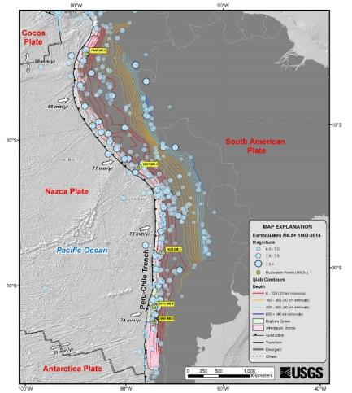
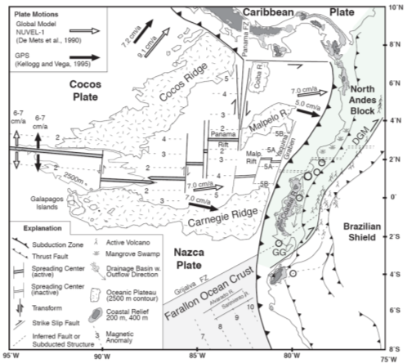
Regional Tectonic Setting
Reyer (2008), after Getscher et al. (1999)
Notes:
South American arc extending 7,000 km from southern coast of Panama in Central America to southern Chile.
Nazca plate subducts beneath the South America continent, creating the Andes Mountains and active volcanic chain.
Displaces at a rate of 65 mm/yr (north) to 80 m/yr (south).
Several large interplate earthquakes of magnitude 8 or greater have occurred (e.g. 1960 Mw 9.5 earthquake, the largest instrumentally recorded earthquake in the world; and 2010 Mw 8.8 earthquake) (USGS 2016).
Strong shallow intraplate earthquakes within the South American Plate along the Andes triggered landslides, subsidence, liquefaction and river impoundment (Espinosa 1979).
Mw 7.8 megathrust earthquake, at west coast of northern Ecuador, near the subducting Nazca-South America plate boundary. Occurred at 23:58 hours UTC at a depth of 19.2 km (USGS 2016).

Slide 10
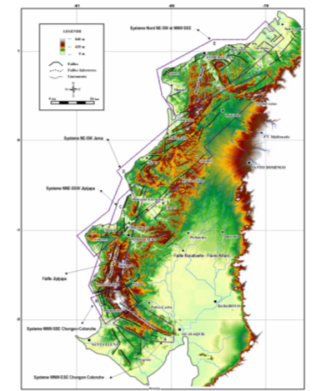
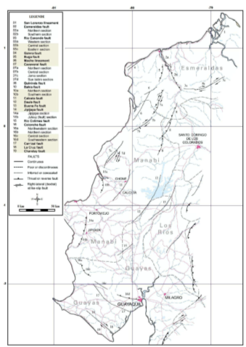
Local Tectonic Activity
Geomorphological and Fault System Analysis of the Manabi Region. Reyes (2008)
Active Faults Map
Eguez (2003). USGS
Notes:
Very few studies on active faulting in the region, though these EQs may have spurred revived efforts in that direction. Some of the observations, including San Isidro which Fiona will talk about may be utilised in validation efforts of the work by Eguez (2003). Reyes (2008) and others suggest that there may very well be currently unsuspected active faults in the region.

Slide 11
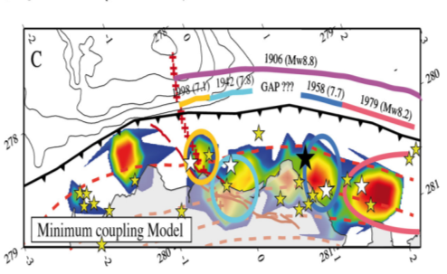
2016 Sequence of Events
N
Chlieh et al. (2014)
Notes:
Ecuador has a history of large seismic events exceeding M_{w}7. The epicentre of the 2016 earthquake was located at the southern end of the 400-500km long rupture area of the 1906 M_{w}8.8 event which generated a tsunami that killed hundreds of people [1]. Closer to the 2016 epicentre, a M_{w}7.8 earthquake occurred in 1942, 43km south of the recent April event, and a M_{w}7.2 event in 1998 close to Bahía de Caráquez.
+ Add the Chlieh et al. (2014) figure

Slide 12
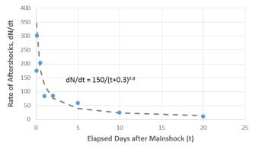
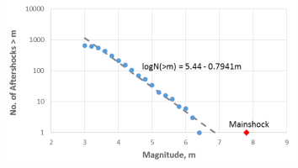
Aftershocks
Hundreds of aftershocks recorded since main event, including many above 5Mw, such as:
Aftershock Date | Magnitude | Area primarily Impacted | Damage
18th of May (just before the mission) | 6.7 & 6.8Mw | Manabi | Loss of power; 1 killed; dozen injured; landslides
10th of July (about a month after the mission) | 5.9 Mw & 6.4Mw | Esmeraldas | Loss of power and phone service; damage to Bailey bridge; 80 people displaced
Rate of aftershocks with elapsed days based on modified Omori’s law
Number of aftershocks with earthquake magnitude based on Gutenberg-Richter relationship
Notes:
Since the main shock, hundreds of aftershocks have been recorded, including many events greater than M_{w}5, such as the M_{w}6.7 and 6.9 aftershock events on 18 May.
Rate of aftershock with elapsed days depicted well with modified Omori’s law, which describe that frequency of aftershocks decrease with reciprocal of time after mainshock.
Gutenberg-Richter relationship showed that the mainshock is significantly larger than the trend produced by the aftershocks.
Nevertheless, both figures indicate that empirical laws can capture broad characteristics of the aftershocks.
The likelihood of an important aftershock to occur whilst on the mission is hence significantly lower a month after the event. However, as the two examples show, they do occur even when the probability is low. Appropriate precautionary measures always need to be taken on the field.
Aftershocks also raise the issue of distinguishing observations associated to the main shock or the aftershocks. Talking to the people or comparing observations to satellite or other imagery from after the main shock are a couple of solutions to come about this problem.

Slide 13
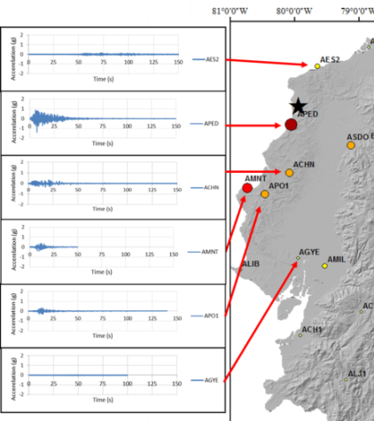
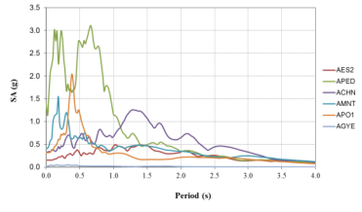
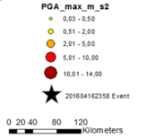
The April 16th Event
~50s, 1.41g PGA
Dominant periods:
Pedernales (APED): 0.2s and 0.7s (falls within natural period of structures about 2-7 stories tall)
Portoviejo (APO1): 0.4s (4 stories tall)
Manta (AMNT): 0.2s (2 stories tall)
Chone (ACHN): 1.3s (>10 stories)
After Singaucho et al. (2016) - Intituto Geofisico
Notes:
-Geophysical Institute (Instituto Geofisico) registered ground shaking lasting about 50 seconds. Highest peak ground acceleration (PGA) recorded was 1.41g at station APED near Perdernales.
-PGA values lower in the north of the epicentre but with longer duration as compared to the south where higher PGAs are observed with a shorter duration of shaking. Further distance away from the epicentre, the PGA of the ground motion decreases
Portoviejo and Manta, high frequency content ; Chone long period motion

Slide 14
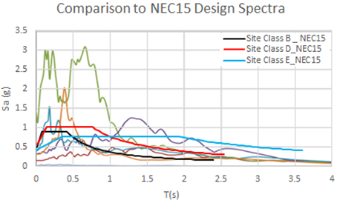
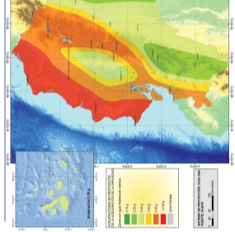
Within Design?
PGA values in (g) | YRP | Manta | Portoviejo | Pedernales
Recorded (16th of April, 2016, IG) | - | 0.68 | 0.51 | 1.41
PSHA studies (results on rock sites)
Wong et al. (2012) | 475 | 0.35 | - | -
 | 2475 | 0.65 | - | -
Parra (2015) | 475 | 0.7 | 0.6 | 0.65-0.7
 | 2475 | 1.15 | 1 | 1.15
SARA (2015) | 475 | 0.37-0.47
 | 2475 | 0.7-0.9
Code | 475 | 0.5
Notes:
Comment on design spectra vs records
NB: at this hour, the site conditions at the recording stations are not known hence the spectra are checked against the design spectra for a range of site classes from B to E.
Accelerations much greater in pedernales than designed up to 1.25s (i.e. the structures which should have survived well are the >10story buildings). Near source effects? Vs Esmeraldas – directionality of the seismogenic rupture towards the south rather than the north
Relative adequacy for Chone and Manta as well, although peak at around 1.5s above the design spectrum which may be problematic for high (>10story heigh) buildings
+ in literature: higher PGA than expected in most studies in the region (though on rock sites).
Usefulness of tendency to provide and communicate PSHA results for rock conditions?
Oversimplificaion of the Z=0.5 cut-off factor in the manabi region, given the complexity of the tectonics there?

Slide 15
Part 2 geotechnical aspects

Slide 16
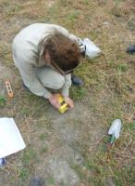
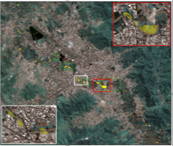
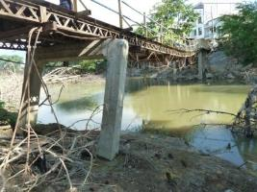
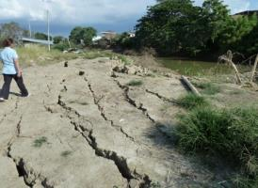
Objectives & Methods
Gather information on primary geological and geotechnical drivers for damage
Observe geological and geotechnical vulnerability sources
Survey geological and geotechnical failures
Geophysical tests for soil amplification analysis
Landslide survey in collaboration with the British Geological Survey (BGS)
Liquefaction damage and other geotechnical failure observations
Notes:
Tried to cover both urban areas as well as less developed areas (rural – san isidro, where significant damage occurred, or where the damage to infrastructure or economically significant lands was observed – slope failures along roads, or damage to shrimp farms embankments or facilities)

Slide 17
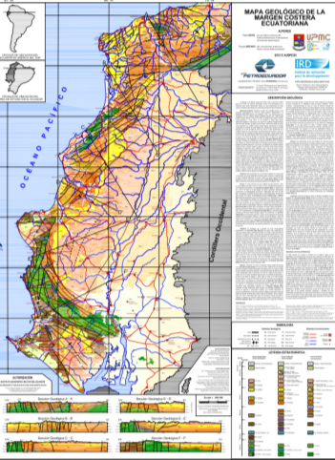
Microtremor Tests
Why?
Non-invasive, rapid and reliable methodology to assess soil amplification effects
Especially useful considering lack of geological information
Tested and compared successfully with other shear-wave velocity measurements such as MASW, SCPT and others (Pappin et al., 2012; Tallett-Williams et al., 2015)
How?
Ambient noise measurement
Reyes & Michaud (2012)
Notes:
single, portable, digital seismometer, with tyically three orthogonal accelerometers and velocimeters which measure surface waves

Slide 18
Microtremor Tests
Methodology
Nakamura (1989) H/V technique, whereby the ratio peaks at the lower limit of the fundamental frequency of the site (Bard 1999)
V_{s,30} of the site can be determined with depth to first stratum
Notes:
Work to be continued. New geological information provided. See final report

Slide 19
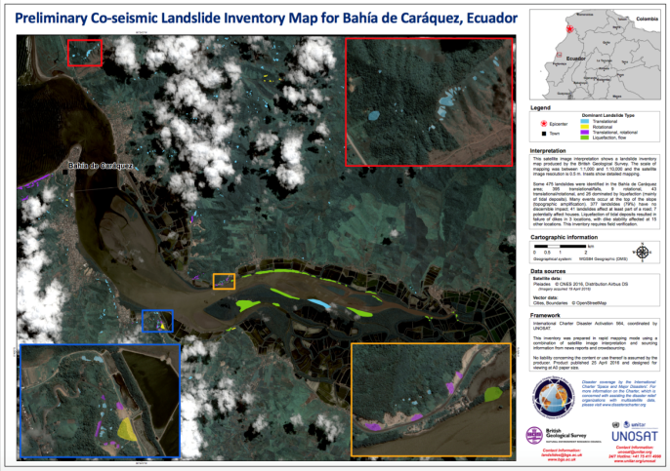
Landslides - BGS Collaboration

Slide 20
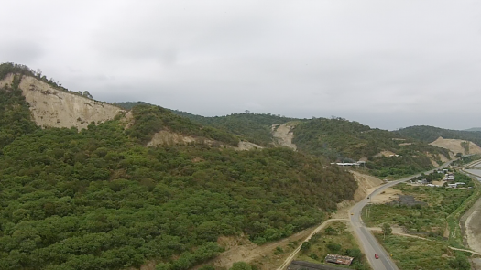
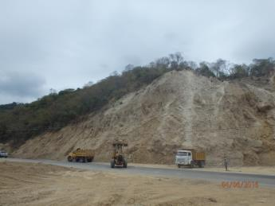
Landslides - BGS Collaboration
Methodology
Photography
Drone footage
Interviewing local neighbours
San Vincente

Slide 21
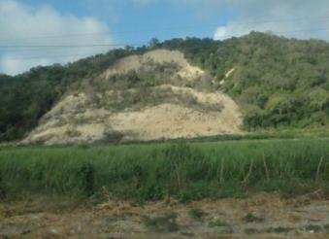
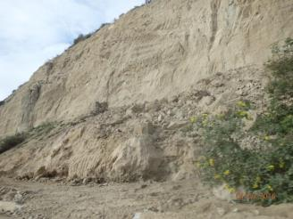
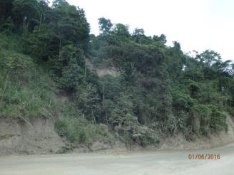
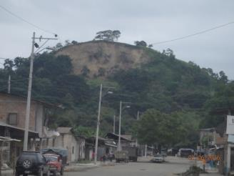
Landslides
Costal: Highway 15 San Vicente - Canoa
Inland:
San Isidro

Slide 22
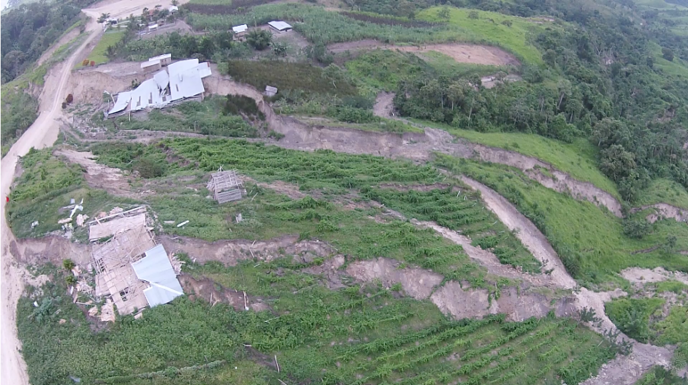
Ground Failure
Near San Isidro

Slide 23
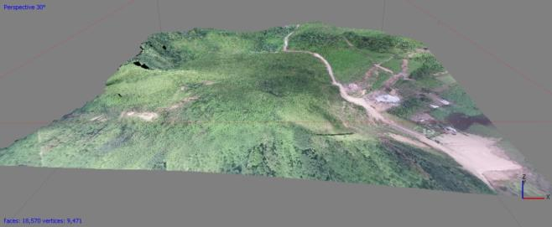
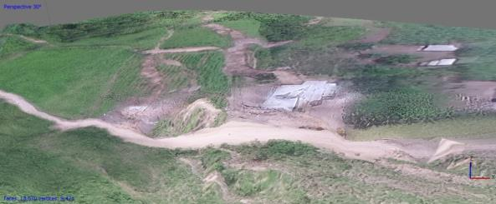
Ground Failure
Near San Isidro
Near San Isidro

Slide 24
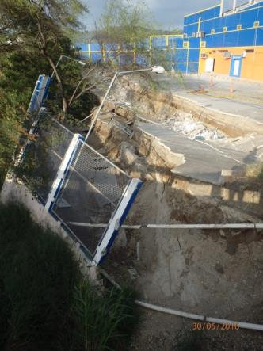
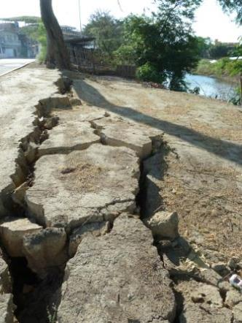
Liquefaction - Lateral Spreading
Portoviejo

Slide 25
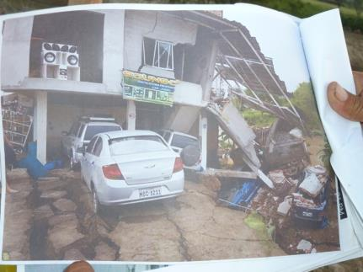
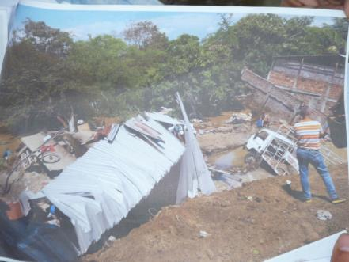
Liquefaction - Lateral Spreading
Portoviejo

Slide 26
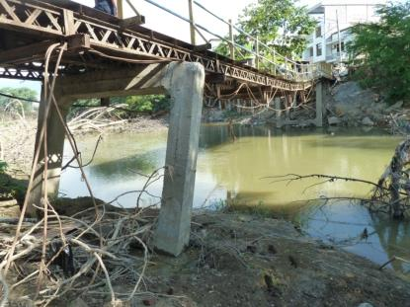
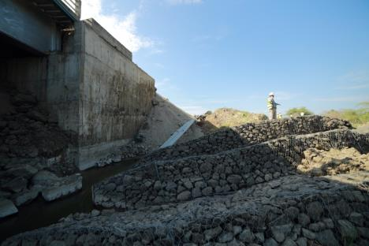
Liquefaction - Lateral Spreading
Puente Chile, Portoviejo
Mejia Bridge
Highway 39A Portoviejo - Rocafuerte

Slide 27
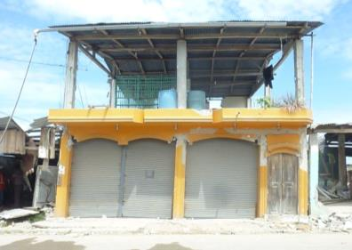
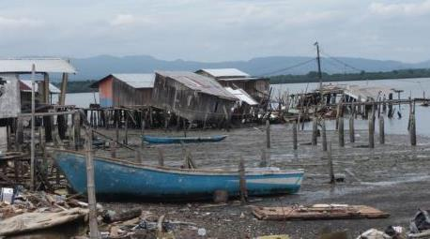
Liquefaction - Foundation Failure
Chamanga

Slide 28
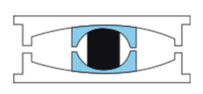
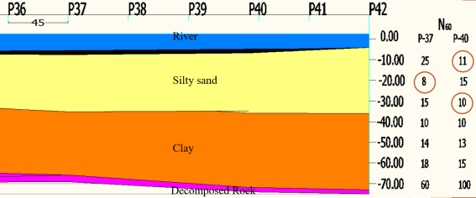
Los Caras Bridge
Triple pendulum seismic isolator
Soil profile Courtesy of Ecuador’s Army Corps of Engineers and Adolfo Caicedo. From personal communication with E. Morales.

Slide 29
Observations Summary
Ground motion
Event could have been expected;
Site effects need further attention
Limiting Z=0.5 factor in the code may be an issue
Microtremor
Analysis to be continued (see final report)
Landslides
Satellite imagery ground-truthing
Slope angle
Reinforcement
Liquefaction
Flooding
Fill
Drainage and slope reinforcement
→ Caution needed to not underestimate losses from geological/geotechnical failures
Notes:
Site effects need further attention to understand the ground motions which affected the structures at surface
Tend to underestimate the losses due to geotech’ failures. Eco losses are still mainly calculated based on structural damage. However, significant losses to shrimp farms, many informal settlements built on unstable ground often overlooked in loss calcs; difficulty as well to calculate impact of road transport disruption on eco losses.

Slide 30
Part 3 structural aspects

Slide 31
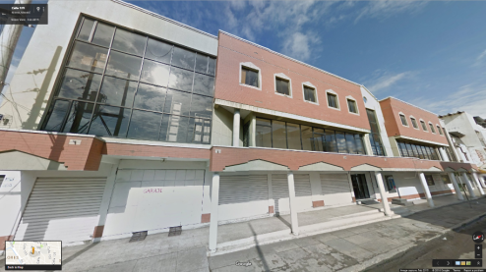
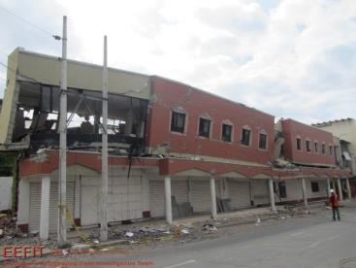
Objectives & Methods
Gather information on primary reasons for earthquake damage
Survey levels of damage to different building typologies in the affected areas
Initial reconnaissance walk-around
RAPID & DETAILED visual survey
Arup’s REDi rating system and GEM’s inventory capture tool

Slide 32
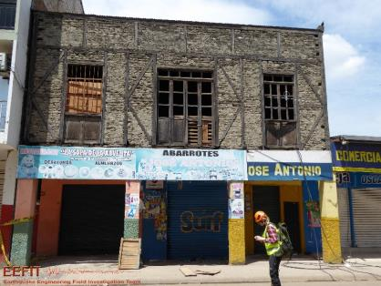
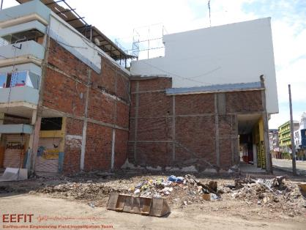
Building Stock
Concrete buildings
Timber buildings
Quincha / Bahareque
Others: Steel, Mixed Concrete / Timber / Steel
Rural housing

Slide 33
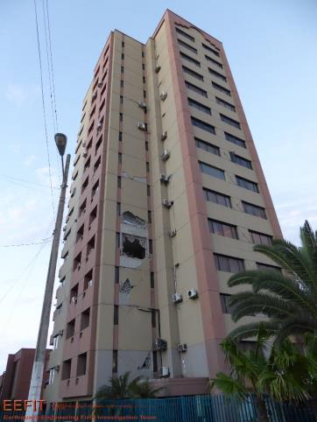
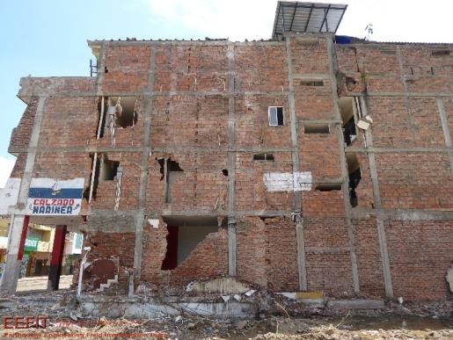
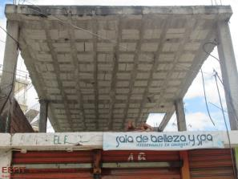
Concrete Buildings
Reinforced Concrete Frames with Unreinforced Masonry Infill Walls

Slide 34
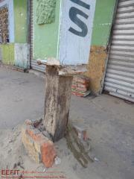
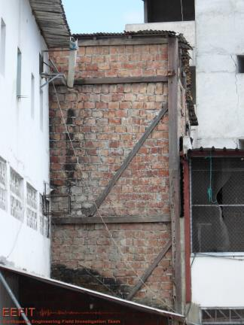
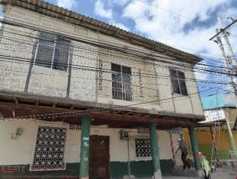
Timber Buildings
Timber Frames with and without Unreinforced Masonry Infill Walls
Quincha / Bahareque

Slide 35
Other
Steel, Unreinforced Masonry, Bamboo, Mixed
NB: No Adobe observed

Slide 36
Rural Housing
Non-engineered systems of various materials (i.e. Timber, Bamboo, RC, Masonry)

Slide 37
Observed Damages
Concrete Buildings
Timber Buildings

Slide 38
Concrete Buildings

Slide 39
Poor RC Frame Construction

Slide 40
Poor Masonry Infill Construction

Slide 41
Poor Masonry Infill Construction

Slide 42
Poor Shear Design & Detailing

Slide 43
Weak & Soft Stories

Slide 44
Short Columns

Slide 45
Insufficient Cover

Slide 46
Inadequate Laps & Corrosion

Slide 47
Poor Quality Concrete

Slide 48
Pounding

Slide 49
Timber/Bamboo Buildings

Slide 50
Rot & Termite/Beetle Damage

Slide 51
Inadequate Connections

Slide 52
Case Studies
Case Study I: School in Pedernales
Case Study II: Church in Canoa
Case Study III: Footbridge in Canoa

Slide 53
Case Study I (School)

Slide 54
Case Study I (School)

Slide 55
Case Study I (School)

Slide 56
Case Study II (Church)

Slide 57
Case Study II (Church)

Slide 58
Case Study III (Footbridge)

Slide 59
Case Study III (Footbridge)

Slide 60
Damage Surveys
Why Collect Damage Data?
To better understand the scale and spread of damage
To better understand patterns of damage by typology, height, location, etc.
To produce empirical fragility and vulnerability functions
To validate analytical fragility and vulnerability functions
What are the Limitations in Collecting Damage Data?
Demolition
Outside inspection only
Lesser-damaged buildings
Relatively small numbers
Surveyor accuracy

Slide 61
Manta - Tarqui Survey

Slide 62
Manta Seismometer Station

Slide 63
Portoviejo
PORTOVIEJO GROUND ZERO

Slide 64
Portoviejo Ground Zero Survey

Slide 65
Portoviejo Seismometer Station

Slide 66
Jama Damage Survey

Slide 67
Pedernales Damage Survey

Slide 68
Damage Survey Results

Slide 69
Damage Survey Results

Slide 70
Spectral Analysis

Slide 71
EU Civil Protection Mechanism
Courtesy of Carlos Molina Hutt and the European Civil Protection Mission
PREVENTION
Disaster prevention is possible by various ways such as creating an inventory of information on disasters, sharing of best practices, reinforcing early warning tools etc.
PREPAREDNESS
Training programmes, exercises during simulated emergencies, exchange of expert's programmes, cooperation projects to prepare communities and the general population.
RESPONSE
Assistance may include search and rescue teams, medical teams, shelter, water purification units and other relief items requested.
COUNTRY REQUESTS ASSISTANCE FOR SPECIFIC NEEDS
EU REQUESTS SKILLS IN MEMBER STATES AND MATCHES WITH NEEDS
IF COUNTRY ACCEPTS
PROPOSED TEAM, TEAM IS DEPLOYED COORDINATING WITH LOCAL GOVERNMENT

Slide 72
EU Civil Protection Team
Courtesy of Carlos Molina Hutt and the European Civil Protection Mission
Base of Operations: Portoviejo (Arrived April 24)
Activities
Supported the Ecuadorian Government
Adapted assessment methodology to Ecuadorian context
Facilitating the task assignment to other teams
Knowledge Transfer

Slide 73
Structural Assessment Work
Courtesy of Carlos Molina Hutt and the European Civil Protection Mission
Rapid Post-Earthquake Safety Evaluations (Adapted ATC-20)
Detailed Post-Earthquake Safety Evaluations (Adapted ATC-20)
Demolition Verification (due to unnecessary demolition taking place)
Safe Road Access (to re-open the arteries of Ground Zero)

Slide 74
Main Contributions
Courtesy of Carlos Molina Hutt and the European Civil Protection Mission
PORTOVIEJO
551 buildings assessed
188 green
189 yellow
174 red
5 km of safe access roads

Slide 75
Part 4 SOCIAL ASPECTS

Slide 76
Objectives & Methods
Conduct qualitative observations on the shelter situation
Conduct preliminary interviews
Design a questionnaire on site adapted to the local situation
Obtain questionnaire responses
Total of 120 families surveyed
PORTOVIEJO
CANOA
PEDERNALES

Slide 77
Before & After Scenarios

Slide 78
Camp Facilities

Slide 79
Camp Facilities

Slide 80
Questionnaire Design

Slide 81
Questionnaire Surveying

Slide 82
Age & Education
BY AGE
BY EDUCATION

Slide 83
Income & Occupations
OCCUPATIONS
INCOME

Slide 84
Property & Preparedness
PROPERTY OWNERSHIP
DISASTER PREPAREDNESS

Slide 85
Dwellings

Slide 86
Construction Material

Slide 87
Year of Construction

Slide 88
Recovery Plans

Slide 89
Reconstruction Strategy

Slide 90
Reconstruction with Bamboo
Chorrera, Pedernales

Slide 91
Canoa Temporary Housing Plans

Slide 92
Part 5 concluding remarks

Slide 93
Outreach - Press
Met with President Rafael Correa and its cabinet
Met the Army highest command, General Mosquera
Interviews published in major TV channels and newspapers
www.teleamazonas.com/2016/06/ingleses-analizan-suelo-zona-cero-manta-portoviejo/

Slide 94
Outreach - Blog
21 Posts (≈ 2/day avg)
2,100+ Views
493 Visitors
247 Visitors on June 2
https://eefitmission.wordpress.com/

Slide 95
Mission Tangible Outcomes
Collected thousands of photos
Conducted about 10 drone flights
Surveyed more than 1,000 buildings
Designed a questionnaire in-situ for social research
Filled out questionnaires from 120 families
1 Paper published within 2 months of the event
About 30 Tromino measurements
About 15 landslides surveyed for the BGS – Successful ground-truthing exercise
Successful outreach and connection to local authorities and press
Successful training and experience for the entire EEFIT team

Slide 96
Concluding Remarks
Salient Observations
The high water saturation due to recent rains and floods exacerbated geotechnical failures of buildings and contributed to trigger landslides
The resonant period of ground motion seems to correlate well with the resonant period of the affected building stock
Shortcomings in construction typical of poor seismic design and typical of non-engineered construction were pervasive
Satellite imagery was used to identify landslides but special considerations have to be taken into account to calibrate image recognition algorithms
The Los Caras Bridge experience should incentivise debate as to the business case for seismic isolation, despite perceived costs in developing contexts
The tagging process deserves more attention and coordination –clear communication as to the meaning of tags can prevent unnecessary loss
Better communication of risks is a constant necessity
Additional Aspects to Consider
Event Response & Financial Aspects

Slide 97
Acknowledgments
We received enormous and generous support from many local experts. Without them, the mission would not have been as successful as it was: Ing. Marcelo Romo (Escuela Politécnica del Ejército), Archs. Jean Paul Demera and Nguyen Ernesto Baca (Historical Preservation), Milton Cedeño (ULEAM), Paulina Soria (INBAR-International Network for Bamboo and Ratan), Christian Riofrio (AIMA), Gen. Mosquera, Crnl. De E.M.C. William Aragon, Col. Ramos, Col. Negrete, Col. Parra, Lt. Col. Iturralde, Maj. De E. Henry Cordova (Secretaria de Gestión de Riesgos), Maj. Fabricio Godoy (ISSFA), and Everth Luis Mera (student at the School of Civil Engineering of Portoviejo). During the mission, we received support from our London-based colleagues, EEFIT coordinators Berenice Chan, Sean Wilkinson and Tristan Lloyd.
Prior, during and after the field mission, we received briefings and support from Carlos Molina (University College London), Anna Pavan, Francisco Pavia, Matthew Free (Arup), Antonios Pomonis (Cambridge Architectural Research & World Bank), Tom Dijkstra, Helen Reeves and Colm Jordan (British Geological Survey), James Daniell (Kahlsruhe Institute of Technology and World Bank Group), Oscar Ishizawa and Rashmin Gunasekera (World Bank Group), Emilio Franco (Gestió de Infraestructures SA, retired), Thomas Ferre (MicroVest Capital Management, LLC), Marjorie Greene and Forrest Lanning (EERI), Eduardo Miranda (Stanford University), Enrique Morales (University of Buffalo), Mario Calixto Ruiz Romero, Alexandra Alvarado and Pedro Espín (Instituto Geofísico), Lizzie Blaisdell (Build Change), Kevin Hagen (EWB-USA), Diego Paredes (UK Embassy in Ecuador), Carla Muirragui (Cámara de Industrias y Producción), Sandra Silva, Jenny Nino, Carolina Gallegos Anda, Natividad Garcia Troncoso (Imperial College), Alby Del Pilar Aguilar Pesantes (ESPOL), Michael Davis, Luz Gutiérrez, and Santiago del Hierro.
The Engineering and Physical Sciences Research Council (EPSRC) provided funding for team members Ahmed, Hughes, and Jirouskova. The Centre for Urban Sustainability and Resilience at University College London provided funds for Stone. Arup supported members Kaminski and López and also provided funding for vehicle hires. Guy Carpenter supported team lead Franco. The Ecuador Army provided additional land and sea transportation to the team. This financial support made the mission possible. EEFIT also receives regular financial sponsorship from Arup, CH2MHill, Mott MacDonald, the British Geological Survey, AIR Worldwide, AECOM, Willis, Guy Carpenter, and Sellafield Ltd. All this support is greatly appreciated.
Notes:
Transition slide to introduce the three following parts of the presentation

