Slide 1
Developing Dynamic Web-GIS based Early Warning System for the Communities Living with Landslide Risks in Chittagong Metropolitan Area, Bangladesh
BUET-Japan Institute of Disaster Prevention and Urban Safety (BUET-JIDPUS)
Bangladesh University of Engineering and Technology (BUET)

Slide 2
Welcome
to the Workshop Presentation on
Developing A Dynamic Web-GIS based Early Warning System for the Communities Living with Landslide Risks in Chittagong Metropolitan Area, Bangladesh
Presented by-
BAYES AHMED
17 September 2015

Slide 3
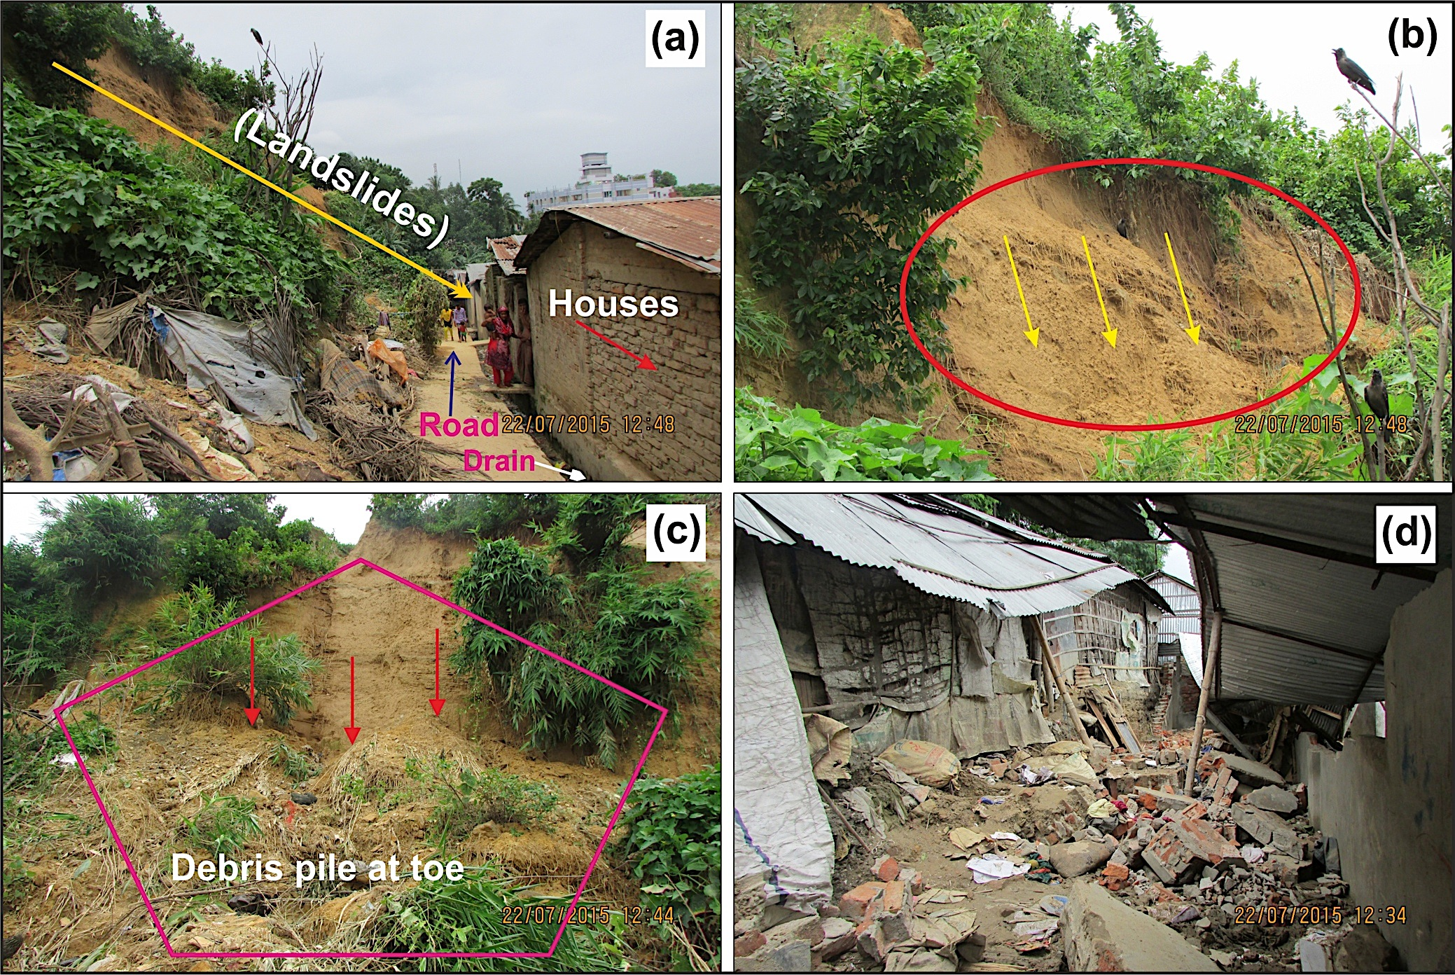
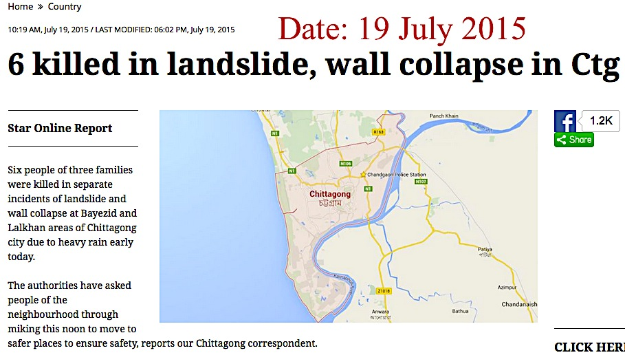
Background
Landslides are one of the most significant natural damaging disasters in hilly environments.
Chittagong Metropolitan Area (CMA), the second largest city of Bangladesh, is vulnerable to landslide hazard, with an increasing trend of frequency.

Slide 4
Background

Slide 5
Background
The major recent landslide events were related to extreme rainfall intensities having short period of time. Landslide events occurred at a much higher rainfall amount compared to the monthly average.
Against this backdrop, it is essential to develop an early-warning system for the hilly communities of CMA incorporating local knowledge.

Slide 6
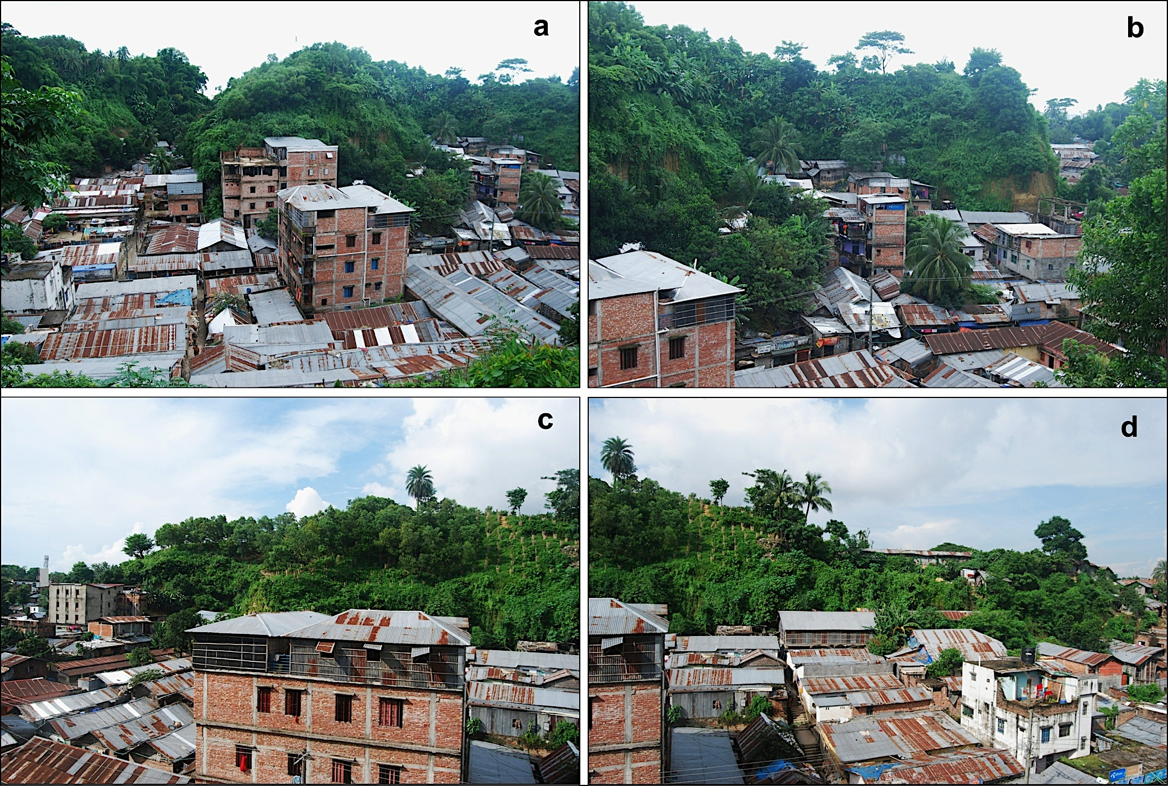
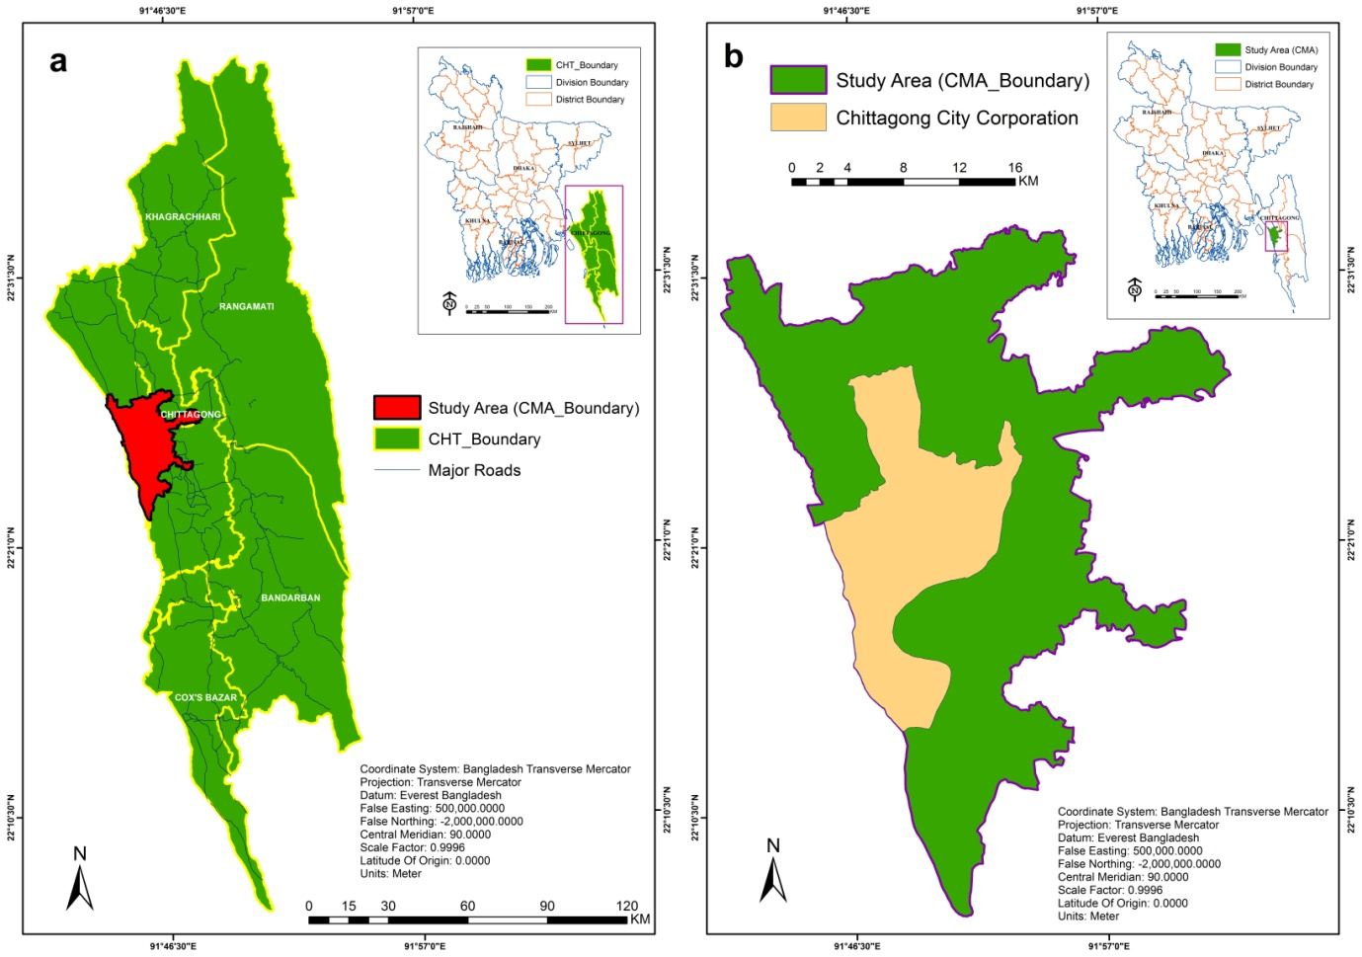
Study Area

Slide 7
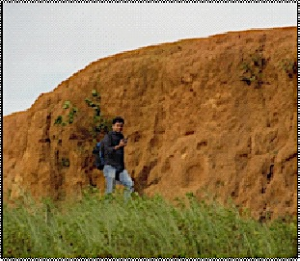
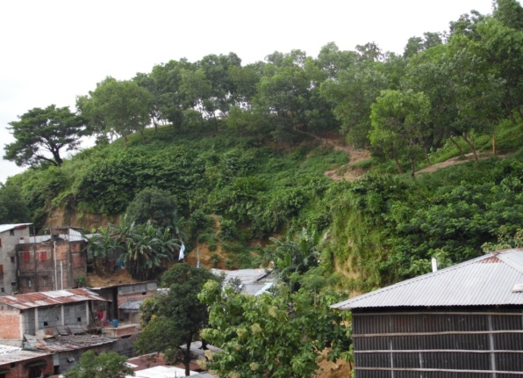
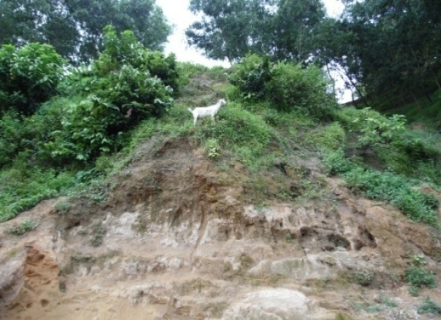
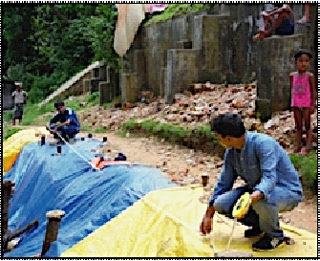
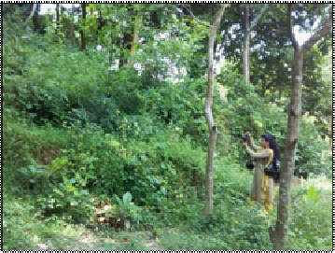
Activities and Result
Detail Inventory for 57 Past Landslides
Basic Information
Landslide ID :05 Landslide Location: Tanker Pahar, Moti Jharna Coordinates: 22̊ 20’54.27’’N, 91̊ 48’51.60’’E | Datum: WGS 1984 Elevation (m): 41.18 Area of Displaced Mass (sqm): 331.84 Rainfall: Unknown
Source: Field Survey, August 2014 | Source: Field Survey, August 2014
Landslide Mechanism
Type of Movement: Slide State: Active, Reactivated, Suspended Distribution: Advancing | Style: Single Water Content: Moist Material: Soil/Earth
Land Cover/Use Type (%): Herbaceous vegetation is the Primary land cover of Tanker Pahar. Forest/ woodland type is also visible in this hill.
Causes of Movement: Hill cutting is the major issue that caused landslide in this area and intense rainfall acted as a triggering factor for landslide.
Land Slide History and Future Risk of Landslide
Landslide in this site occurred in 1982, 1989,1991,1994,1996 and 2013. 10 houses got damaged and almost 22 people died due to landslide at different periods. Utility facilities were highly damaged in this incident. Economic activities were hampered so does the social life of people. Environment has been found to be severely damaged. Still there are many houses located at the down slope of the hill. Soil of this site has been found to be sandy. The escapement slope is found to be near vertical. The failed mass is a part of upper portion. Vertical Slope characteristics can be considered as a contributing factor to future landslide for this hill. Settlements located at the down slope of this hill are at a huge risk of massive landslide. The risk is high (Field survey, August 2014).

Slide 8
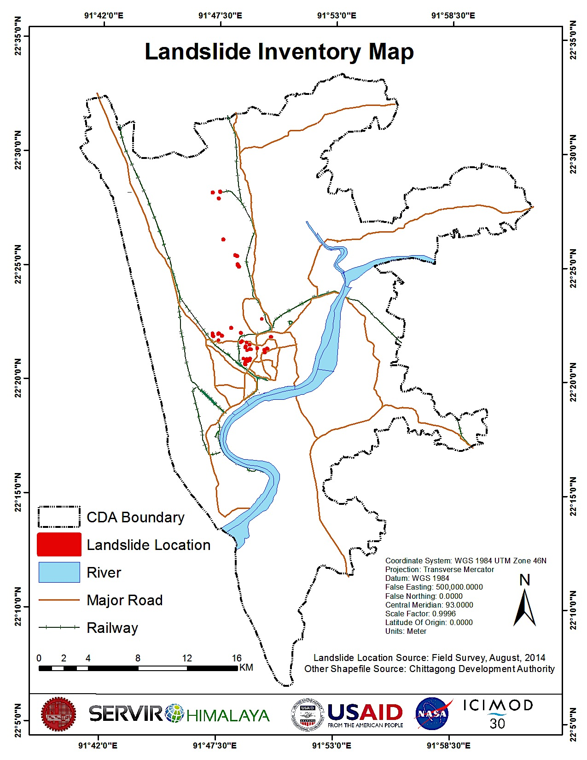
Landslide Inventory

Slide 9
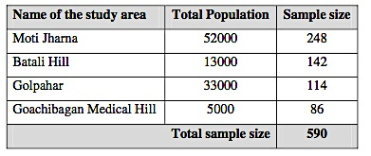
Questionnaire Surveying

Slide 10
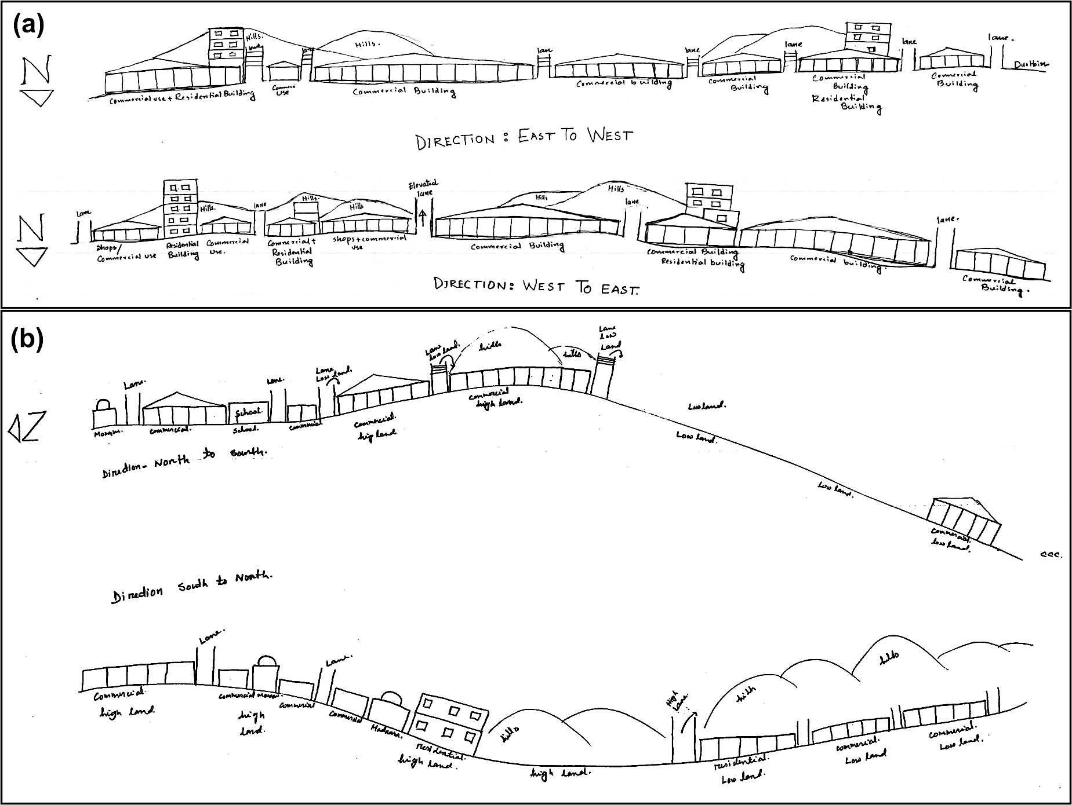
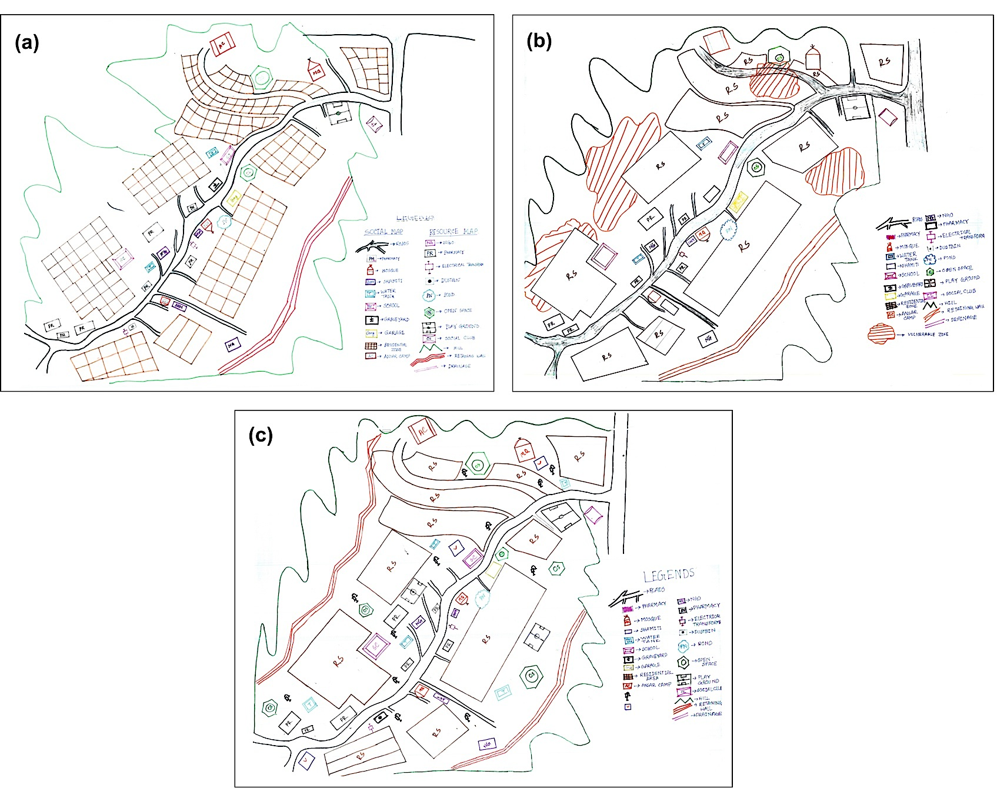
Participatory Rural Appraisal Surveying

Slide 11
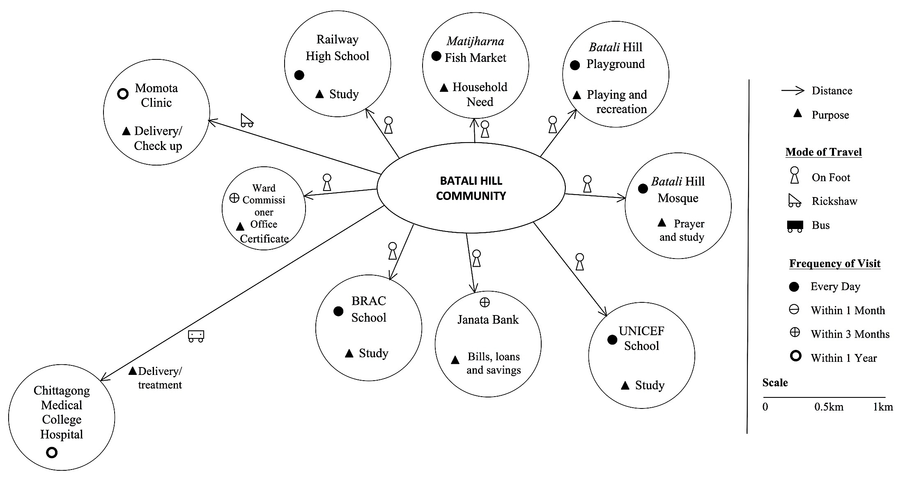
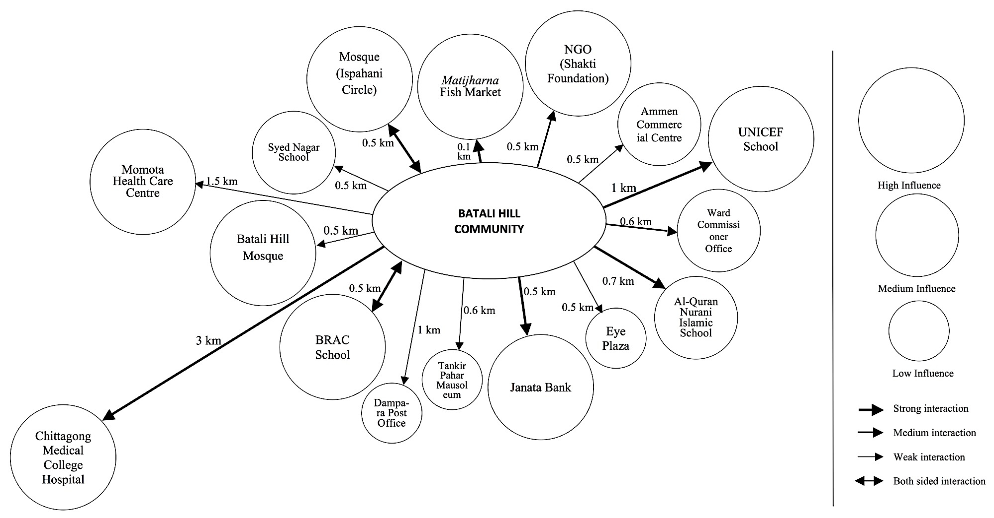
Participatory Rural Appraisal Surveying

Slide 12
Social Aspect of Landslide Risk Management
Cause of landslide:
High precipitation and hill cutting

Slide 13
Activities and Result ( Social Aspect of Landslide Risk Management)
Early warning system:
Announcement through mike (72.5% said).
81.25% respondents stay at their houses after getting warning.
81.45% respondents do not have contact number of the nearest fire service/ police station/ volunteer groups/ emergency services/ relevant agencies for emergency purpose.
One person attended training in nearby school.
Suggestion on Landslide Disaster Management:
Permanent relocation,
Awareness building,
Stop hill cutting,
Engineering measurement/constructing retaining wall, tree Plantation,
Leveling the hills

Slide 14
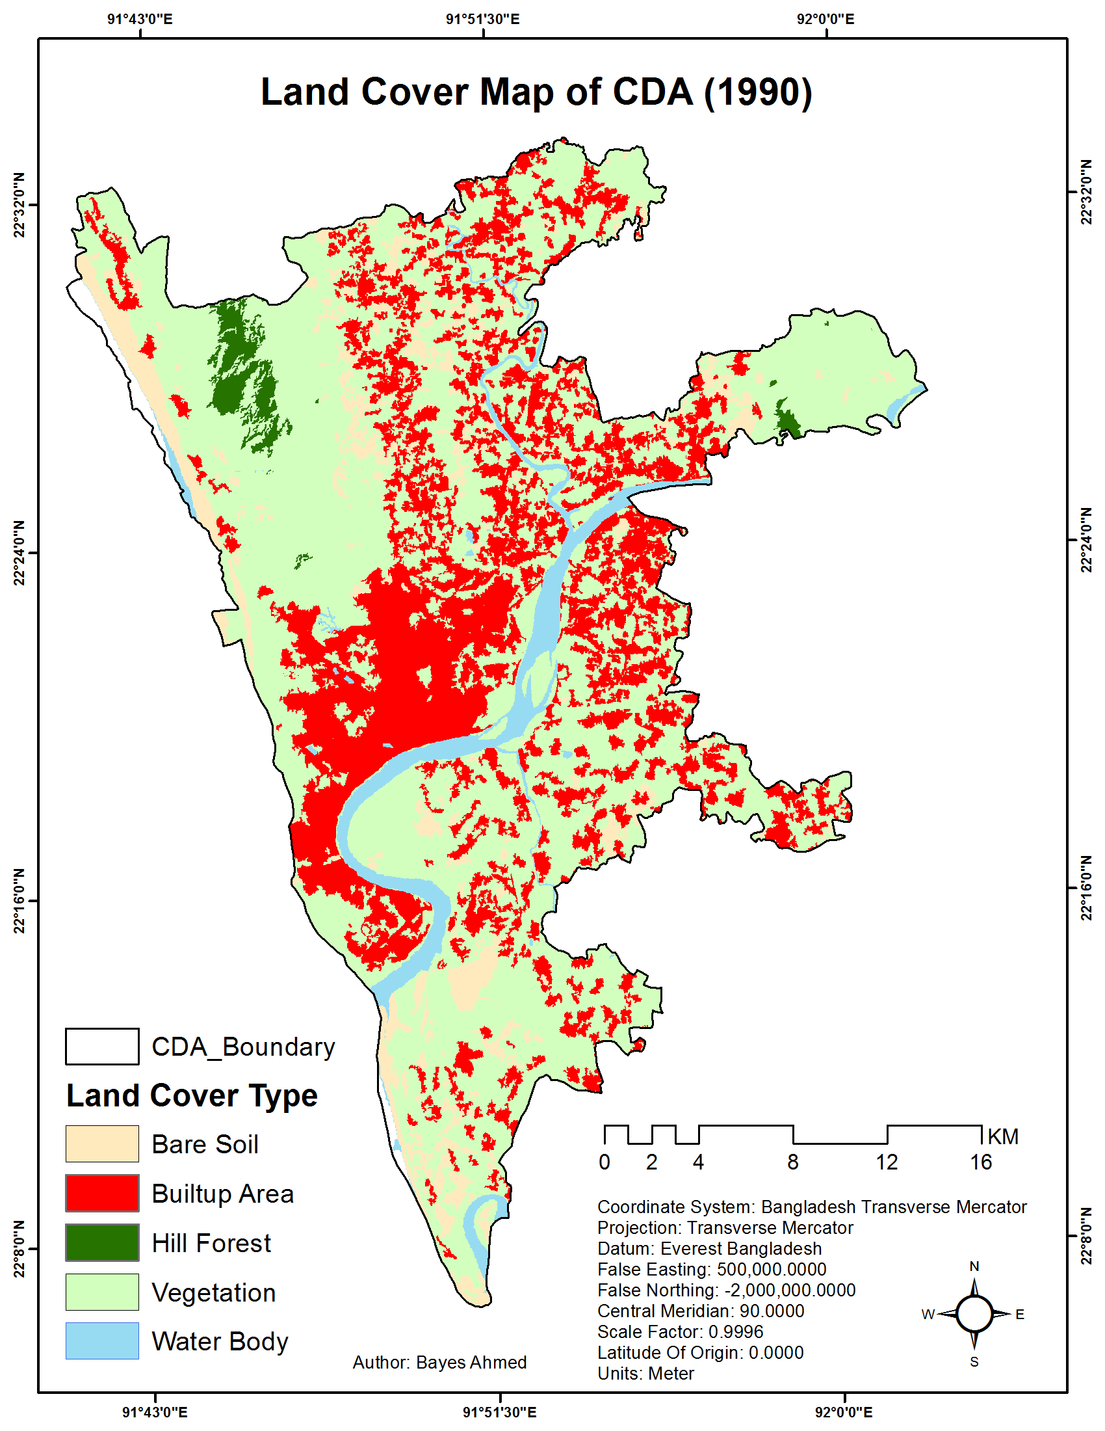
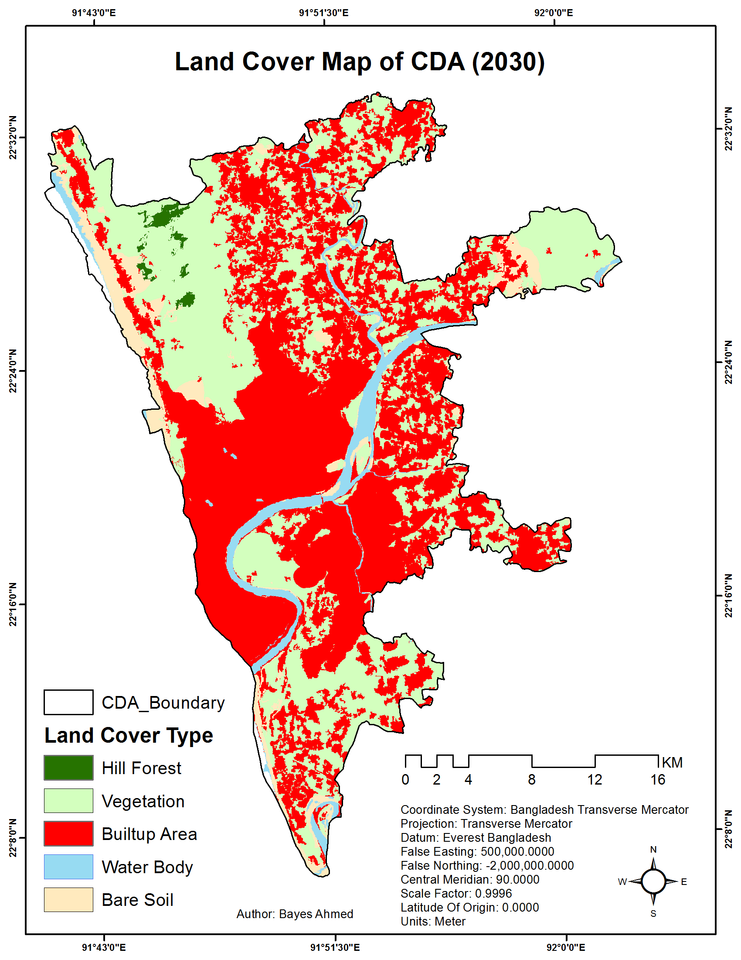
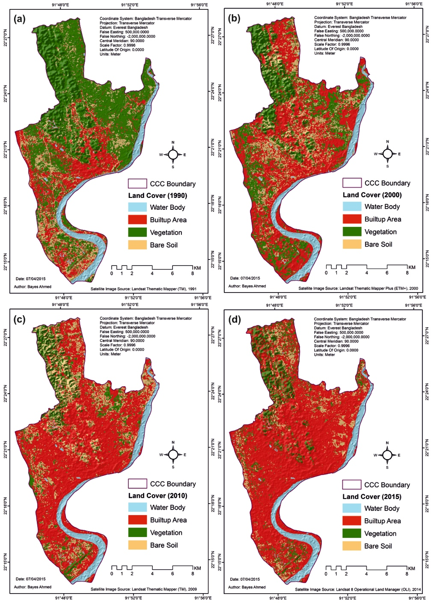
Landover Modeling

Slide 15
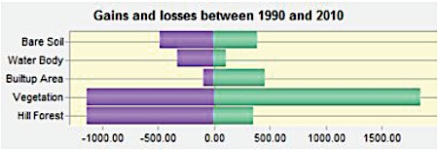
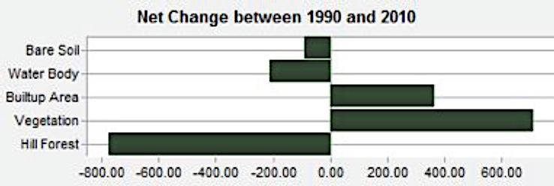
Landover Modeling

Slide 16
Current Practice
Rainfall Threshold for the Initiations of Landslide considers:
Duration of Rainfall/ cumulative rainfall in 7 days
Teknaf = 170mm in 1 day or 420mm in 2 days
Cox’s Bazar = 96mm in 1 day or 185mm in 2 days
Cox’s Bazar Warning System:
50mm in 1 day = Alert
75mm in 1 day = Ready for Evacuation
90mm in 1 day = Evacuate
Source: CDMP-II

Slide 17
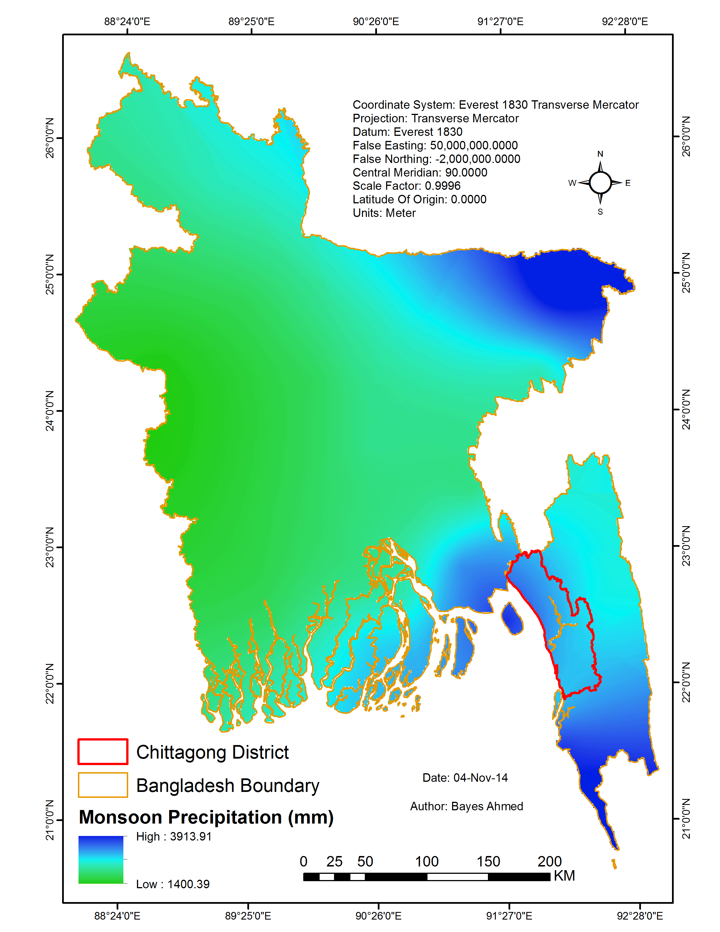
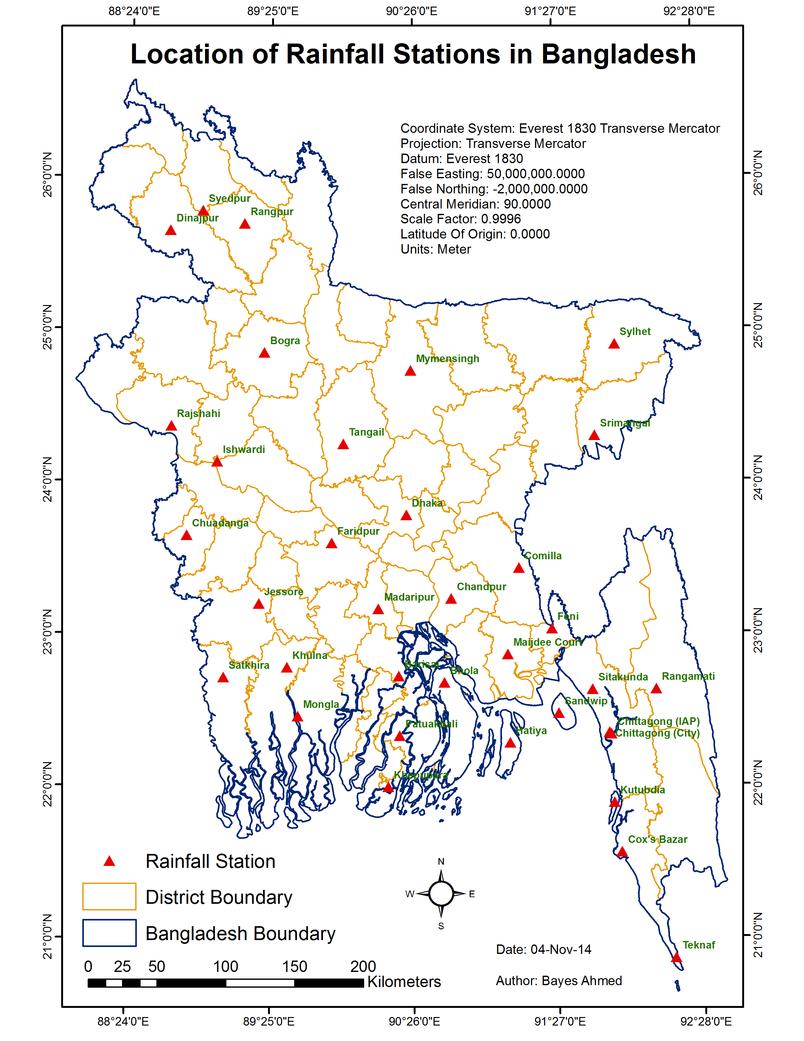
Rainfall Pattern
Year: 1950-2010
Month: April-October
Source: BMD

Slide 18
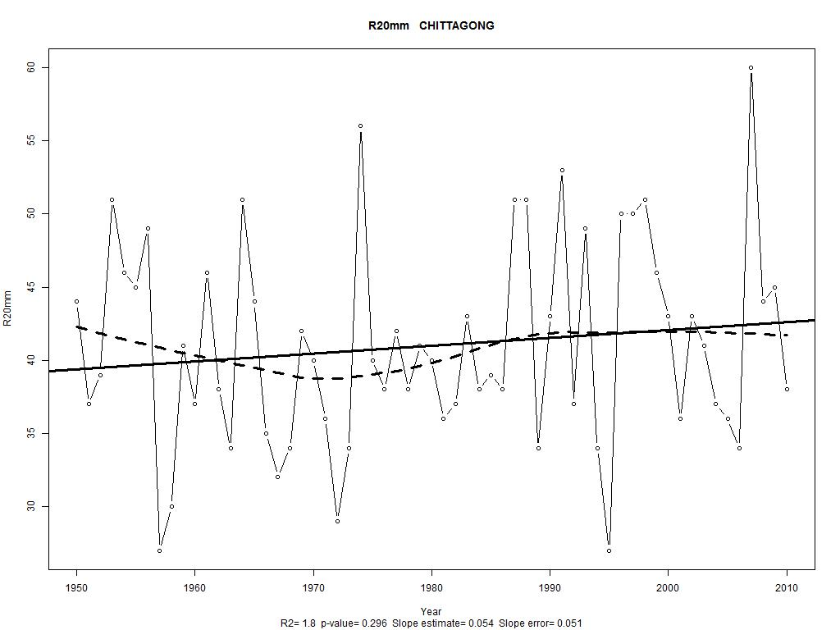
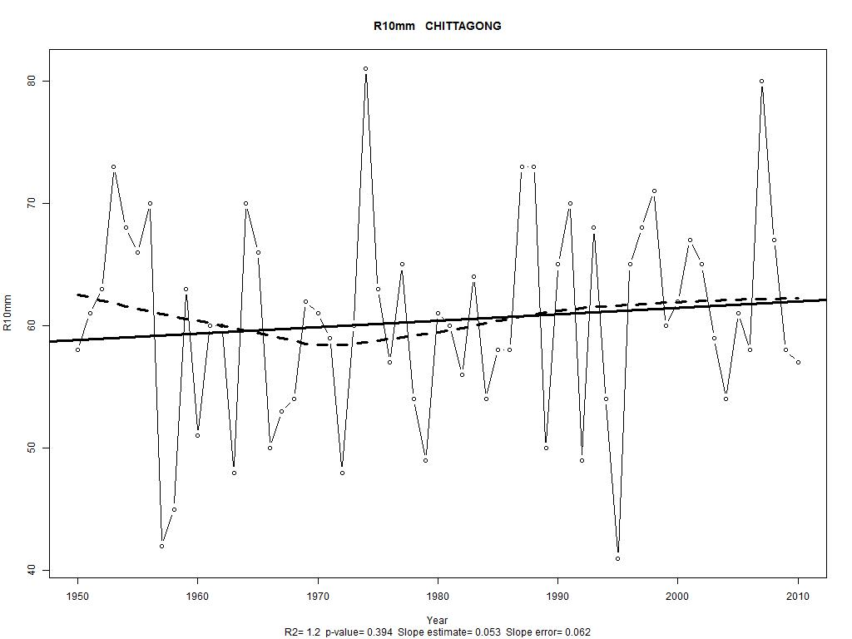
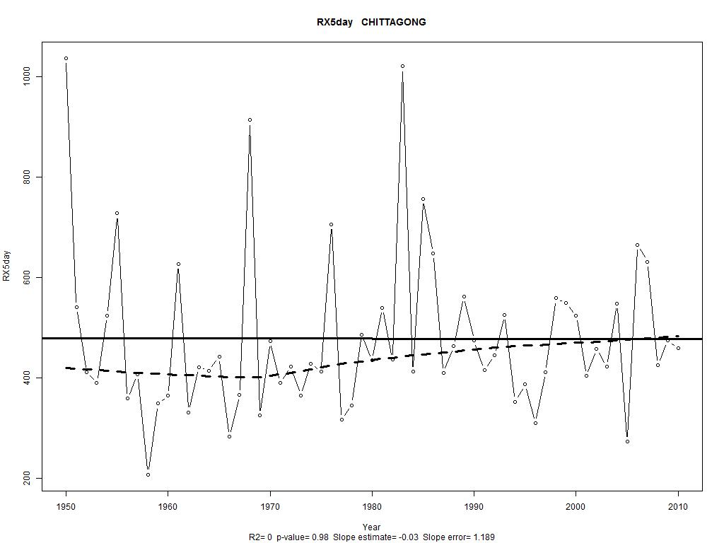
Rainfall Pattern

Slide 19
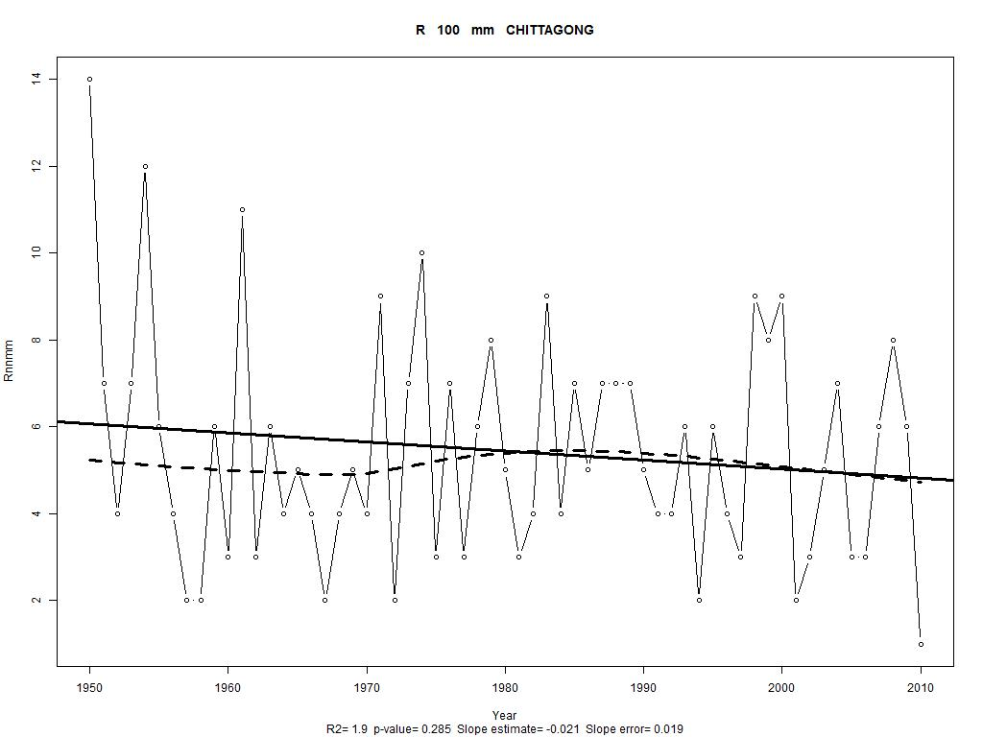
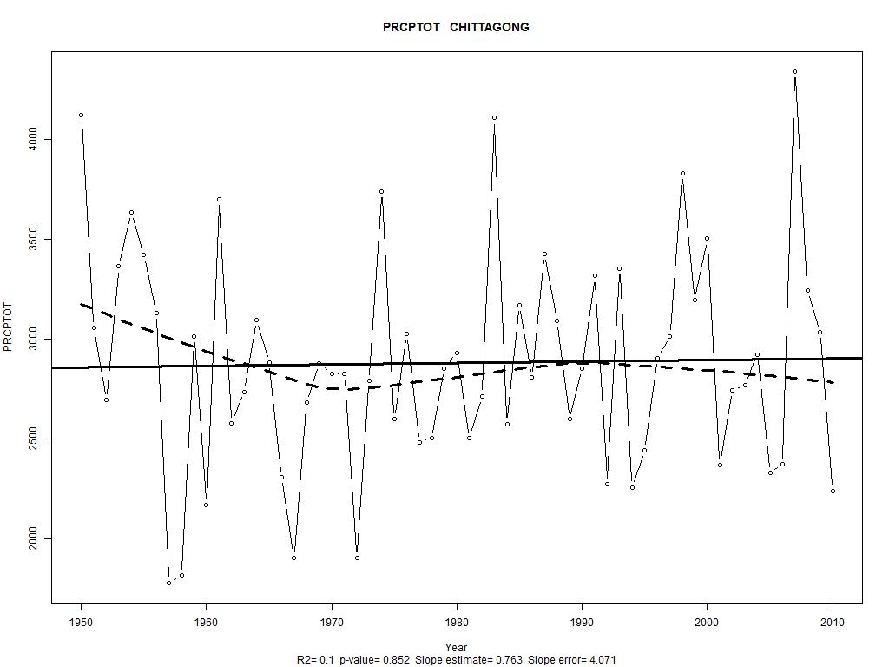
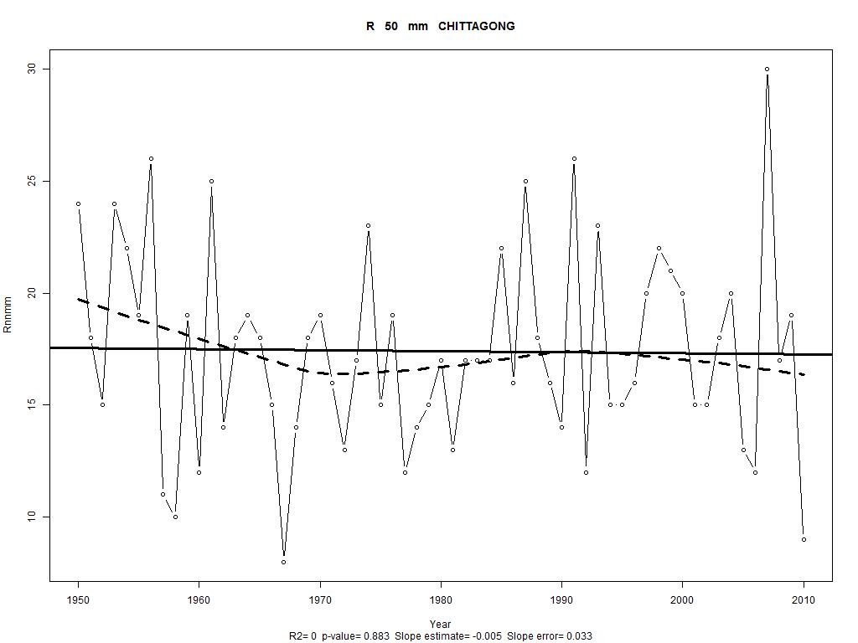
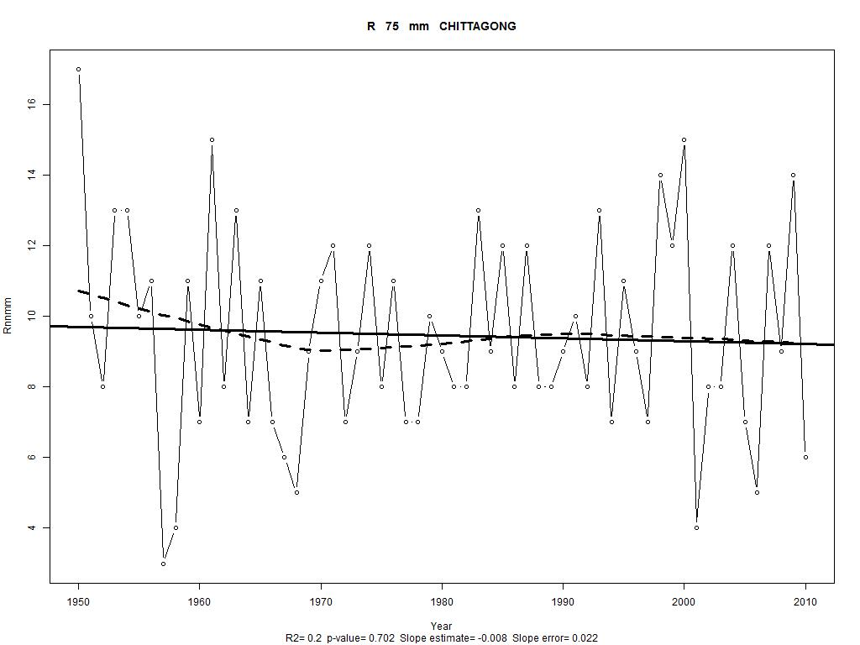
Rainfall Pattern

Slide 20
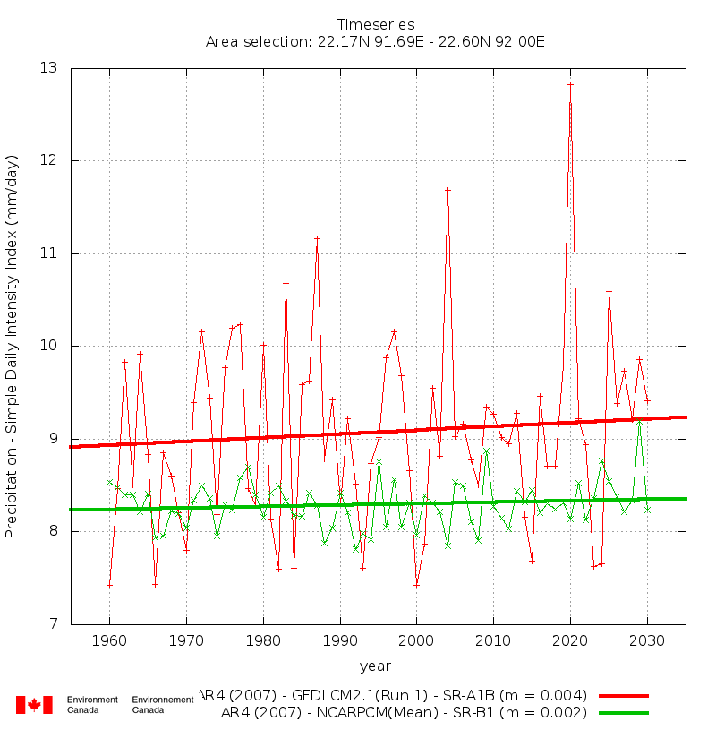
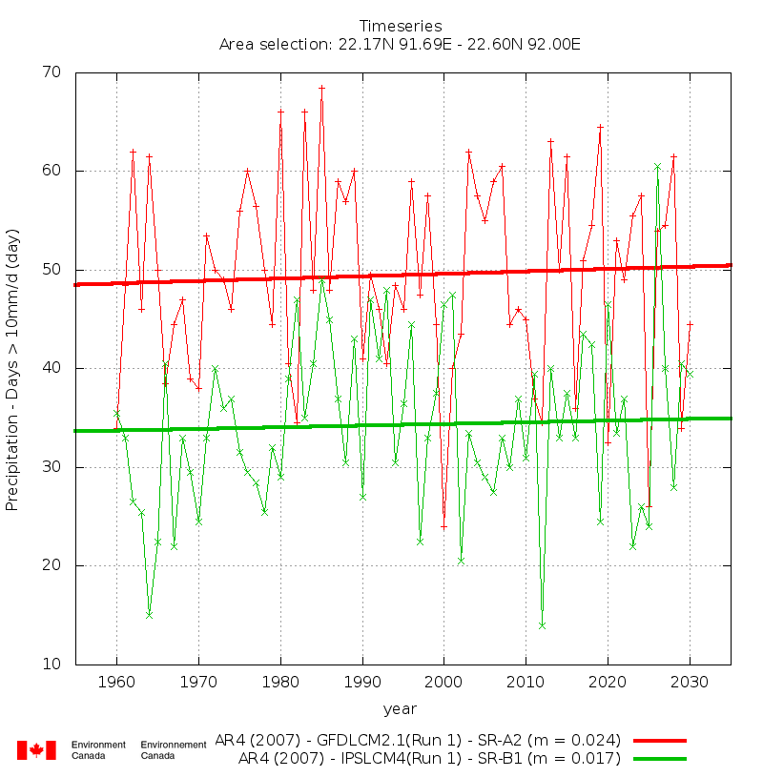
Rainfall Pattern

Slide 21
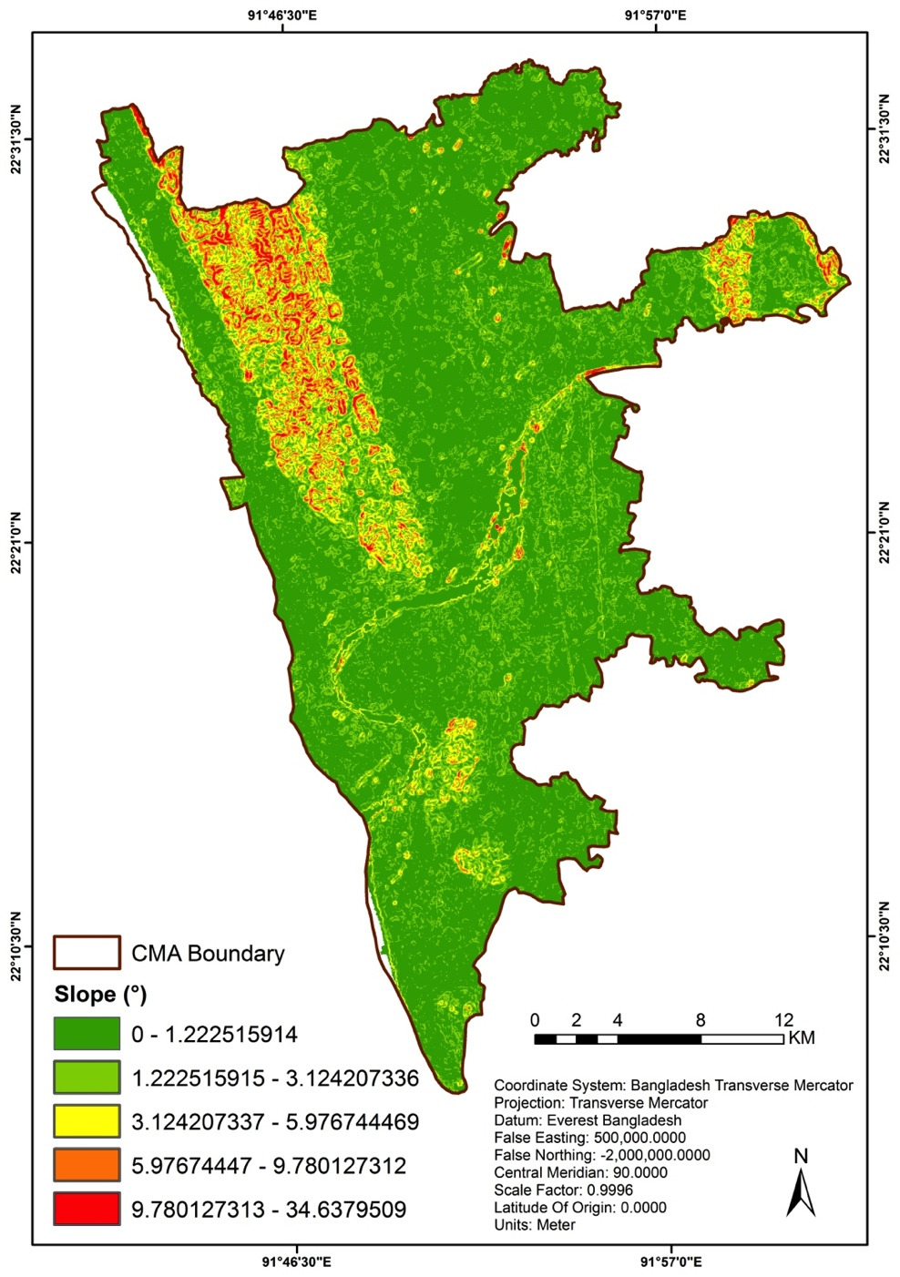
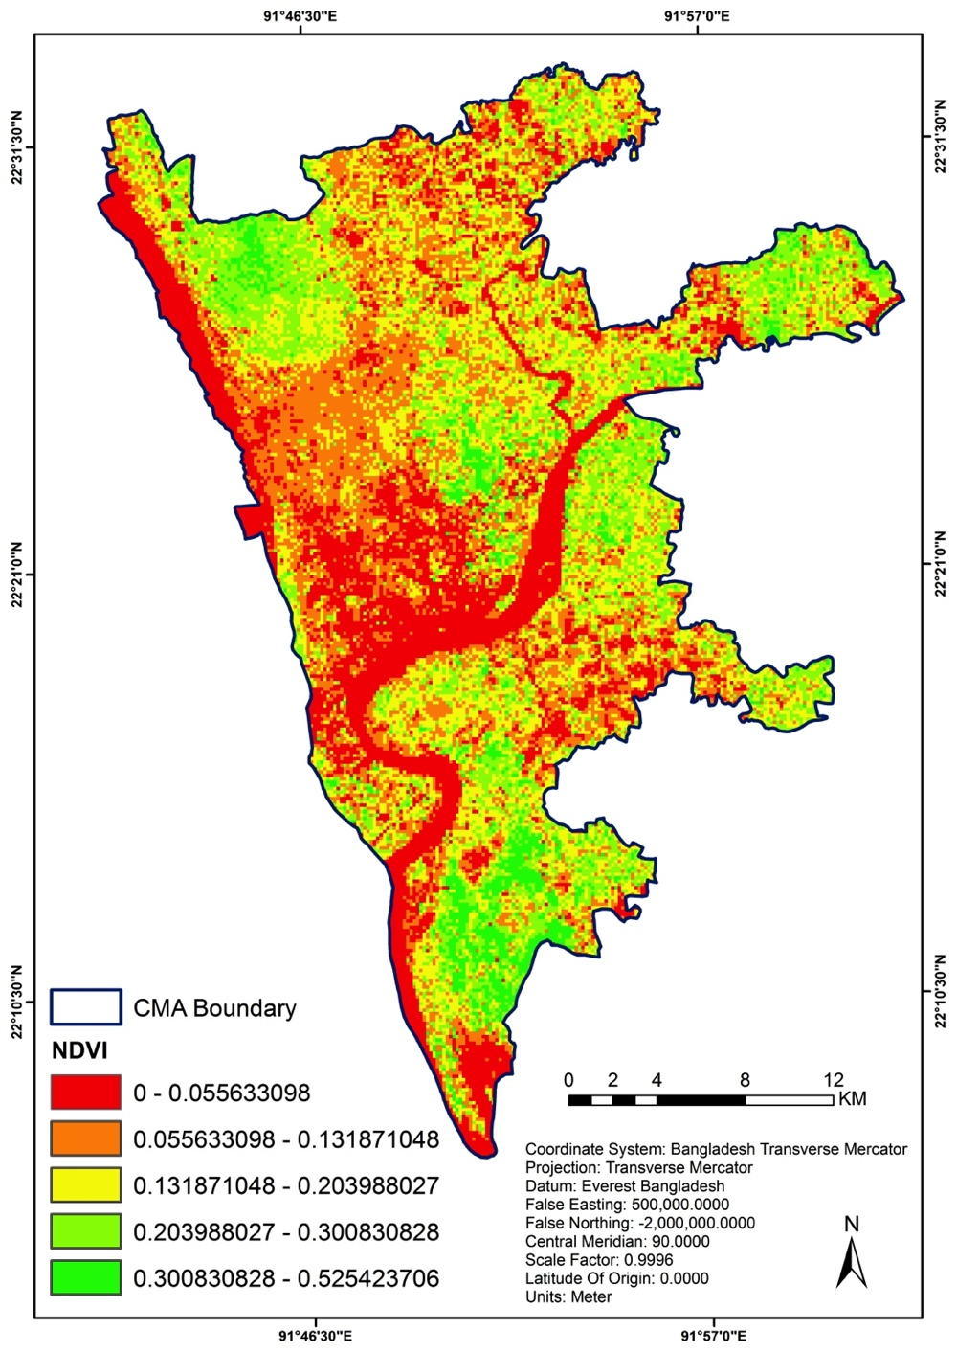
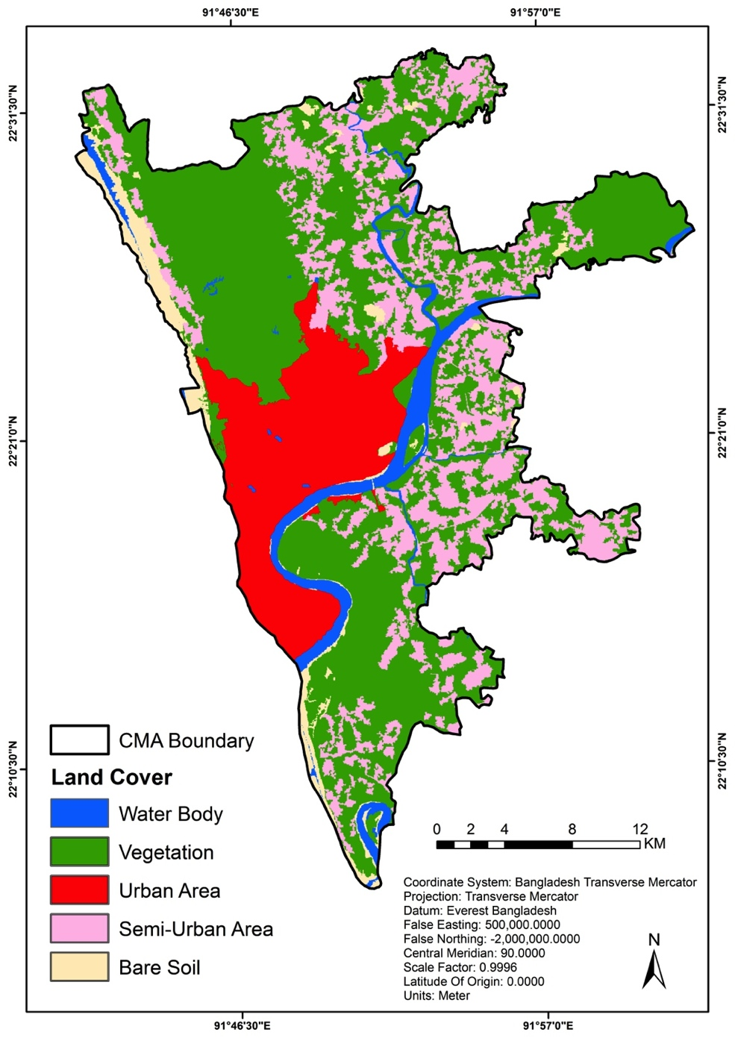
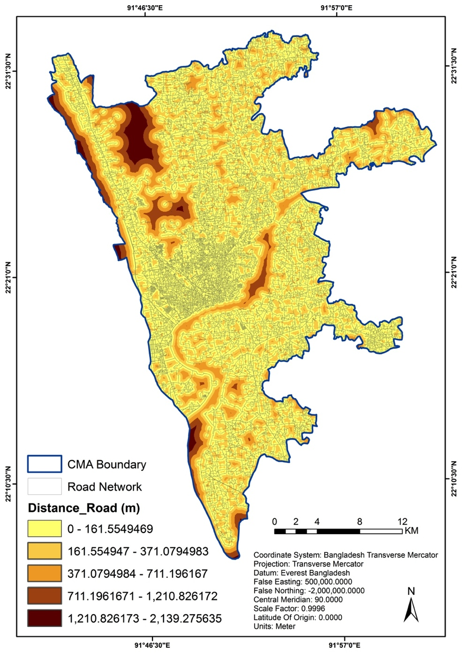
Causative Factors

Slide 22
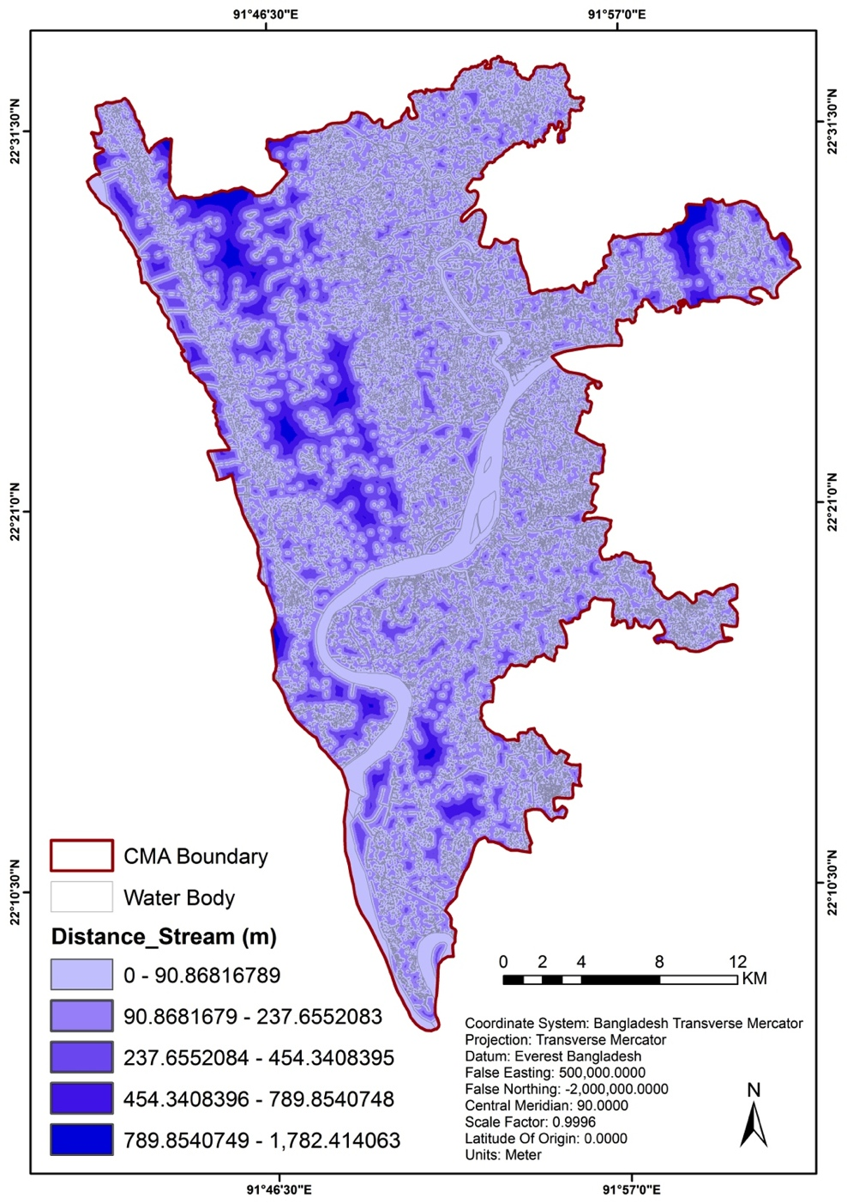
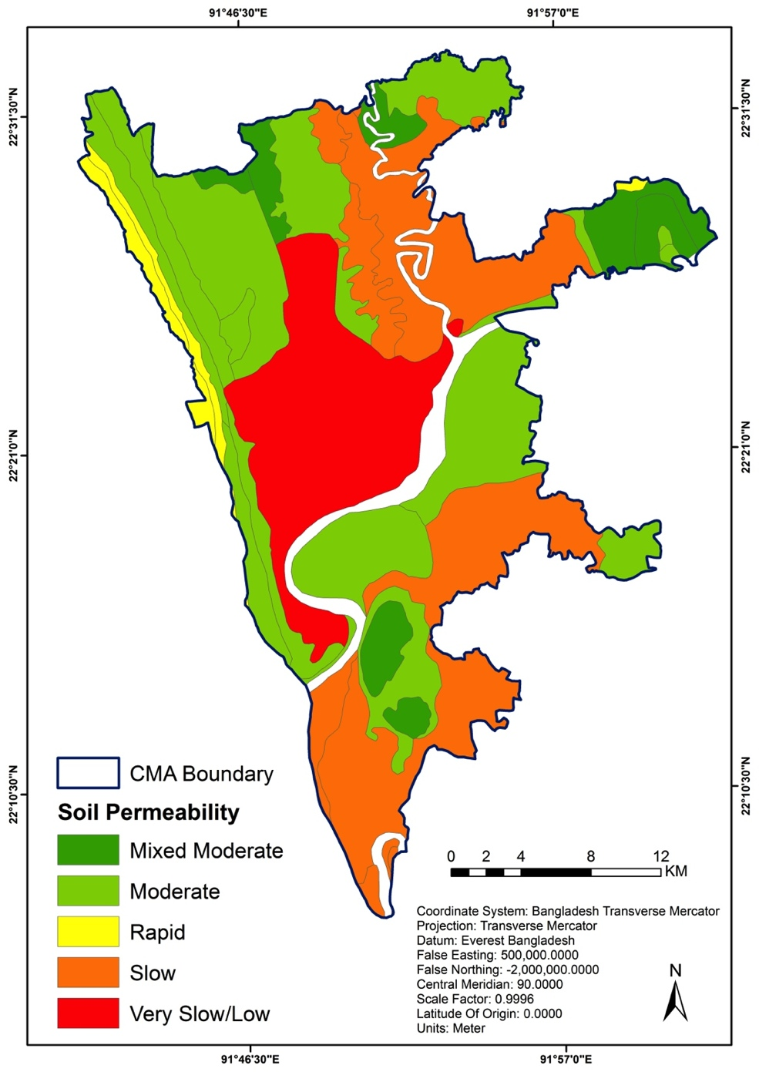
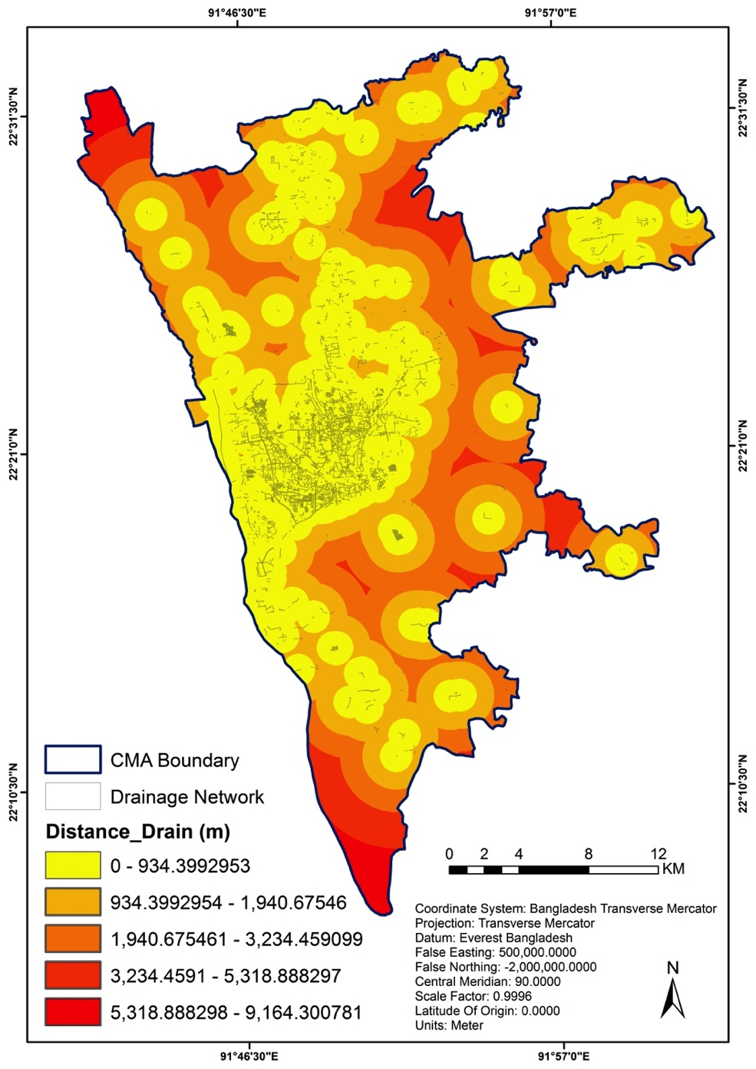
Causative Factors

Slide 23
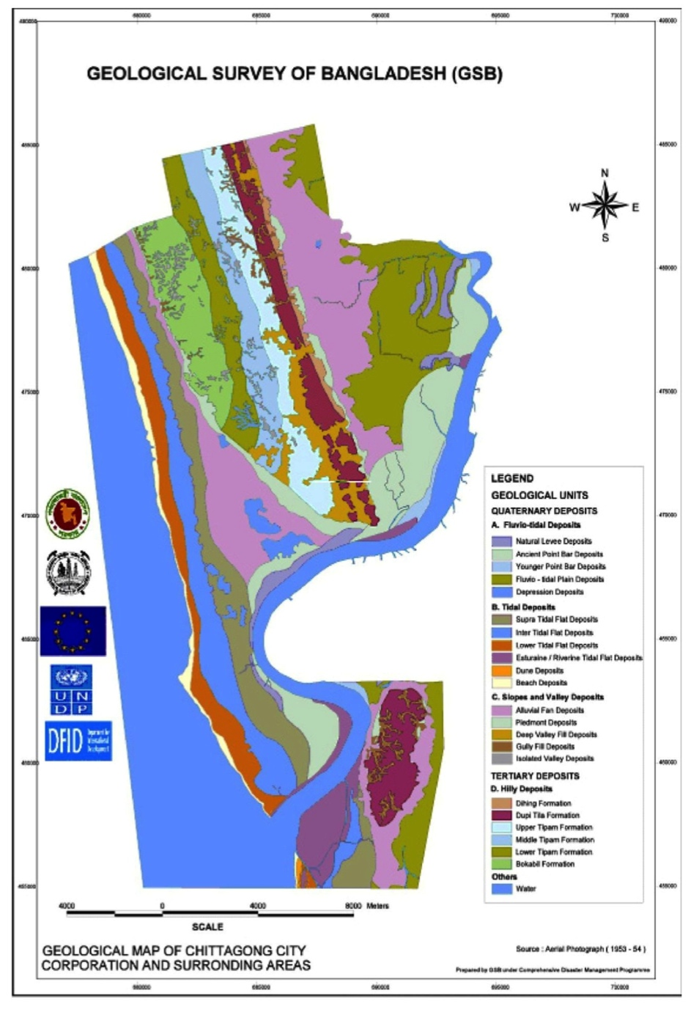
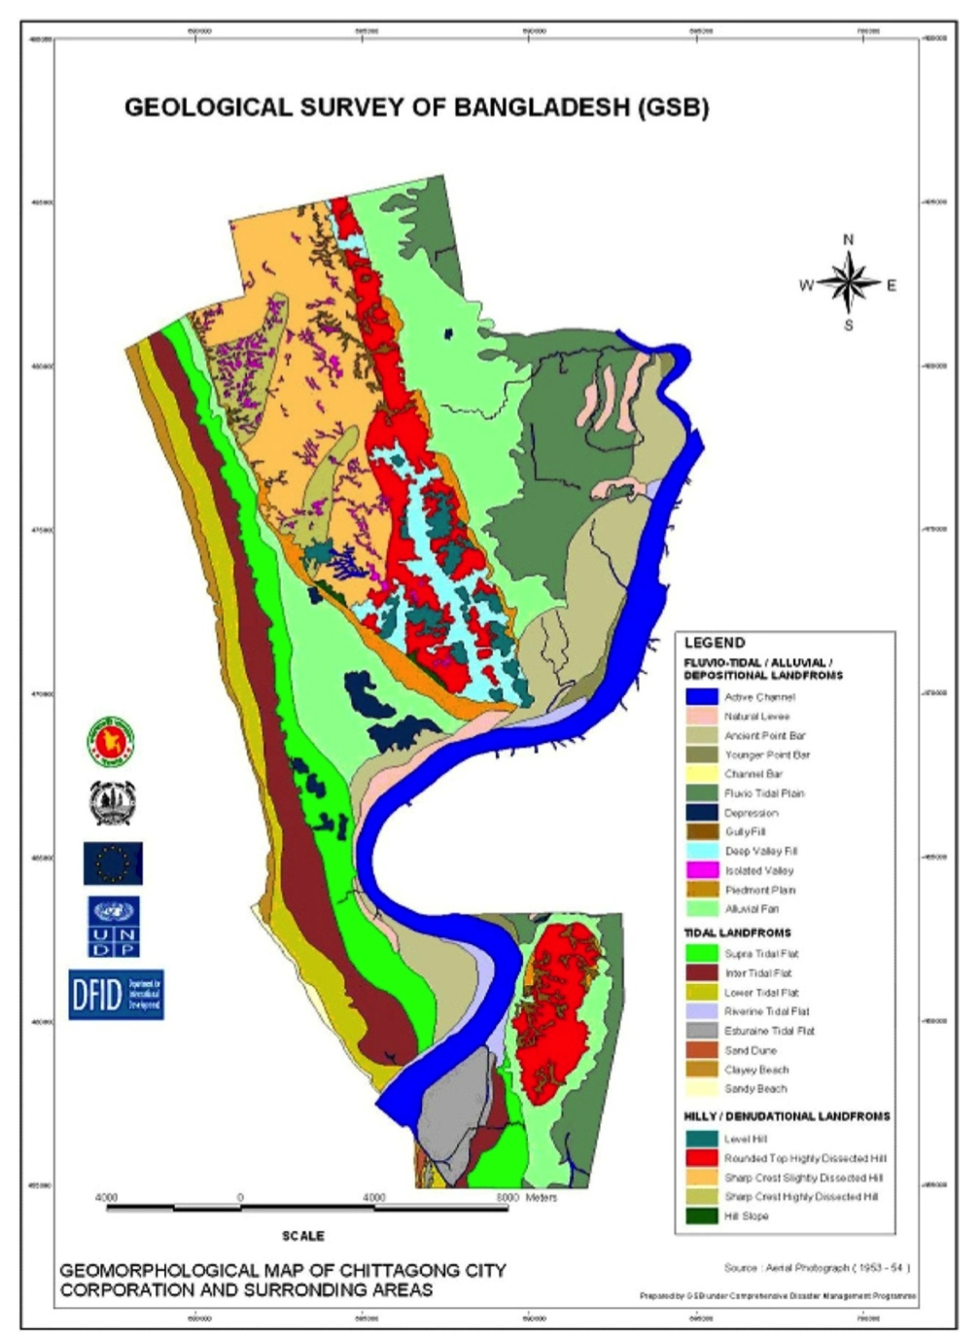
Causative Factors

Slide 24
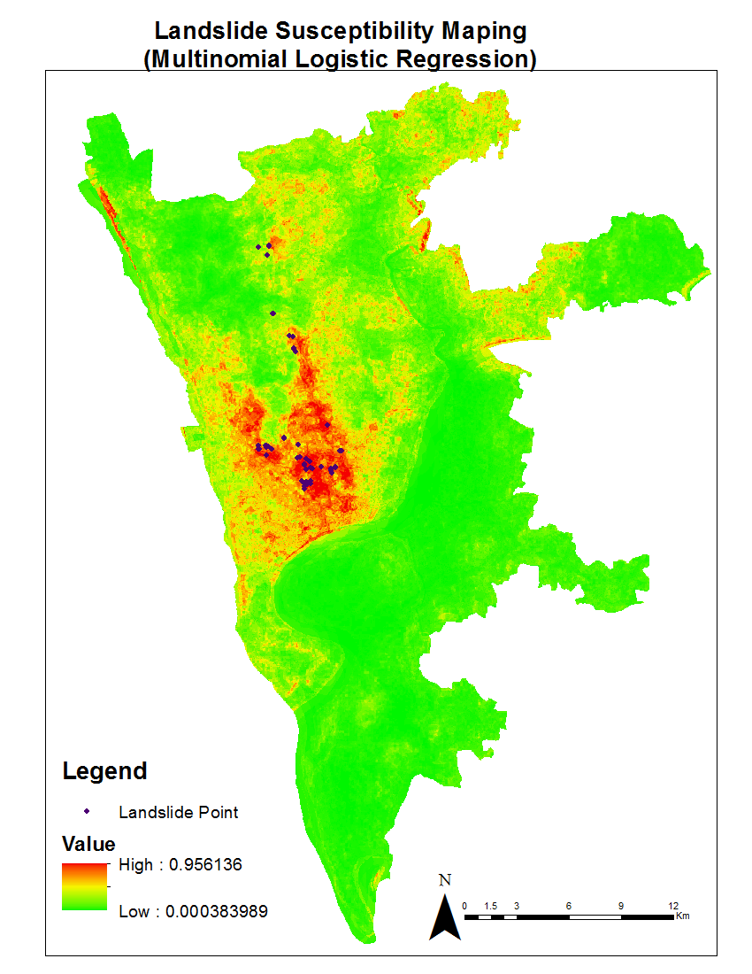
Landslide Susceptibility Mapping (LSM)
Multinomial Logistic Regression
MLR assume the dependent variable following the logistic probability distribution and use the Maximum Likelihood Estimation as the estimation method.
0.000383989 - 0.101581253
= precipitation > 250mm in 1 day
0.101581253 - 0.247755079
= precipitation > 100mm in 1 day
0.247755079 - 0.416417186
= precipitation > 40 mm in 1 day or > 200mm in continuous 3 days
0.416417186 - 0.626307808
= precipitation > 25 mm in 1 day or > 50mm in continuous 3 days
0.626307808 - 0.952387882
= precipitation >= 15mm in 1 day or > 30mm in continuous 3 days

Slide 25
Threshold Limit

Slide 26
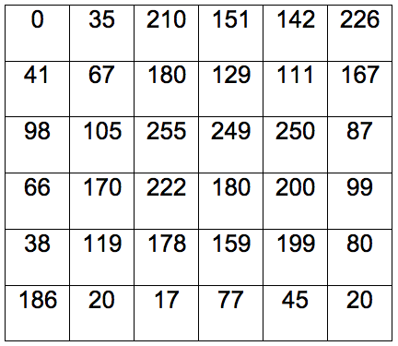
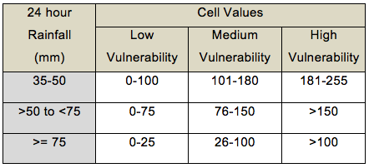
Determining the Scale

Slide 27
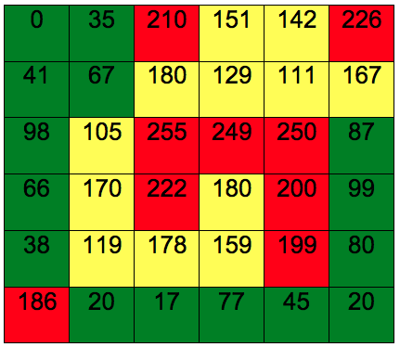
Vulnerability Mapping
24 hours 40mm Rainfall
Red Cells: 9
Yellow Cells: 12
Green Cells: 15

Slide 28
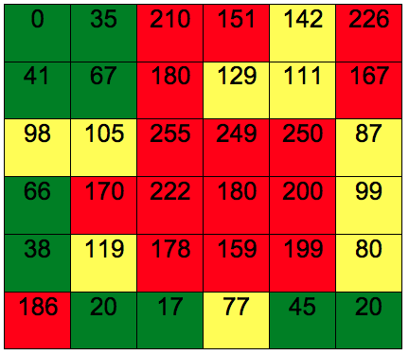
Vulnerability Mapping
24 hours 70mm Rainfall
Red Cells: 16 (9)
Yellow Cells: 10 (12)
Green Cells: 10 (15)

Slide 29
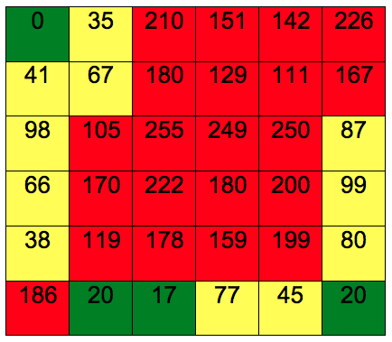
Vulnerability Mapping
24 hours 90mm Rainfall
Red Cells: 21 (16)
Yellow Cells: 11 (10)
Green Cells: 4 (10)

Slide 30
How It Works
Separate 24 Hour and 7 Days Scale will be Produced
Web-GIS based Dynamic Website
Linked with (Advanced) 5 Days Rainfall Amount
Linked with Community People and Relevant Experts through Mobile SMS and Email
Universal Model, Applicable Everywhere by Changing the Data Sets as per the Local Needs and Desired Accuracy
Website: www.landslidebd.com

Slide 31
Limitations
Cell Size Determination
Low Resolution Images (e.g. slope and land cover)
Lack of Data (e.g. detail geological issues)
Lack of Other Soil Parameters
Updating the Landuse Map
Assigning the Weights
Incorporating Local Knowledge

Slide 32
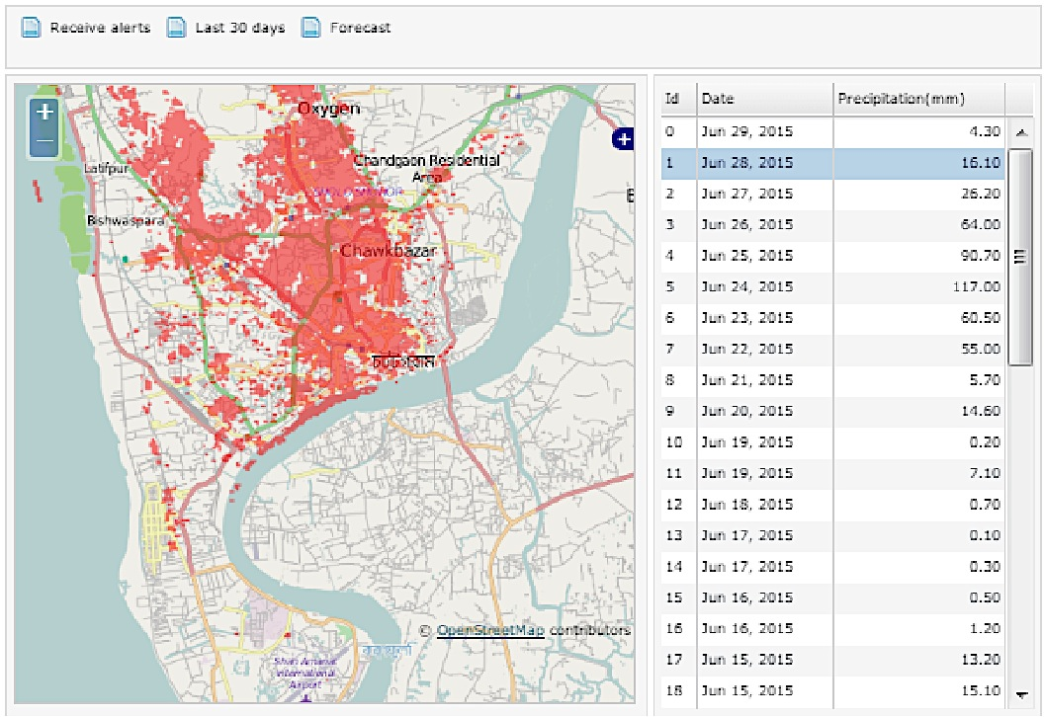
Web Based Early Warning ( www.landslidebd.com)

Slide 33
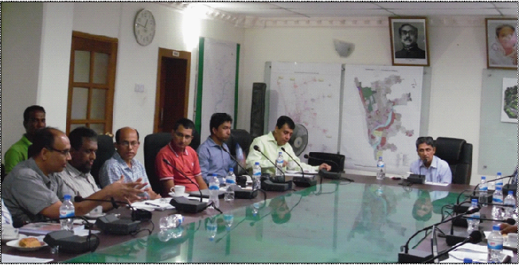
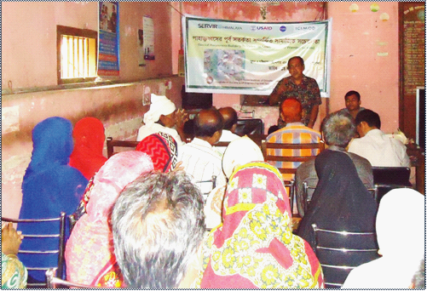
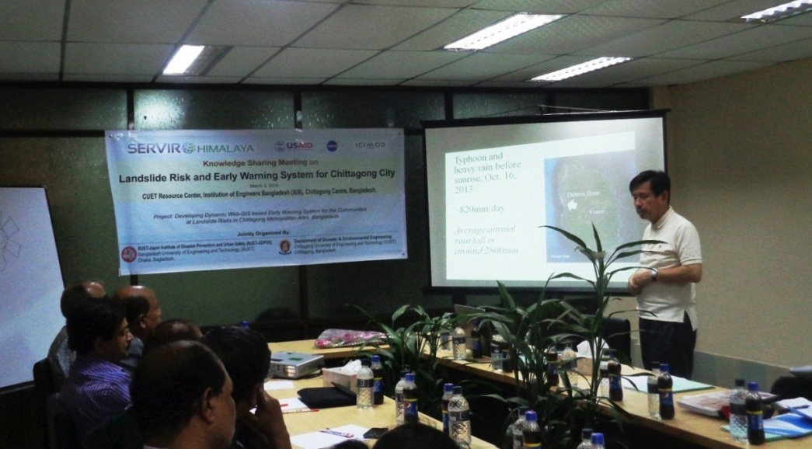
Outreach
Stakeholder Meeting with Chittagong Development Authority
Community Awareness Building at Ward Councilor office
Expert Knowledge Sharing Meeting at Chittagong
Door to Door Awareness Building Program in Vulnerable Community

Slide 34
THANKS TO ALL!
Email: bayesahmed@gmail.com

