Slide 1
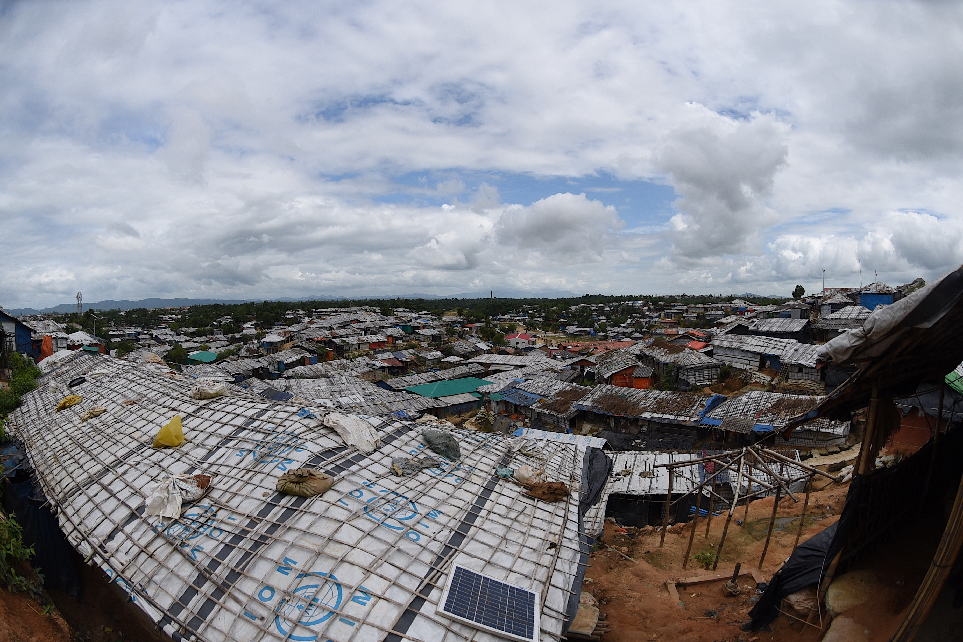
Rohingya Journeys of Violence and Resilience in Bangladesh and its neighbours: Historical and Contemporary Perspectives
BAYES AHMED
UCL Humanitarian Institute, University College London (UCL)

Slide 2
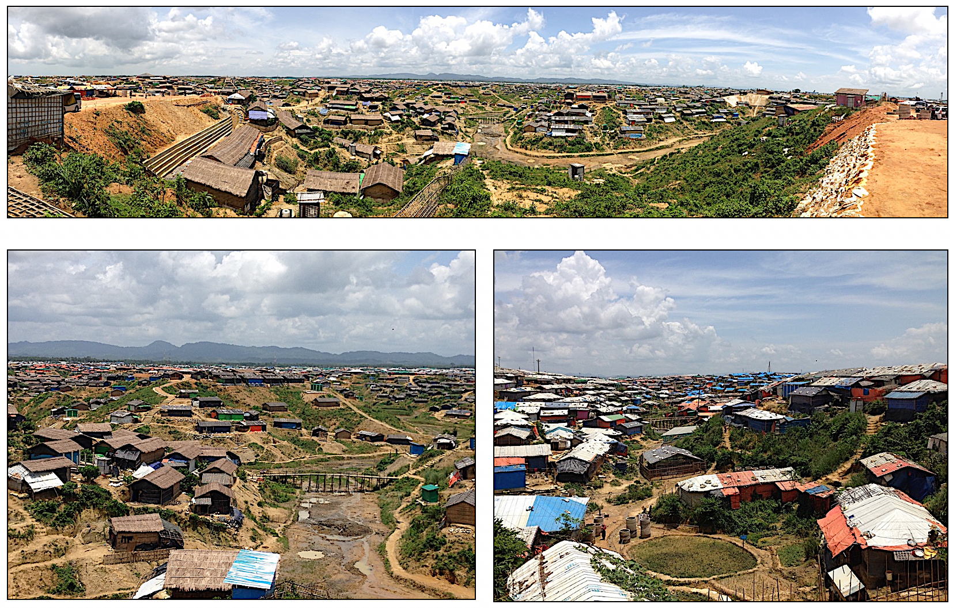
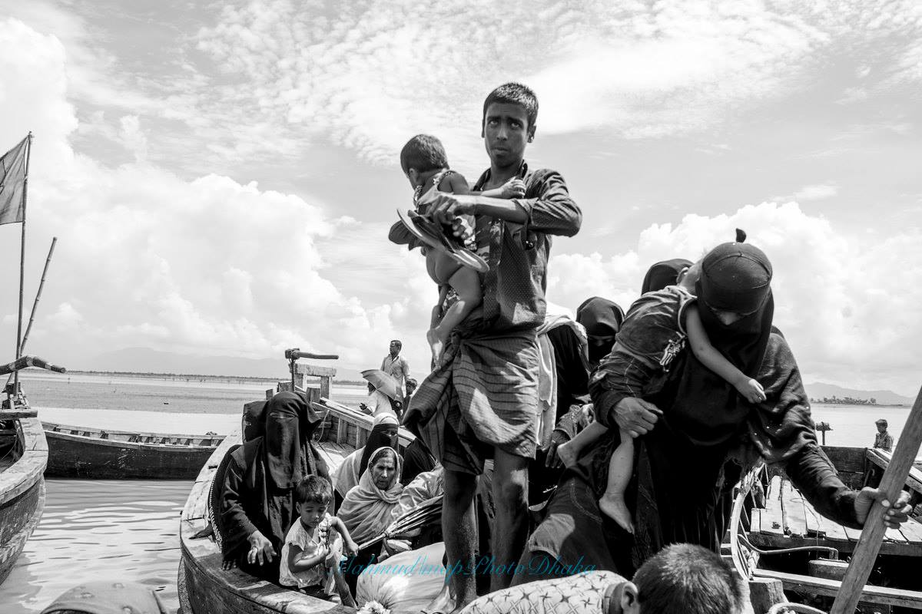
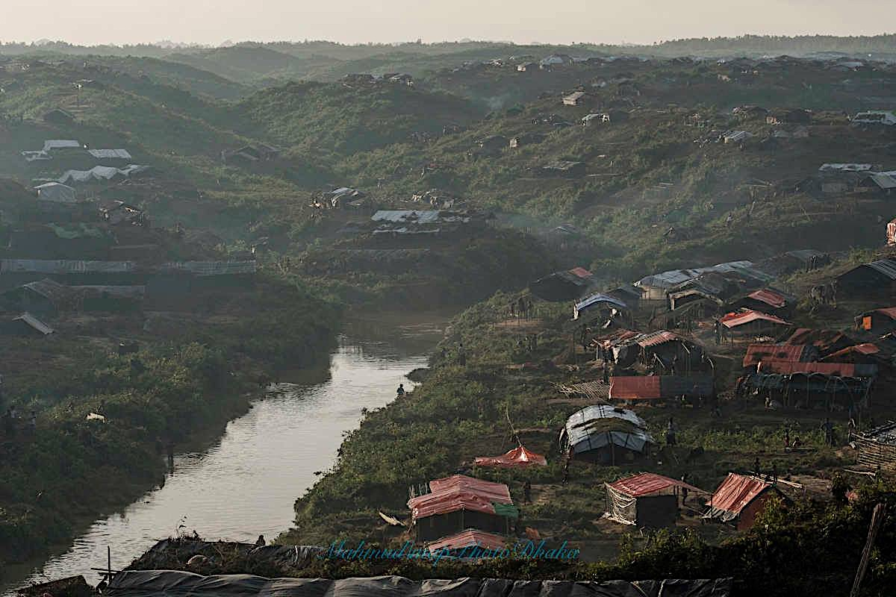
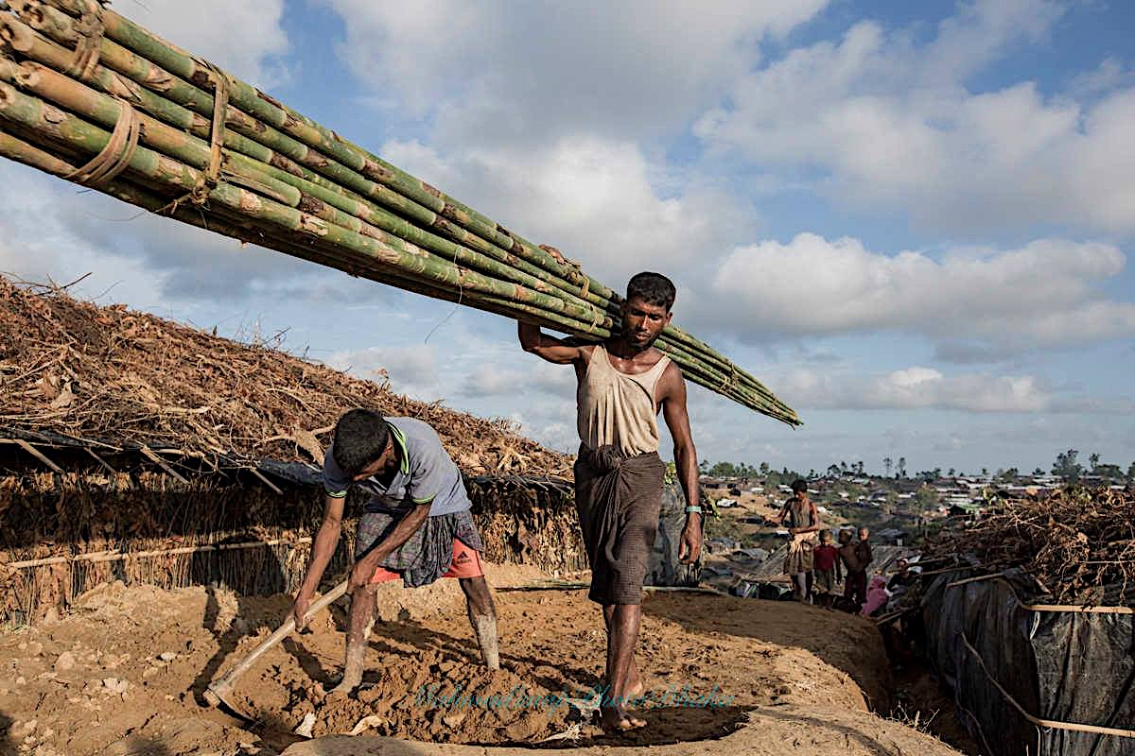
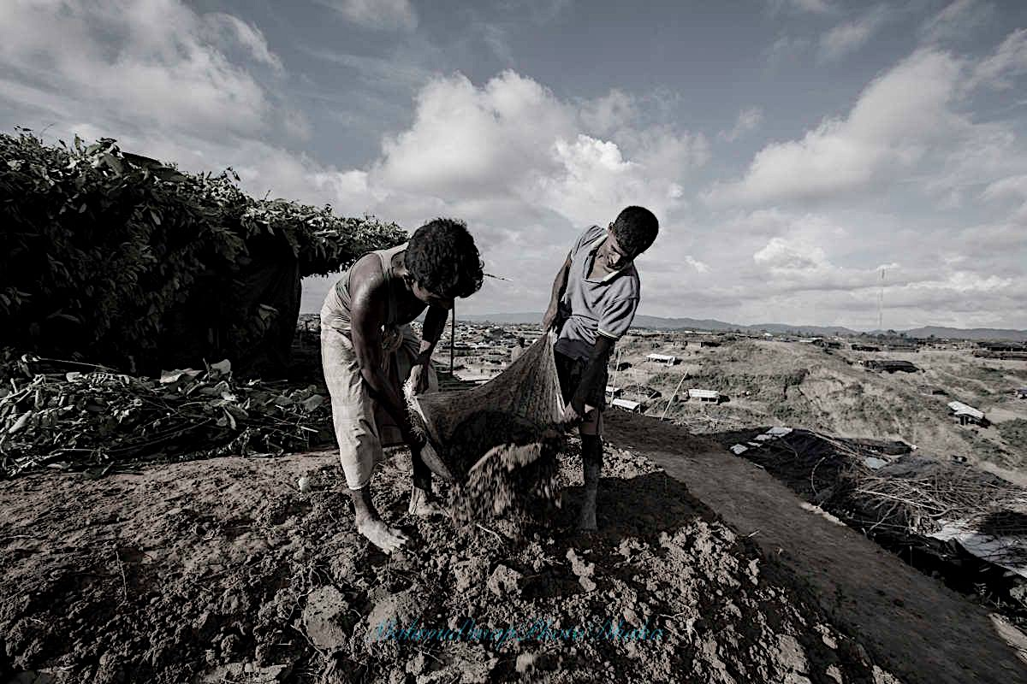
August 2017 Rohingya Exodus

Slide 3
Rohingya Crisis
The Inter Sector Coordination Group (ISCG) estimates that nearly 1.25 million people are in urgent need of humanitarian assistance in Cox’s Bazar, Bangladesh including the Rohingyas and over 336,000 vulnerable Bangladeshis in host communities. To tackle this crisis and meet the massive needs, the United Nations (UN) seeks US$920 million in 2019 (ISCG, 2019).
“Myanmar military should be investigated and prosecuted in an international criminal tribunal for genocide, crimes against humanity and war crimes”.
Source: UN Independent International Fact-Finding Mission on Myanmar (17 September 2018)

Slide 4
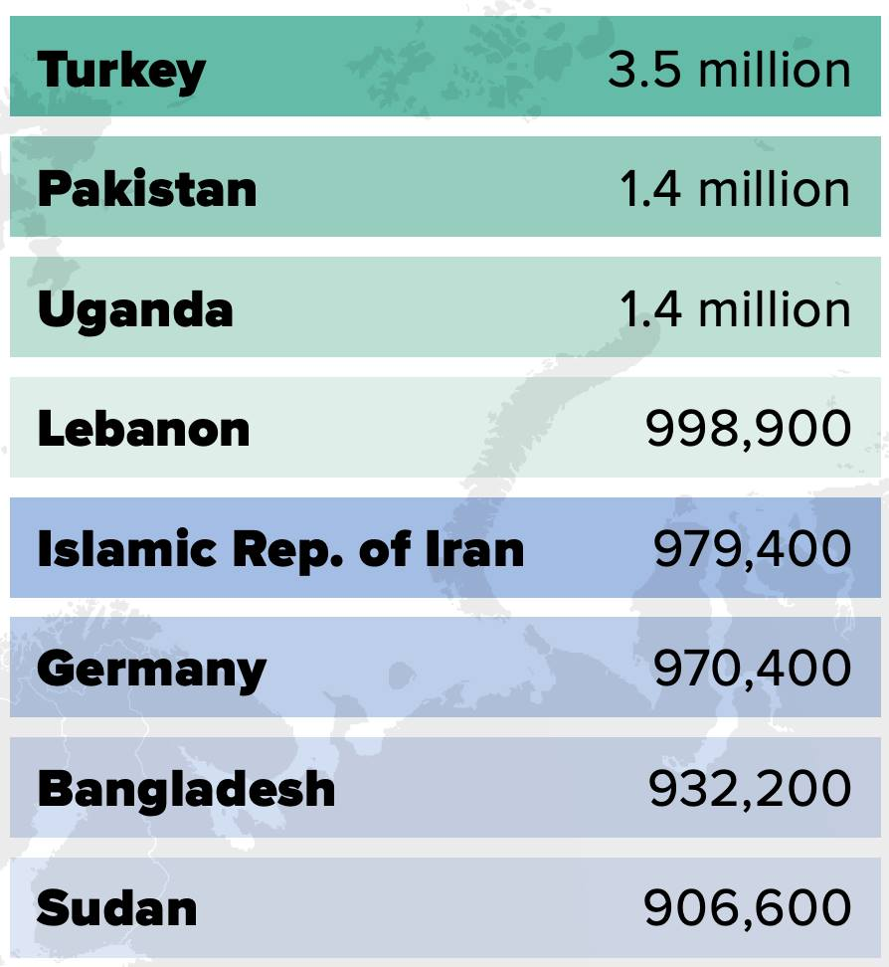
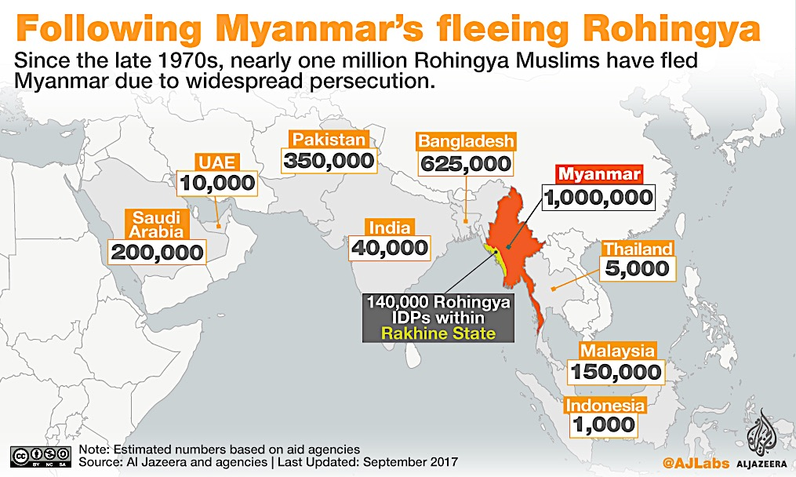
Rohingya Diaspora

Slide 5
Project Aim
The inter-disciplinary collaborative project aims to generate new knowledge produced by, and with, Rohingya refugees regarding their experiences of gendered violence, vulnerability to disasters, resilience characteristics and societal adaptability in a humanitarian context.
The UN Sustainable Development Goals (SDG) – to promote peaceful and inclusive societies and provide access to justice (SDG-16), reduce inequality (SDG-10), achieve gender equality (SDG-5), and to end poverty (SDG-1).

Slide 6
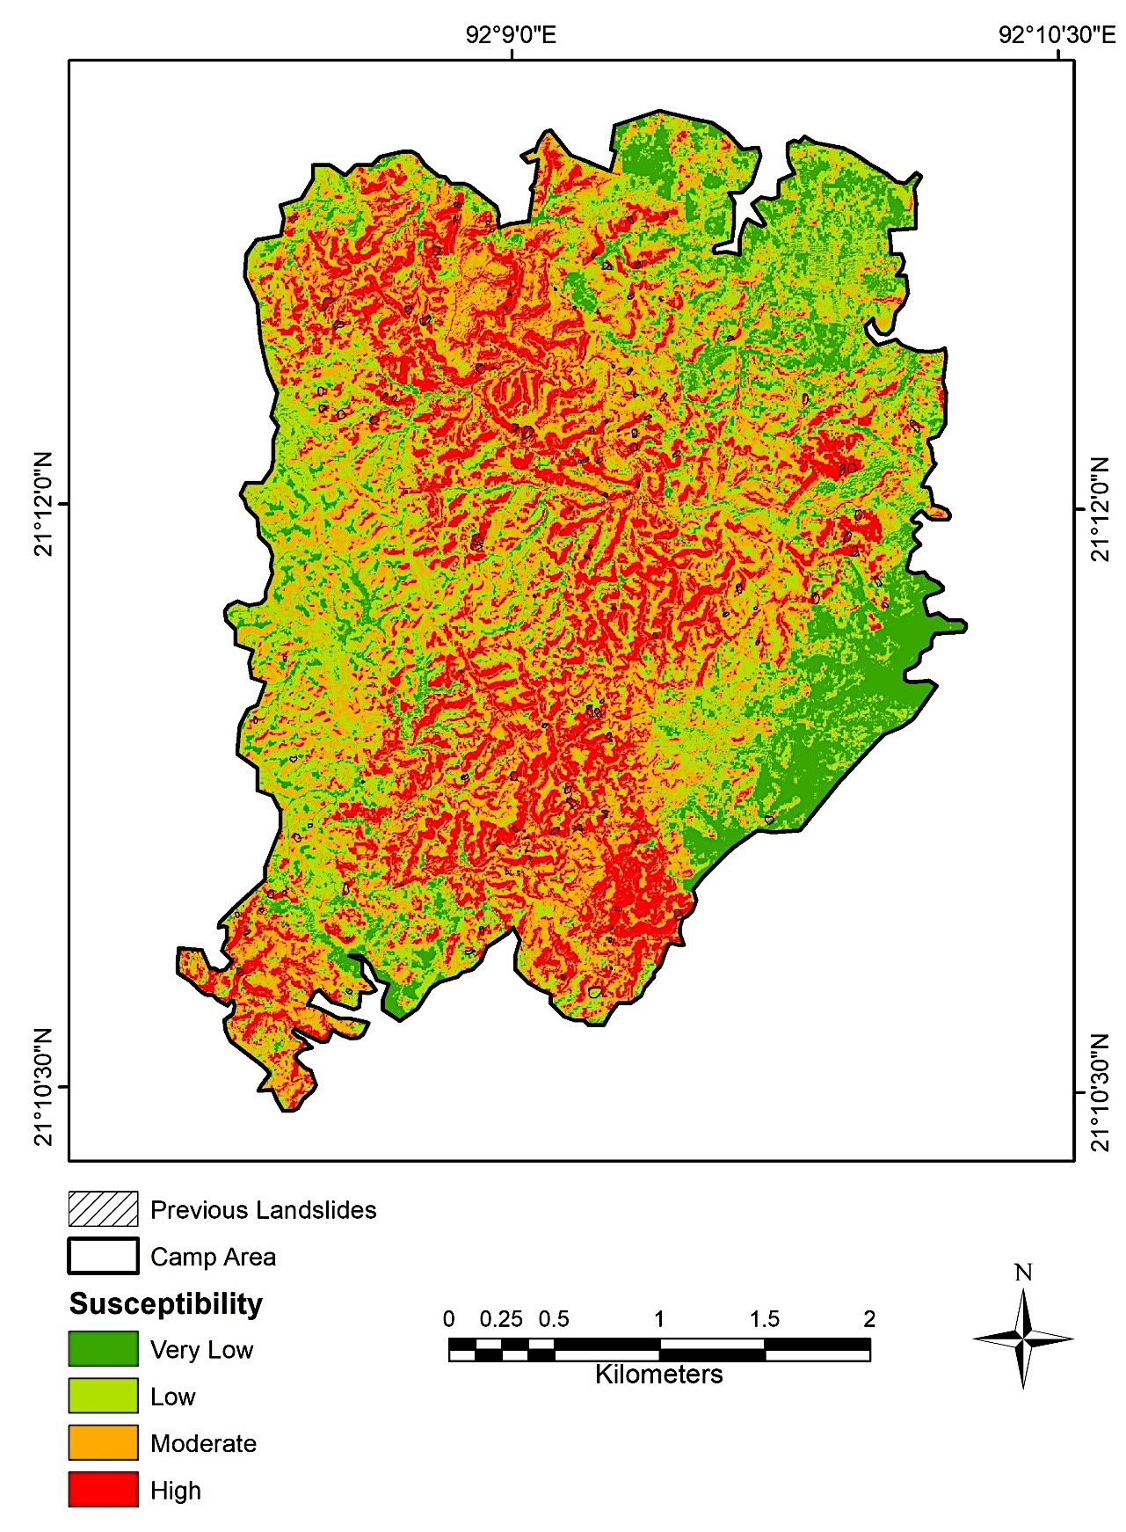
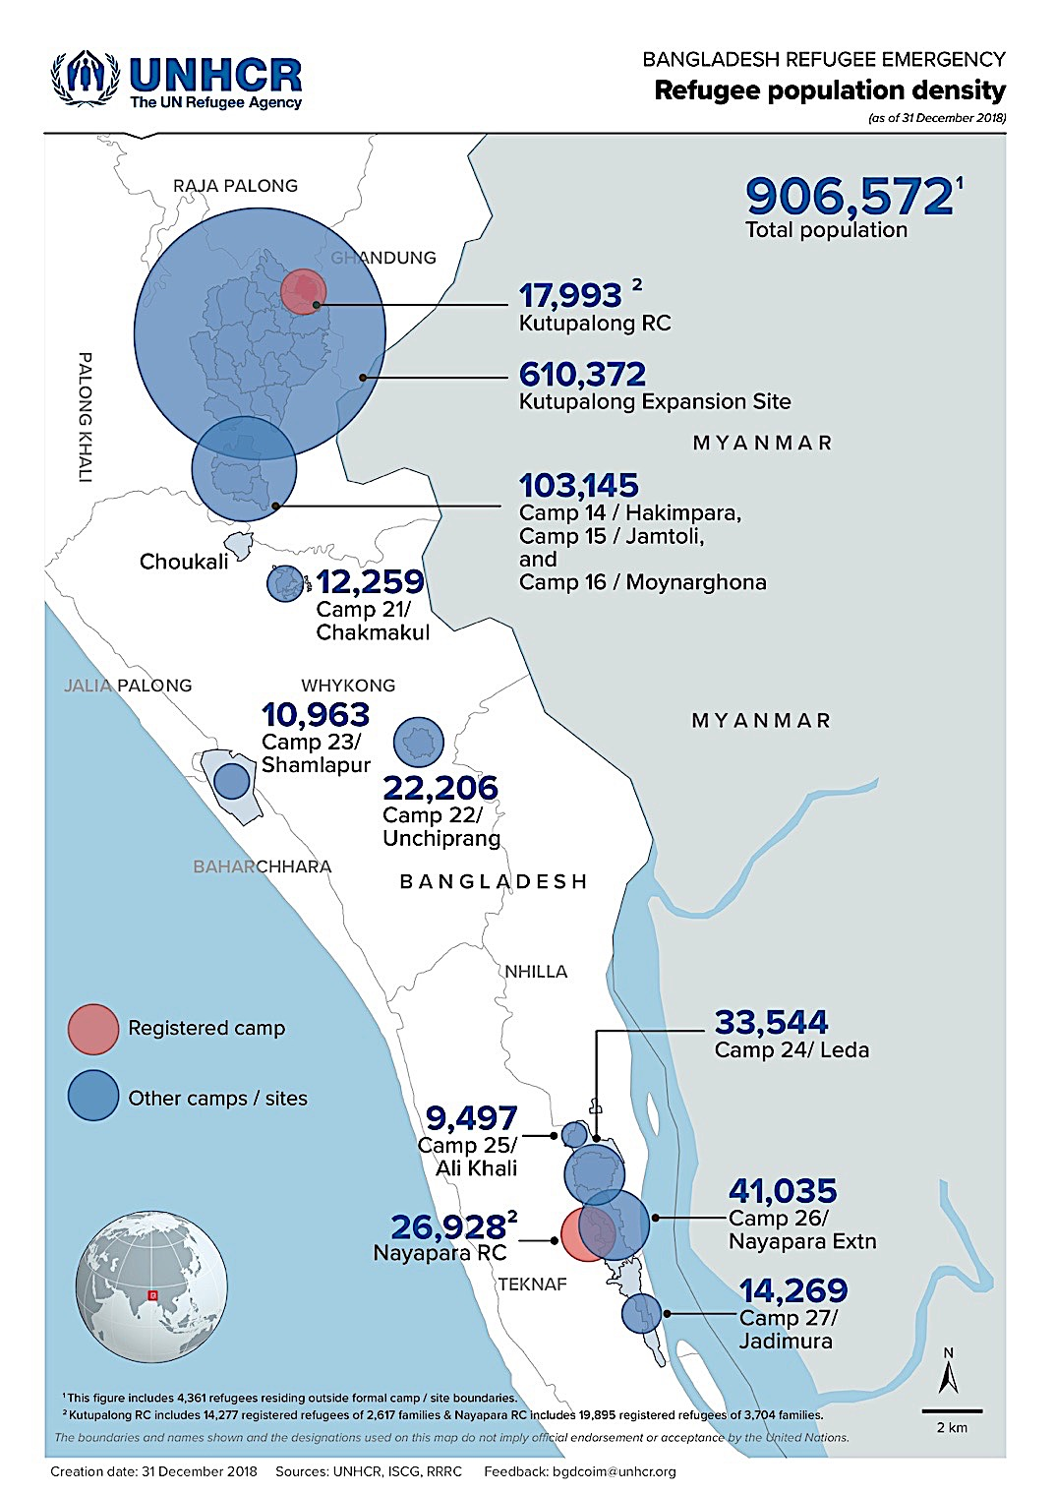
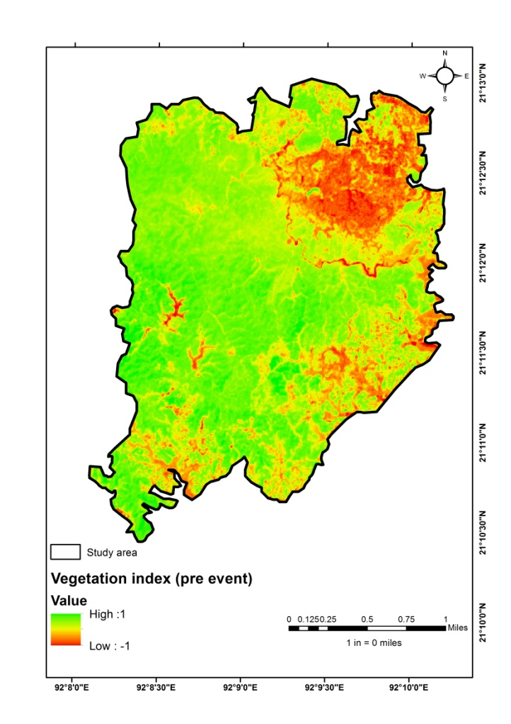
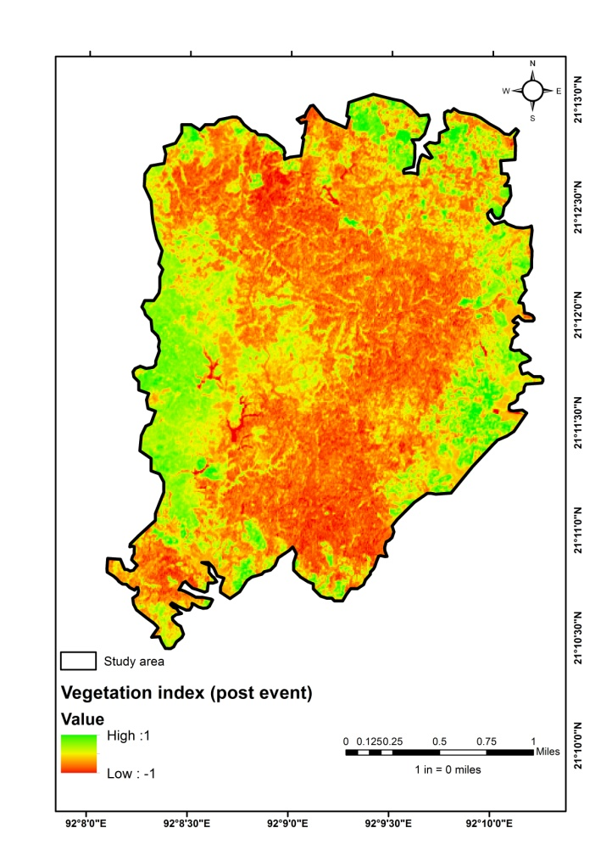
Physical Environment – Bangladesh

Slide 7
Objectives
To understand the political economy of the fresh violence and the gendered nature of its impacts in Bangladesh in contemporary and historical perspective.
To examine Rohingya refugee self-definitions of risk in the context of physical, social and cultural threats (violence), economic and institutional challenges (structural violence) and environmental threats (hazards) in the three case study host countries.
To explore Rohingya refugee coping mechanisms and highlight the different notions of cultural heritage, histories, art and belonging – especially how they have transformed their lives amidst hardships and their relationships with the host communities in selected campsites in Bangladesh, India and Malaysia.

Slide 8
Methodology
Rohingya micro-narratives
Focus group discussions
Questionnaire surveying
Participatory mapping
Key informant interviews
Host community assessment

Slide 9
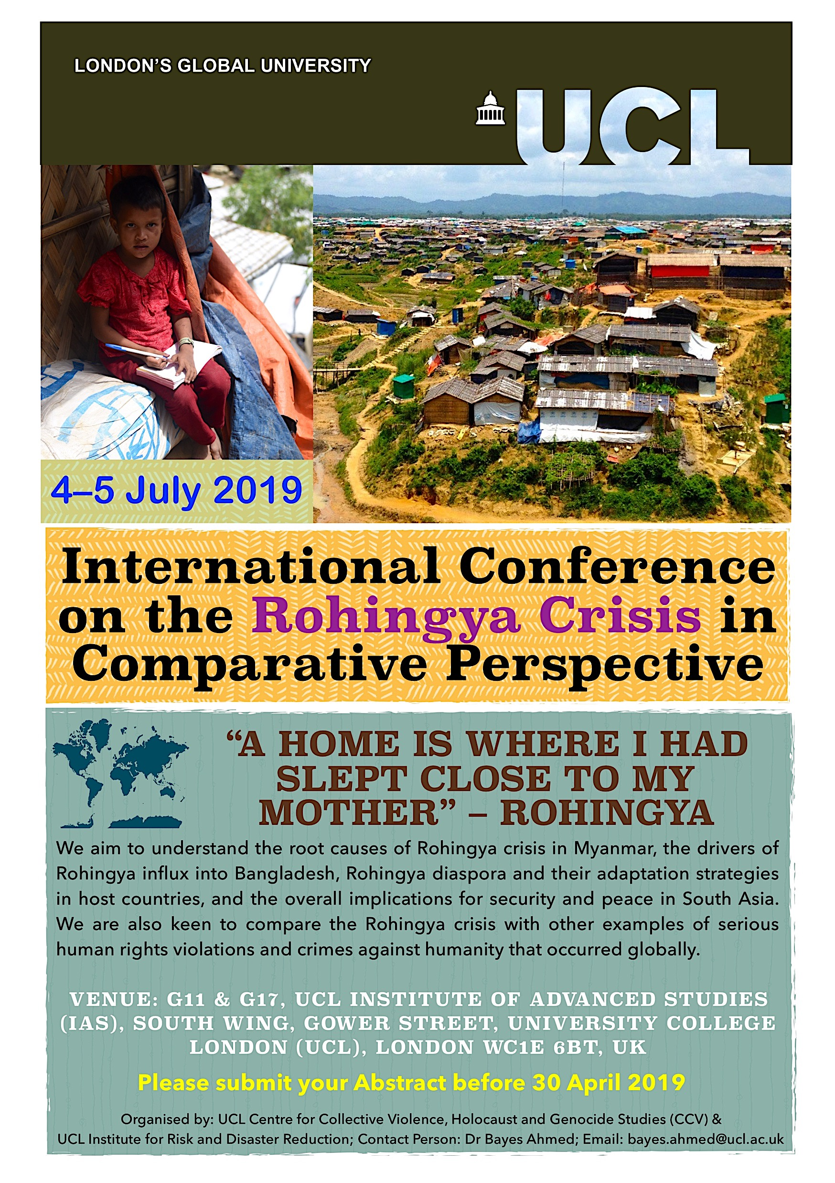
bayes.ahmed@ucl.ac.uk

